Slide 1
Welcome to the Southeast RPO Fall Meeting
If you are joining us virtually, please mute yourself and we will begin shortly. Thank you.

Slide 3
Executive Board Call to Order/Roll Call Chairman Bill James
If you are joining us virtually, please turn on your mic for roll call.

Slide 4
Technical Committee Call to Order/Roll Call Chairman Dan Evans
If you are joining us virtually, please turn on your mic for roll call.

Slide 5
Approval of Previous Minutes Executive Board and TCC
If you are joining us virtually, please turn on
your mic for approval of minutes.

Slide 7
Southeast RPO Updates
SOUTHEAST TENNESSEE DEVELOPMENT DISTRICT
SARAH MURRAY | RPO COORDINATOR
NOVEMBER 18TH, 2021

Slide 8
Rural Regional Transportation Plan
Draft is in progress
Currently gathering photos throughout the region to add to the plan
Set to be reviewed next year
For examples of other RPO RRTP's please follow the link below:
https://www.tn.gov/tdot/long-range-planning-home/longrange-oct/rural-regional-transportation-plans.html

Slide 9
Grants
Rural Planning Initiative Grant (RuPI)
Multimodal Access Grant (MMAG)
Traffic Signal Modernization Program
Transportation Alternatives (TAP)
Community Transportation Planning Grant (CTPG)
State Industrial Access (SIA)

Slide 10
Rural Planning Intiative Grants (RuPI)
Southeast RPO had 4 RuPI Grants through TDOT with Mattern & Craig as the engineer:
Graysville – Bike/Pedestrian Plan
Rhea County – Transportation Feasibility Study
Decatur – Resurfacing and Restriping Plan
Tracy City – Resurfacing and Restriping Plan
Completed in September 2021

Slide 11
State Industrial Access (SIA)
Bledsoe County – Aviagen "Project Protein"
Connecting to SR 28 | US 127
Jasper Industrial Park
Phase 1 of Industrial Boulevard has been paved
Future Phase 2 of Industrial Boulevard – Going towards Kimball

Slide 12
Multimodal Access Grant (MMAG)
Active MMAG:
Jasper 2018 – Sidewalks Project – Working on a contract between Croy Engineering & Jasper
Decatur 2018 – Sidewalks Project – NEPA Phase
Monteagle 2019 – Awarded
2021 Applications – Should know award status by 2022
Dayton – SR 30|SR 29/US 27
Graysville – SR 303

Slide 13
Traffic Signal Modernization Program (TSMP)
Applications are due by 4:00PM EST Wednesday December 1, 2021, to TDOT.TrafficOps@tn.gov
Please include subject line "Traffic Signal Modernization Program Grant Application"
The following is eligible for TSMP funding, but not limited to:
Controllers & Conflict Monitors
Controller Cabinet & Equipment
Signal Heads & Flashing Beacons
Signal Head Backplates
Supplemental Signal Heads Pedestrian Signal Heads
Pedestrian Push Buttons
Signal Wiring and Cables
Advance & Stop Bar Detection
Timing Optimization Plans

Slide 14
Transportation Alternatives Program (TAP)
2021 Applications
Deadline has been extended to Wednesday December 1, 2021
TDOT will only accept applications through the eGrants system

Slide 15
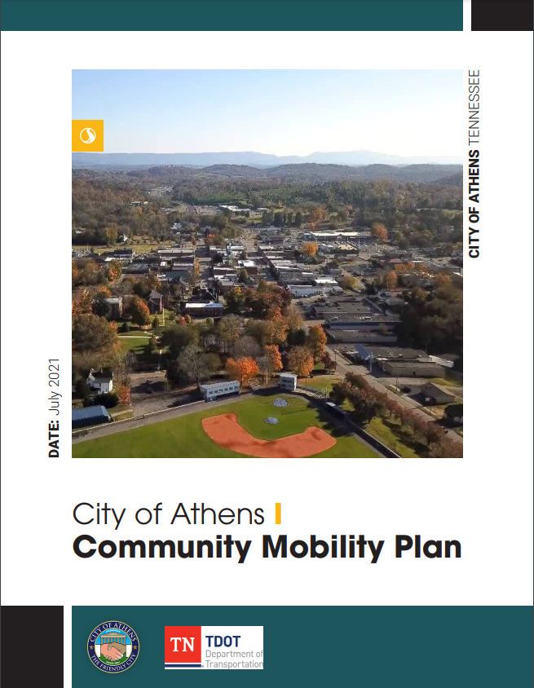
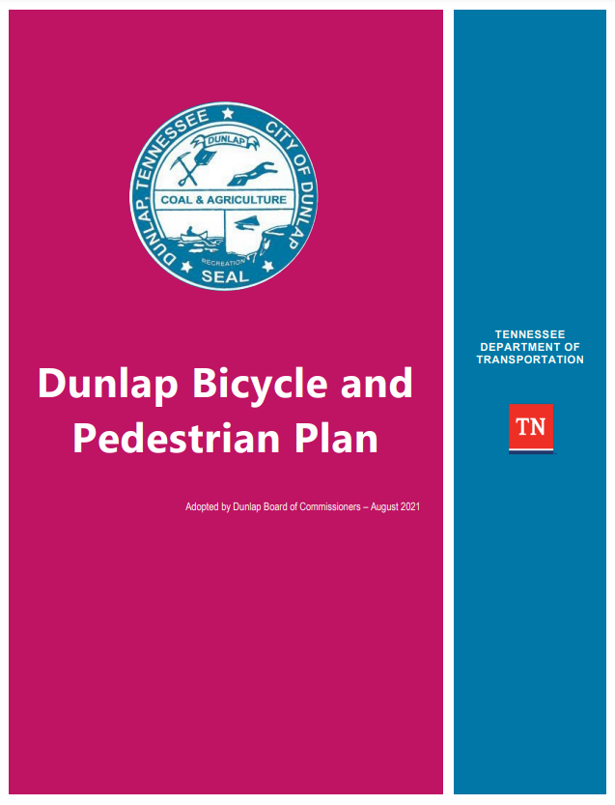
Community Transportation Planning Grant (CTPG)
2020 CTPG – 3 Plans Completed in the Southeast
2021 Application - Due December 30th to Stacy.Morrison@tn.gov
If interested in applying or have any quesitons, please reach out
Notes:
Distressed and At-Risk Counties: 10% match is waved
Plans included: Community Mobility Plan, Bike/Pedestrian Plan, Resurfacing Plan, Transportation Systems Management and Operations, Corridor Study, and Complete Street Plan

Slide 16
Other Updates & Questions
TACIR – Tennessee Advisory Commission on Intergovernmental Relations – Thank you to everyone to who has sent in updates on your community's bridge inventories. If you haven't already, be on the lookout for an email from SETDD Staff Planners.
LRSI - Local Roads Safety Initiative – Met with Rhea, Sequatchie, and Meigs County in August to address safety concerns on County-owned roads with T-Square Engineering
TDOT iTRIP - Interactive Tennessee Road Improvement Program: https://www.arcgis.com/apps/dashboards/e14888bce2954050a10df5e949a1bc1d
Southeast RPO Website in the works

Slide 17
Thank you!
SOUTHEAST TENNESSEE DEVELOPMENT DISTRICT
SARAH MURRAY | RPO COORDINATOR
423-424-4238 | smurray@sedev.org

Slide 19
Project Ranking 101
Andrea Noel
Fall 2021
Notes:
We want to thank (the RPO and the technical committee) for helping us rank these projects. I know we have been asking you to do this for years, but we wanted to give a “Big Picture” overview for those who are new to the process and for the public who may wonder why we do this.

Slide 20
WHY?
There is limited funding with hundreds of projects at various stages at any given time.
We have to have a way of prioritizing projects that will move forward for funding during the next fiscal year.
Why does TDOT ask the MPO/RPO’s to rank projects?
Name, Position
Date
Notes:
TDOT evaluates projects on an annual basis to determine funding priority for the next 3 fiscal years. For this cycle, TDOT is planning for the fiscal years 22-24. This draft list comes to you from Brian Hurst, he is the Assistant Director of TDOT’s Programming and Administration Division. Brian oversees a database of all TDOT projects. He works with the Departments Executive Management Team in developing the Comprehensive Multimodal Program (better known as the Governors Highway Program or the 3-year Plan). In other words, that is the list of project phases with dedicated funding to move forward during that time period.

Slide 21
Timeline
November – The project lists are distributed to the RPO’s/MPO’s for ranking during their November/December meetings.
December - local/regional ranks are returned to TDOT with comments.
January – March – Development of the Comprehensive Multimodal Program
April/May – Public Release of the approved Highway Program.
Notes:
Every year in November/December, we give the draft list of projects to the MPO’s and RPO’s and we have them rank and prioritize the project phases. From January through April, TDOT is developing the Comprehensive Multimodal Program which gets approved by the Governor of Tennessee and the Legislators of Tennessee. Then sometime in April, TDOT provides the approved Highway Program to the public.

Slide 22
Criteria Weight
TRAFFIC OPERATIONS 25.8%
Multimodal/Func. Class 4.2 %
Economic Development 16.7%
Roadway Safety
26.3%
Region/MPO/RPO Rank
23.6%
Environmental lmpact
3.4%
Notes:
On the screen you can see a graph called TDOT Project Weight. During the development of the Comprehensive Multimodal Program, the Executive Management Team considers several criteria. They consider Traffic Operations (22.7%), Multimodal and Functional Classification (4.2%), Economic Development (16.7%), Roadway Safety (26.3), Regional and MPO Ranks (23.6%), and Environmental Impacts (3.4%). Each project is scored for each criteria with these weights applied, which provides an overall Technical Rank. You can see that the RPO rank is 11% of the total score.

Slide 23
Process (January – April)
Projects are given an overall rank which includes:
Technical Scores (which includes the weighted criteria (MPO/RPO Ranks)).
Investment (cost of the Phase of Work)
Funding Source
Scheduling Constraints
Additional Considerations
Even Distribution of Projects per Region
Phase of Development (PE/ROW/Construction)
MPO/RPO Distribution
Draft Program is submitted to the Governor and Legislature for review and approval.
Notes:
The team looks at the technical rank and also considers the distribution of projects by region and by MPO/RPO to ensure the program is equitable across the state.

Slide 24
Comprehensive Multimodal Program
Notes:
This is announced sometime in April or May each year. This shows which projects will be funded in the following Fiscal Year. For instance, the list you are ranking now will be for project phases funded in the 2023 Fiscal year. With probable funding for FY 24 and FY25.

Slide 25
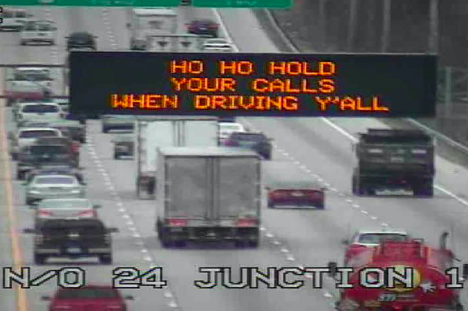
Contacts – Region 2
Andrea Noel | Planning Supervisor |Region 2
Long Range Planning Division
Office of Community Transportation
7512 Volkswagen Drive, Chattanooga, TN 37416
[O] 423-510-1213 [C] 423-453-1196
Andrea.noel@tn.gov
Robert Rodgers, P.E. | CE Manager 2
Project Development Region 2
7512 Volkswagen Drive
Chattanooga, TN 37416
p. 423-510-1138 c. 423-619-2503
Robert.Rodgers@tn.gov

Slide 27
TDOT Prioritization Southeast RPO
TCC Recommendation and Executive Board Approval

Slide 31
RPO Progress Survey
RPO Meetings Fall 2021
Rachael Bergmann, Office of Community Transportation, R2 Senior Planner
Notes:
My name is Rachael Bergmann and I am a Senior Planner for TDOT's Office of Community Transportation in Region 2. Today, I am going to be sharing the results of a survey TDOT shared earlier this year with RPO members statewide. Technical Committee and Executive Board members should have received this survey at the beginning of this year through your RPO Coordinator.

Slide 32
Overview
Every 5 years, TDOT develops a report for FHWA about how we work with the RPOs and partners
The report includes:
TDOT programs focused on rural communities
Outreach initiatives
Survey results
Notes:
First, I want to share a bit of background information about why TDOT sends out a survey to RPO members. Every 5 years, TDOT's Office of Community Transportation develops a report for FHWA about how we work with RPOs and partners. In this report, we discuss details of TDOT's various programs and outreach initiatives, such as the Rural Regional Transportation Plans and the Community Transportation Planning Grant. We also share the results of this survey to give more of a perspective from RPO Partners. So, while the survey is prompted by this report for FHWA, at TDOT we also see this as an opportunity to ask our own questions about the RPO Program for continued refinement.

Slide 33
Overview
Survey:
Distributed by RPO Coordinators
Open for approximately 1 month
Survey Sections
Background
Effectiveness
Communication and Meetings
Planning Efforts and Grants
Notes:
The survey was distributed in February by your RPO Coordinators and was left open for about 1 month. The survey was divided into four main sections: Background, Effectiveness, Communication and Meetings, and Planning Efforts and Grants. Each section combined a mix of multiple choice and open-ended questions, with space to leave comments. The survey had 19 questions, so we will not be reviewing all of them, but just the ones that are most relevant to you all.

Slide 34
Overview
Responses: 168 total
Regional Breakdown:
Notes:
Statewide, we had a total of 168 responses. We are discussing these results at a statewide level versus by RPO for 2 main reasons. The first is that the number of responses varied significantly between RPOs, ranging from 4 responses to 30 responses. The second reason is that the RPO program is statewide and therefore any changes would be implemented statewide.

Slide 35
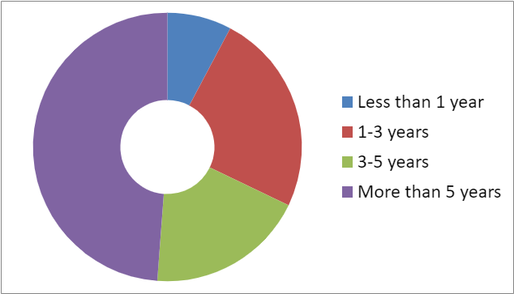
Background
Role in the RPO Program
49% Technical Committee Members
30% Executive Board Members
21% Other Stakeholders & Citizens
Year of Involvement
Notes:
First we will start with some of the background questions asked of respondents to give an idea of who answered the survey. The source of responses was 49% Technical Committee, 30% Executive Board members, members, 21% Interested Citizens and Other Agency Stakeholders.
In the case of length of involvement, we do expect and stay up to date on changes in local officials due to local elections, RPO Coordinators keep TDOT informed of these changes. The high number of responses from people who have been involved in the RPO program for more than 5 years (nearly 50%) indicates good feedback from officials who had had an opportunity to become involved in the RPO over time.

Slide 36
Background
Notes:
When asked about level of involvement in the transportation process in their community, 35% reported high involvement, 37% reported medium involvement, and 29% reported low or no involvement. Over 70% of people report a good level of involvement.

Slide 37
Effectiveness
Results indicate progress in establishing trust and communication between TDOT and local officials
Nearly 75% of respondents reported a high understanding of the purpose of RPO Program
Nearly 70% of respondents believe that TDOT effectively engages with RPOs and local officials
Notes:
Moving on to the effectiveness section. Overall, respondents seemed to have a good understanding of the RPO Program and believe that TDOT engages well with RPOs and local officials. Nearly 75% of respondents reported a Good or Excellent understanding of the RPO Program and nearly 70% respondents believe that TDOT does a good or excellent job of engaging with RPOs and Local Officials in planning for transportation issues.. Many of the comments in this section specifically compliment specific RPO coordinators and note their importance in advocating for rural communities transportation needs.

Slide 38
Effectiveness
Project Prioritization
Comments related to project prioritization:
Not useful for RPO
Limited understanding/ need for education
Promotes knowledge of process and projects
Notes:
However, we did see more variation in responses related to project prioritization. Here, over 70% of people have a “Neutral” or higher perspective, but we are aware of that there are frustrations. The comments relating to project ranking can be generally grouped into 3 main categories. The first is that the TDOT’s Project Prioritization is not useful for the RPOs, suggesting that the rankings do not have any bearing on TDOTs projects. Others commented that TDOT should provide more regular project status updates, including continuing explanations of both the prioritization process and project phases. Other comments suggest that the Project Prioritization process helps with local understanding and provides an opportunity for questions. We hear these comments, and are continuously seeking to improve this process. We plan to continue to do the 101 Presentation to keep new members informed and encourage you to ask questions of the Project Development folks in attendance. Some of these findings are included in our conclusion slides as well.

Slide 39
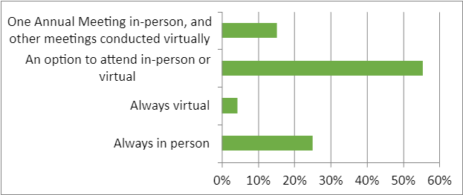
Communication & Meetings
Key Takeaways:
Nearly 75% of respondents reported Excellent or Good communication from TDOT and the RPO
Over 95% of respondents find the content presented at meetings useful for supporting rural transportation issues
Preferred meeting format:
Notes:
Moving on to meetings, approximately 75% of people indicated that communication and coordination from TDOT and the RPO was either excellent or good. TDOT continues to use the RPO Meetings to share information with local officials and other stakeholders. When asked about the preferred format for future RPO meetings, 55% want an option to attend in-person or virtual, 25% prefer meeting always in person, 15% prefer one annual meeting in-person and other meetings virtual throughout the year.
The comments in this section help TDOT and the RPO develop meetings that are useful to attendees, particularly related to projects and funding opportunities. We also hear you that in-person meetings are important for networking and communication across the RPO.

Slide 40
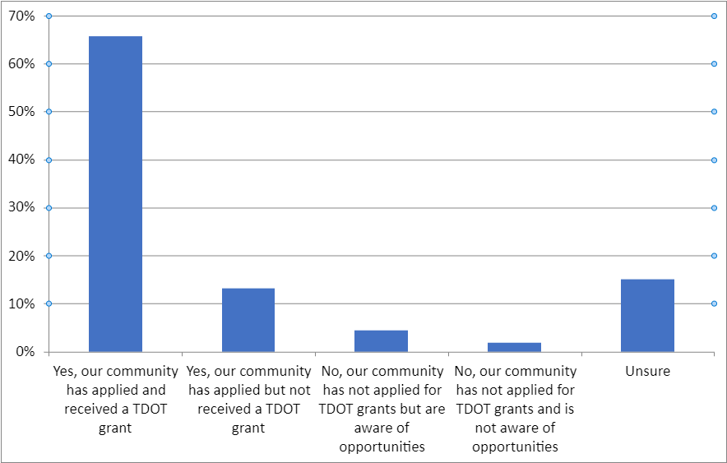
Planning Efforts and Grants
Notes:
Moving on to Planning Efforts and Grants, we love to see that 80% of communities have applied for a grant, and 65% of communities have received a TDOT grant. The grant opportunities identified in the survey include our Community Transportation Planning Grant, Rural Planning Initiative, Multimodal Access grant, Transportation Alternatives Program (TAP), and State Aid Opportunities. The next highest response was Unsure, so we encourage you to reach out to us if you want to know if you community has applied for and/ or received any of these grants.

Slide 41
Planning Efforts and Grants
Notes:
For this question about how TDOT and the RPO can best support communities, people could select all that apply. In chronological order, 59% said we can better educate communities on available grant opportunities, 41% said to recommend planning needs to communities, 35% want TDOT and the RPO support the writing of grant applications, 32% are interested in additional planning grant opportunities, and 18% had no comments. An “other” option was provided, with additional suggestions including: allowing communities to work with local consultants; giving the RPO more funding oversight; and making local share requirements as minimal as possible.
The other question in this section was about how you like to receive information regarding grant opportunities, to which over 95% said Email. I will note that TDOT distributes all grant related information through the RPO Coordinators.

Slide 42
Conclusion
Progress involving locals in transportation planning
Opportunities for ongoing education for both new and seasoned stakeholders
Continue working with local officials to establish understanding of project prioritization process
Change takes time:
Some comments point to things that have changed significantly over the last 5 years
Not all local officials are aware
Continue to solicit feedback

Slide 43
How are we going to respond?
Identified opportunities for ongoing education:
RPO 101: Developing quarterly newsletter aimed at local officials
Project Prioritization: Overview presentation at Fall 2021 meetings
Grants: CTPG Webinar in November, updated fact sheets, past grants are all available on website
Communication
Share information through RPO Coordinators
Internal involvement beyond Long Range Planning Division in rural communities

Slide 44
Questions?

Slide 46
Thank you so much for joining us today!
Lunch will be provided in the kitchenette.

