Slide 1



Highway Safety Improvement Program (HSIP)
Roadway Safety Audit Program (RSA)
Brandon Darks, Manager 2
Project Safety Office

Slide 2

Agenda
Strategic Highway Safety Plan
HSIP-Highway Safety Improvement Program
TDOT Safety Programs
  Road Safety Audits (RSA)
  Spot Safety Program
  Safety Initiatives – (LRSI) Local Road Safety Initiative

Slide 3
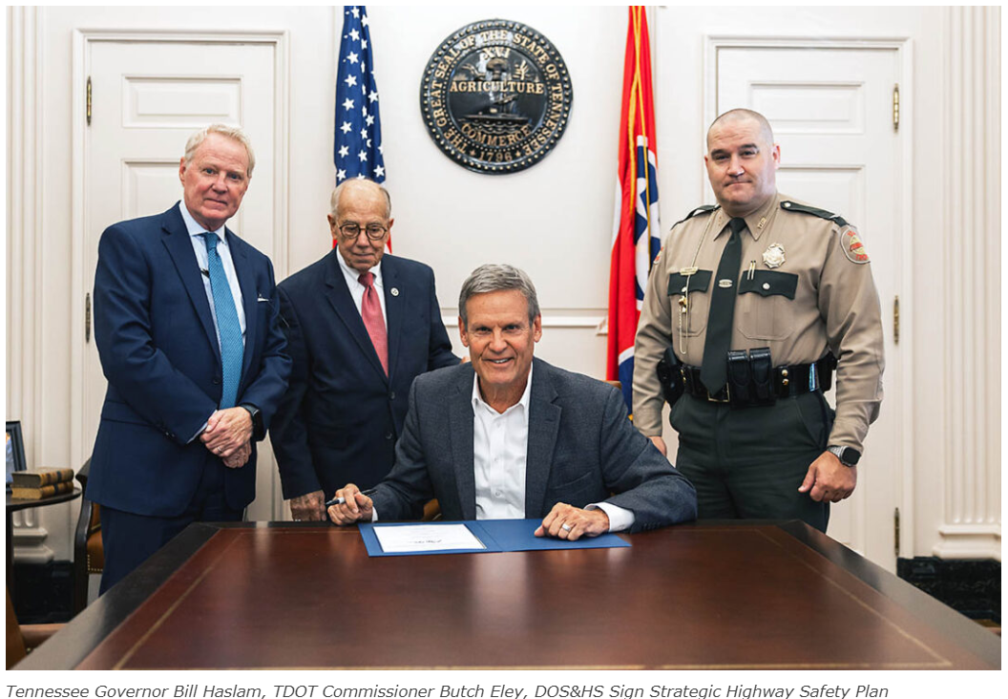
Notes:
November 4, 2024

Slide 4
What is A SHSP?
It is a statewide-coordinated safety plan that provides a comprehensive framework for reducing highway fatalities and serious injuries on all public roads.
It is a major component and requirement of the Highway Safety Improvement Program (HSIP) (23 U.S.C. § 148).
Notes:
All public roads includes local roads. Tennessee has 90K miles of roadway and 66K of them are local roads. One of the things that distinguishes the HSIP from other federal programs is, we can do projects on ALL roadway types.
The Highway Safety Improvement Program became a core federal program in 2005 (back when the SHSP was initiated) which increased federal funding from $2M per year to $27M per year which eventually increased to $50M per year.

Slide 5

What is the SHSP?
Incorporation of Plans
Highway Safety Improvement Program
Highway Safety Performance Plan
Motor Carrier Safety Action Plan
Traffic Records Plan
Interstate Incident Management Plan
Work Zone Safety and Mobility Manual
Notes:
HSIP is for infrastructure projects that TDOT administers.
HSP is the plan that lists all behavioral activites funded by the Tennessee Highway Safety Office who receives funds from the National Highway Traffic Safety Administration (NHTSA)
The Motor Carrier Safety Action Plan (MCSAP) lists commercial vehicle activities. The Tennessee Highway Patrol receives funding from the Federal Motor Carriers Safety Administration for those projects.
The Traffic Records Plan is developed by the Traffic Records Coordinating Committee and submitted to NHTSA.
The Interstate Incident Management Plan is administered by the TDOT Operations Division. I believe there are 4 plans for each region.
The Work Zone Safety and Mobility Manual was first developed in 2007 but revised a few years ago…and it outlines requirements related to traffic management plans, training, etc. that come from 23 CFR 630 Subpart J.

Slide 6
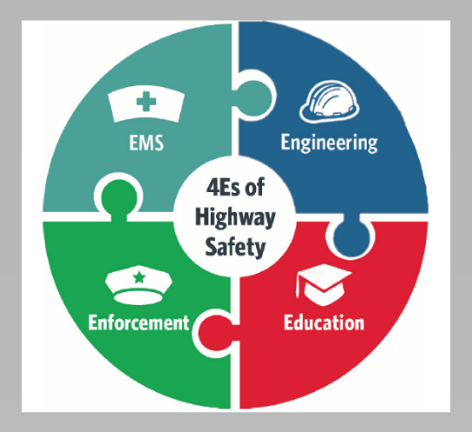
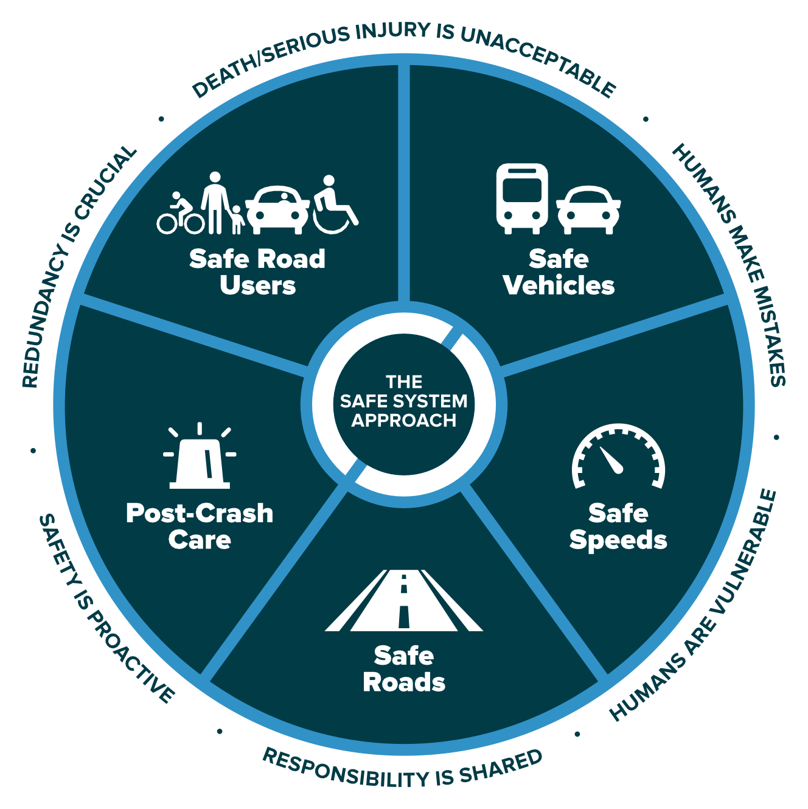
What is a SHSP?
SHSP must haves :
  Consultation from a variety of stakeholders during the development process
  Analysis and effective use of crash data
  Incorporation of the 4Es / “Safe Systems Approach”
  Consideration of safety needs of all public roads
  A program of strategies to reduce fatalities and serious injuries
  Evaluated every 5 years
Notes:
It’s not only consultation during the develop process but also consultation during the implementation

Slide 7
Tennessee SHSP Emphasis Areas
Infrastructure Improvements
  Intersections
  Railroads
  Roadway Departures
Operational Improvements
  Work Zones
  Incident Management
Vulnerable Road Users
  Bike/Ped
  Motorcycles
  Senior Pedestrians

Slide 8
Tennessee SHSP Emphasis Areas
Motor Carrier Safety
  Inspections
  Impaired Driving
Data Collection and Analysis
  TITAN
  TRIMS
  DDSA (HSM)
Driver Behavior
  Impaired Driving
  Occupant Protection
  Senior Drivers
  Young Drivers
  Distracted Driving
  Aggressive Driving

Slide 9










Why are people killed and seriously injured on the roads?
People are killed and seriously injured on the roads when the collision forces transferred onto the human body exceed tolerable thresholds.

Slide 10



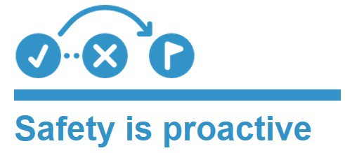


The Safe System Approach
Notes:
More proactive approach to safety
Innovative design: speed management, Road diets, Complete streets, roundabouts
Use of known-effective safety countermeasures

Slide 11
Highway Safety Improvement Program (HSIP)
Section 148 of Title 23, United States Code (23 USC 148)
Achieving a significant reduction in traffic fatalities and serious injuries on all public roads, including non-State-owned public roads.
Strategic Highway Safety Plan (SHSP)
All safety programs to use a data-driven process with set qualification criteria.

Slide 12
Strategic Highway Safety Plan (SHSP)
Highway Safety Improvement Program (HSIP)
RSA / Initiative
Inclusive
Multidisciplinary Team with State and Local Stakeholders to Engineer, Educate, Enforce, and provide EMS services for roadways
Identify Needs
&
Establish Emphasis Areas
Collect and Process
Crash Data
Create Systemic
Engineering Approaches
Based on Needs
Notes:
HSIP-Federal Aid program focused to reduce fatalities and serious injuries crashes on all public roads.
Project Safety Office main funding source
2014 Strategic Highway Safety Plan
Committee members (Partners): TDOT, FHWA, Governors Highway safety office, TN Hwy Patrol, MPO, RPO and others.….
2015 budget of 48 million
2016 budget of 60 million
Template for PSO project process

Slide 13
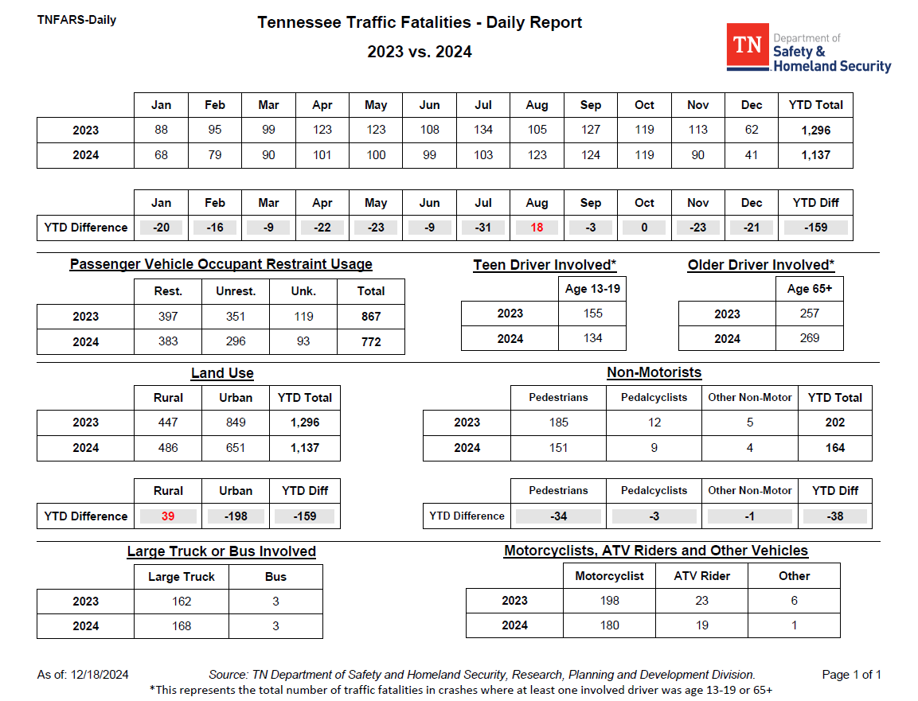
Data Driven Process

Slide 14
Safety Data
HSIP Annual Report- submitted to FHWA
E-TRIMS: Tennessee Roadway Information Management System
TDOT Statewide database housing all roadway elements
AASHTO Safetyware- Numetric:
Early implementation phases: Crash analysis
Network screening
Tennessee Integrated Traffic Analysis Network (TITAN)
Collecting/analyzing crash data/crash rates/severity for HSIP eligibility

Slide 15
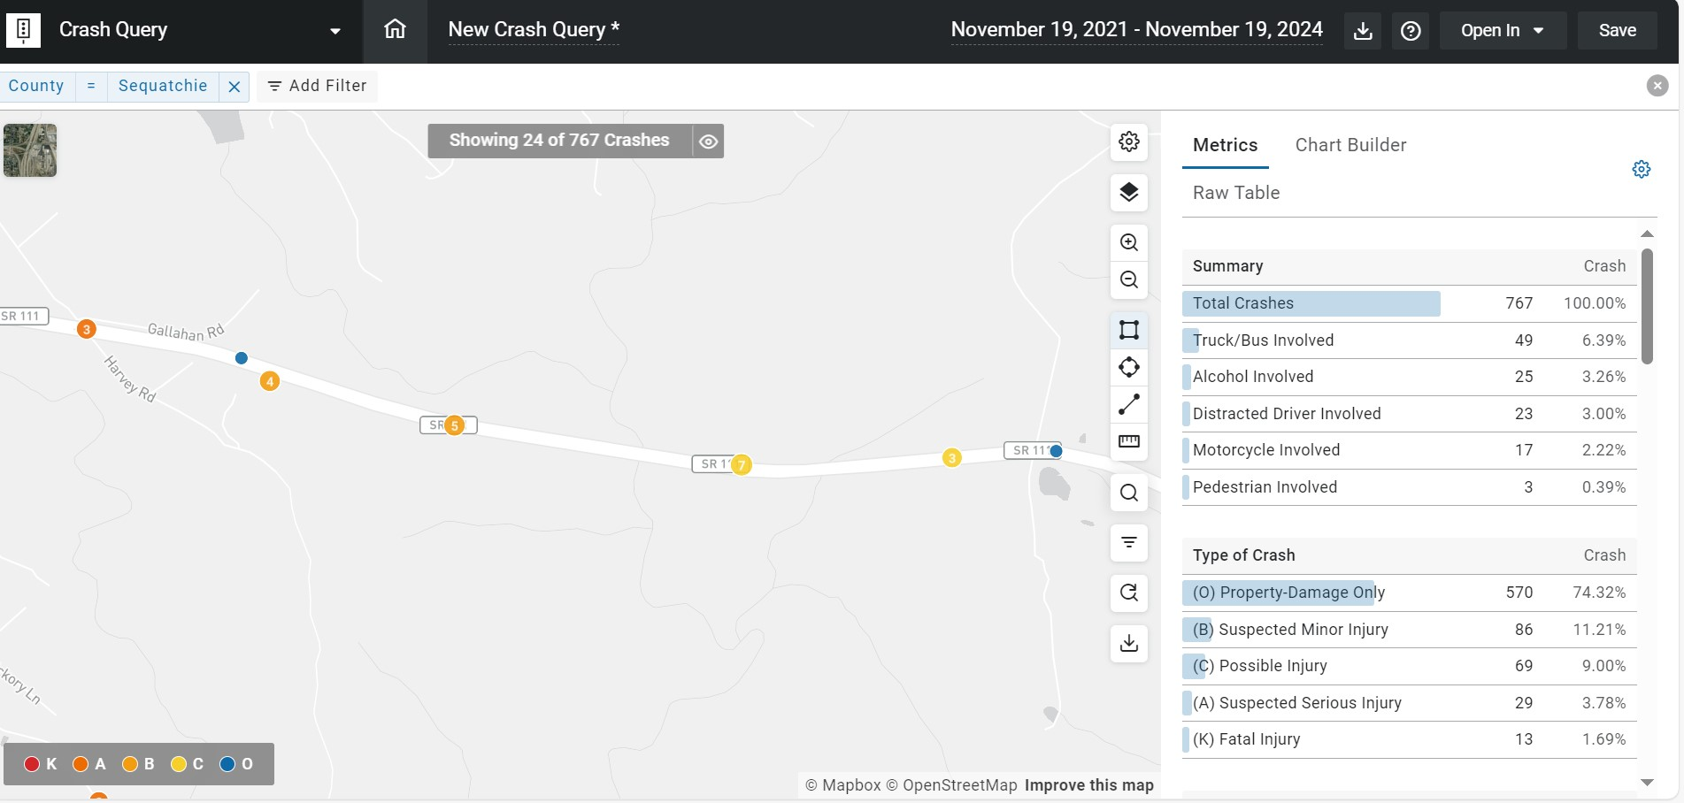

Slide 16
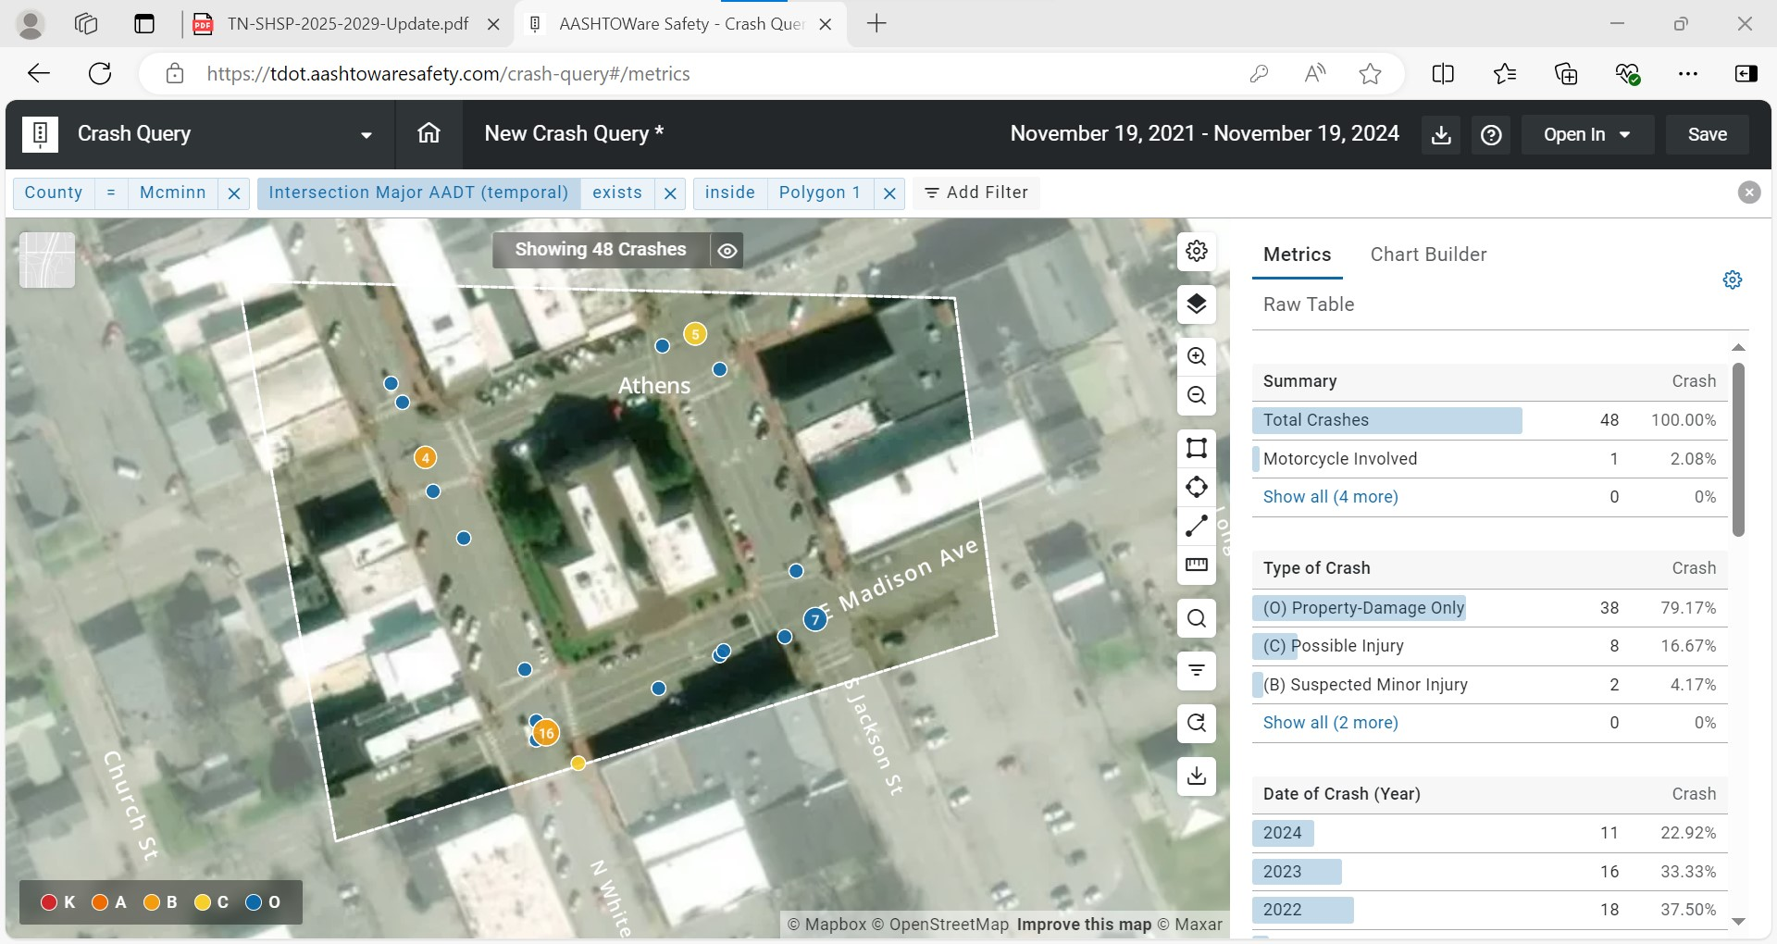

Slide 18
What is a Road Safety Audit (RSA)
A Road Safety Audit (RSA) is a formal safety performance examination of an existing or future road or intersection by an independent audit team.
The RSA team considers the safety of all road users: utilizing crash data, field data and reports on road safety issues and opportunities for safety improvements.

Slide 19
RSA Process
Pre-Brief Meeting
  Site Identification
  Crash Rates
  Crash Diagrams
Site Visit
  Photo Inventory
  Recommendations
RSA Packet
  Guidance Figures
  Cost Estimate
  Review Report

Slide 20
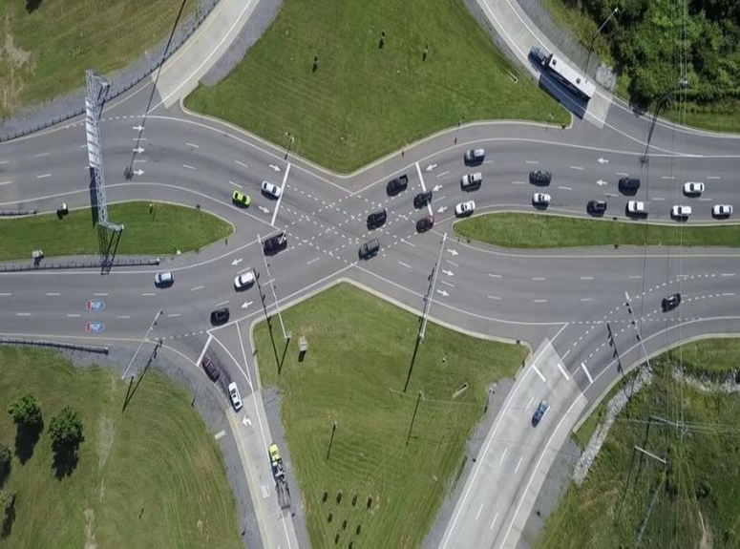
SHSP/HSIP Road Safety Audits / Initiatives
Ramp Queue
Spot Safety
Wrong Way Initiative
Local Road Safety Initiative
Pedestrian Safety Initiative

Slide 21
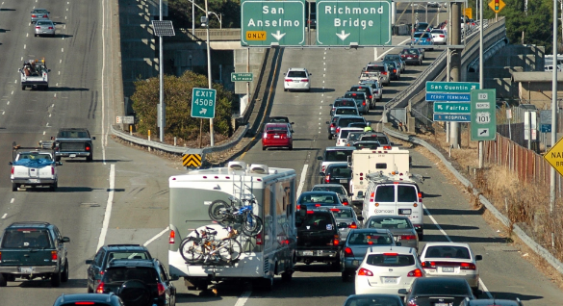
HSIP Programs/Initiatives
Ramp Queue Program:
Identify and address Ramp safety concerns on Interstate and control access facilities: Ramp traffic queuing back to mainline traffic.
Typical countermeasures:
Geometric Design
Improve length of ramp storage
Signalization of Ramp
Improve shoulder for turn lane
Signs and pavement markings
Snowplow-able pavement markers
Guardrail/barrier wall delineation
Upgrade of guardrail/end terminals

Slide 22
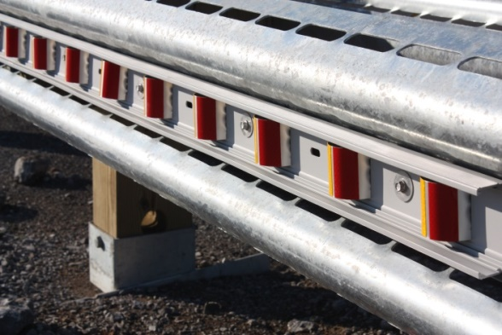
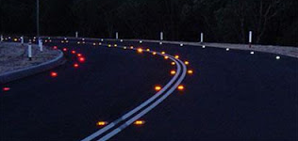
HSIP Programs/Initiatives
Wrong Way Safety Initiative:
Address vehicles making wrong way movements onto ramps of access-controlled facilities.
Typical countermeasures:
Signs and pavement markings (direction arrow)
Snowplow able pavement markers
Flexible Delineators
Concrete curb/raised islands
Bi-directional guardrail delineation
Reflective signpost delineation
Modular curbing

Slide 23
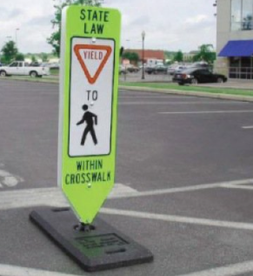

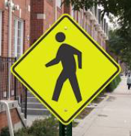
HSIP Programs/Initiatives
Pedestrian Road Safety Initiative (PRSI):
Typical countermeasures:
Pedestrian countdown signal heads
Cross walks/Pedestrian crossing
Concrete curb/raised islands
Signs, pavement markings
Reflective signpost delineation
Modular curbing
Pedestrian signal (PHD) HAWK
Rapid flashing beacon (RRFB)

Slide 24
Spot Safety Program
Committee selected locations
Goal to reduce fatalities, injury and other roadway crashes
Projects submitted by Regional Traffic Office to SSC
Projects are Federally and State funded
More Complex Design projects than RSA
  Signalization
  Geometric improvements
  Flashing Beacons
  Other safety improvements

Slide 25
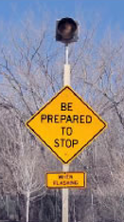

Local Road Safety Initiative (LRSI)
Identify and address safety concerns on local, non-state route segments located outside an urban boundary and NOT represented by a Metropolitan Planning Organization (MPO). (82 Counties - $ 22.5 MIL)
Typical countermeasures:
Signs and pavement markings
Edge line / shoulder rumbles
Snowplow-able pavement markers
Guardrail/barrier wall delineation
Upgrade of guardrail/end terminals

Slide 26
Local Road Safety Initiative (LRSI)
Number of active LRSI: 112 Statewide
LSRI Construction Cost to date: $51.8 Million
Statewide number of projects let to construction: 245
Estimated miles of implemented safety countermeasures:
~ 3,000 miles
Notes:
2014-Operations Division to the Project Safety Office
2017, 2019, 2022
$210 k average per County LRSI

Slide 27
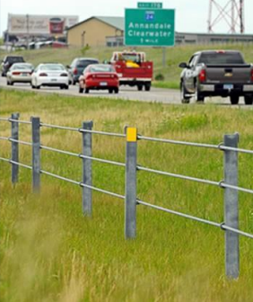
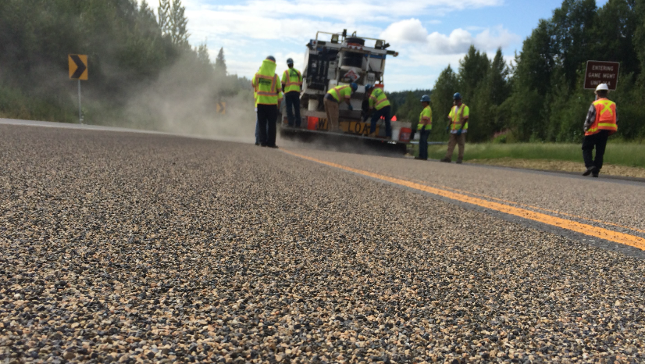
New Start HSIP Programs
(HFST) High friction surface treatment
Cable Median Barrier
Rural Interchange/Ramp Design
Automated Flagger System
Wrong Way Detection Tech.

Slide 28
Project schedules
Project Safety Office (PSO)- request all phases of funding
  Funding request to FHWA
  Request NEPA /Environmental Doc.
  Conduct/prepare RSA program
  Let to construction – completion notice

Slide 29
Project Delivery Method
“No-Plans Contract”- Projects calling only for improvements that have no in-depth design considerations and require no acquisition of right-of-way
“Design” – More in-depth design of improvements (i.e. drainage, earthwork, signalization, survey, etc.)or the acquisition of right-of-way is required… the project will undergo a formal design

Slide 30
Project Requests/ Prioritization
Internal and external stakeholders request crash data investigations on spots, sections, or intersections of roadways
Safety projects are identified through crash data criteria and software (HSIP)
Numetric Software –Network Screening of severity

Slide 31
TDOT HSIP Annual Funding
Highway Safety Improvement Program (HSIP)
Road Safety Audit (RSA) (~$25-35 mil/year)
STID-Project Safety Office
Local Road Safety Initiative (LRSI) (~$5.5 mil/year)
Operations Division
Multi-modal Division (~$6-7 mil/year)
Statewide resurfacing program (~$8-10 mil/year)
Spot Safety (NON-HSIP) (~$4.0 mil/year)
Tennessee Highway Safety Office
Notes:
~ 60 million annually. (2023 exact amount $64.4 Mil)
$4.2 HRRR and 9.8 VRU million are set aside for HSIP funds

Slide 32
TDOT HSIP Project/Funding History
2019 – 50 let- to-contract Cost: $ 49.5 Million
2020 – 85 let- to-contract Cost: $ 38.5 Million
2021 – 63 let- to-contract Cost: $ 35.6 Million
2022 – 44 let- to-contract Cost: $ 52.9 Million
2023 – 57 let- to-contract Cost: $ 62.4 Million
Notes:
299 projects let past 5 years
$ 238.9 Million

Slide 33

Active HSIP
Bledsoe | STID-LRS | 132450.03
Grundy | STID-LRS | 132450.29
Grundy | STID-D | 129114.00
Marion | STID-SS | 131309.00
Marion | STID-LRS | 132450.50
Marion | STID-NP | 133912.00
Marion | STID-NP | 132767.00
McMinn | STID-PED-VRU | 125526.20
McMinn | STID-NP | 135056.00
Polk | STID-LRS | 132450.62
Polk | STID-NP | 135073.00
Polk | STID-LRS | 128634.62
Polk | STID-LRS | 125450.29
Rhea | STID-LRS | 132450.64
Sequatchie | STID-LRS | 132450.67

Slide 34

Thank you….
Quest?ons & Comments !!

Slide 35
Contact Information:
Brandon Darks
Transportation Manager 2
Project Safety Office
Tel: 615-253-3999
Email: Brandon.Darks@TN.Gov

