Slide 1



Southeast Tennessee
RPO Fall Meeting
Thursday, December 19th, 2024

Slide 2
RPO Bylaws Adoption:
Combining Executive Board & Technical Committee
Creates One Voting Board Simply Known as the RPO
Purpose Statement, Attendance, Staff Responsibilities, Requirements for Quorum, Voting Procedures, & Roles of Each Still Mostly the Same With Language for Each of These Sections Combined into One
# of Members and Regional Representation is Not Changing
Who Appoints Each Member is Changing
The Election of Chair & Vice-Chair Also Changing

Slide 3
RPO Bylaws Adoption:
What is the Same
All County Mayors serve on RPO coterminously with their elected position
County Mayor will still appoint the City Mayor or Delegate the selection to all municipal mayors in the county
State Reps. & Senators still appointed by SETD Executive Board
Special Interest Members still appointed by SETD Executive Board
Non-voting members still mostly the same
Membership terms of elected officials slightly changed to state that municipal mayors elected mid-term will fulfill to the end of their term and then a new appointment can be made or they can be reaffirmed
Mayor of municipality larger than smallest county a member
All Highway Superintendents serve coterminously with elected position

Slide 4
RPO Bylaws Adoption:
What is Different
County representatives, which have typically been citizen appointments, will now be selected by the Highway Superintendents instead of the county mayor
Municipal Mayor will still select the municipal appointment, but it cannot be another city or county mayor
Now gives each elected official the ability to select one other appointment on the RPO:
  County Mayor selects City Mayor
  City Mayor selects at-large citizen for municipal representation
  Highway Superintendent selects at-large citizen for county representation

Slide 5
RPO Bylaws Adoption:
What is Different
Election of Officers will now be among the elected Mayors and Highway Superintendents on a 2-year rotating basis
  1st Year 2025 – Mayor as Chair / Highway Super as Vice-Chair
  2nd Year 2026 – Highway Super as Chair / Mayor as Vice-Chair
  From then on it will rotate back in forth ever 2-years on even years
  Elections will be held each Spring
RPO Bylaws will go into affect January 1, 2025
1st Election of Officers or Reaffirming Current Officers from Exec. Board & Technical Committee to take place at Spring 2025 meeting

Slide 6
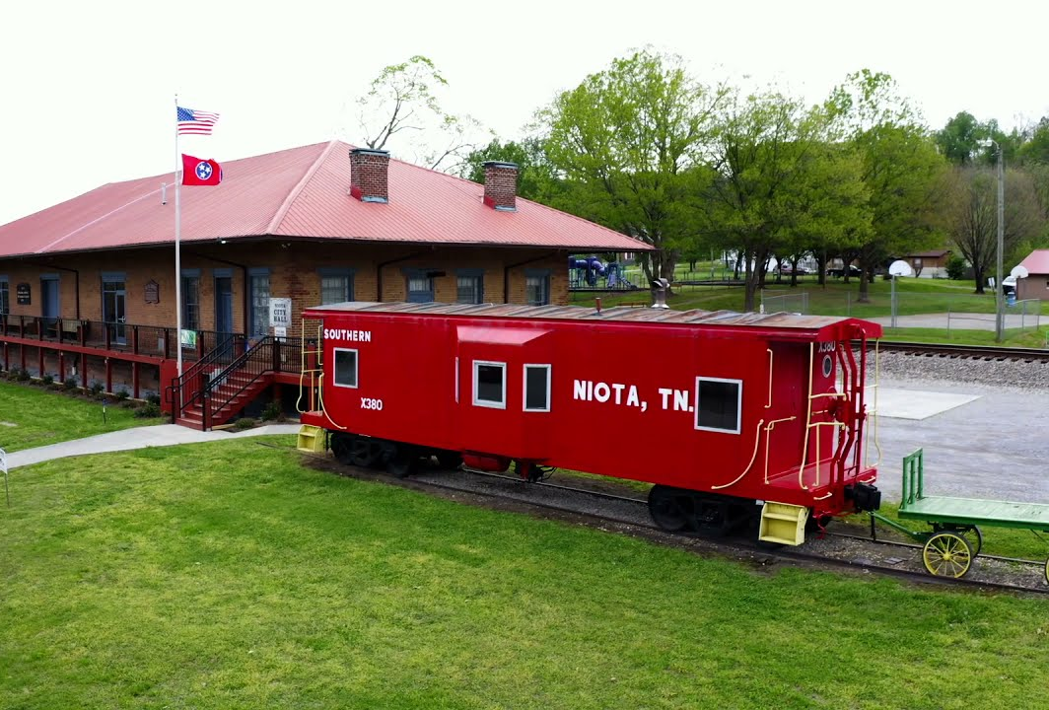
CONGRATULATIONS!
Traffic Signal Modernization Program awarded to Niota
Notes:
Also, Roy Thomason was selected to serve as the 2024-2025 State President of the TN County Highway Officials Association at the TCSA Annual Fall Conference in Murfreesboro. He will represent road officials and departments across all 95 TN Counties at the state level.

Slide 7
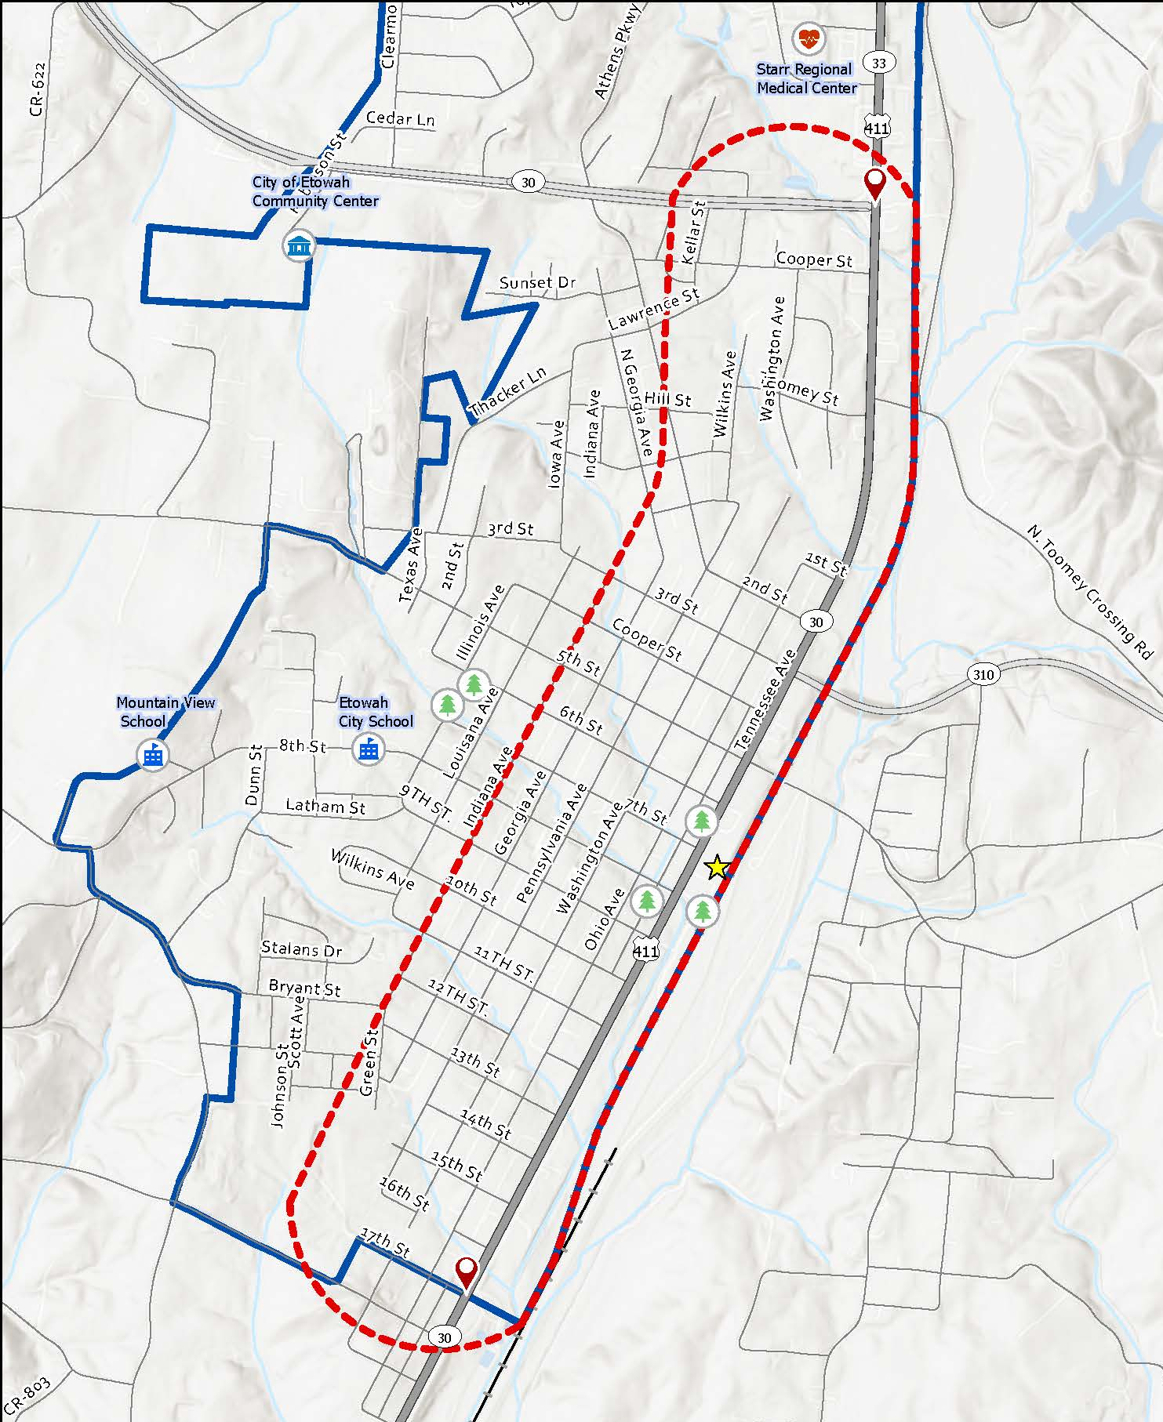
Transportation Planning Grant – Etowah, TN
End of study area
Intersection of SR-30 (D.W. Lillard Memorial Highway) and U.S. Highway 411 (Tennessee Avenue)
Start of study area
17th Street and U.S. Highway 411
(Tennessee Avenue)

Slide 8
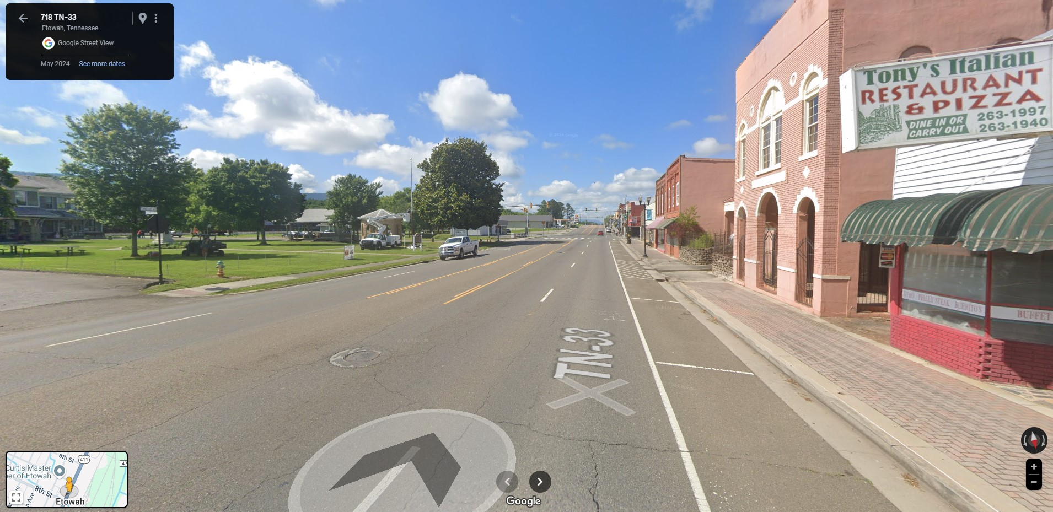

Slide 9
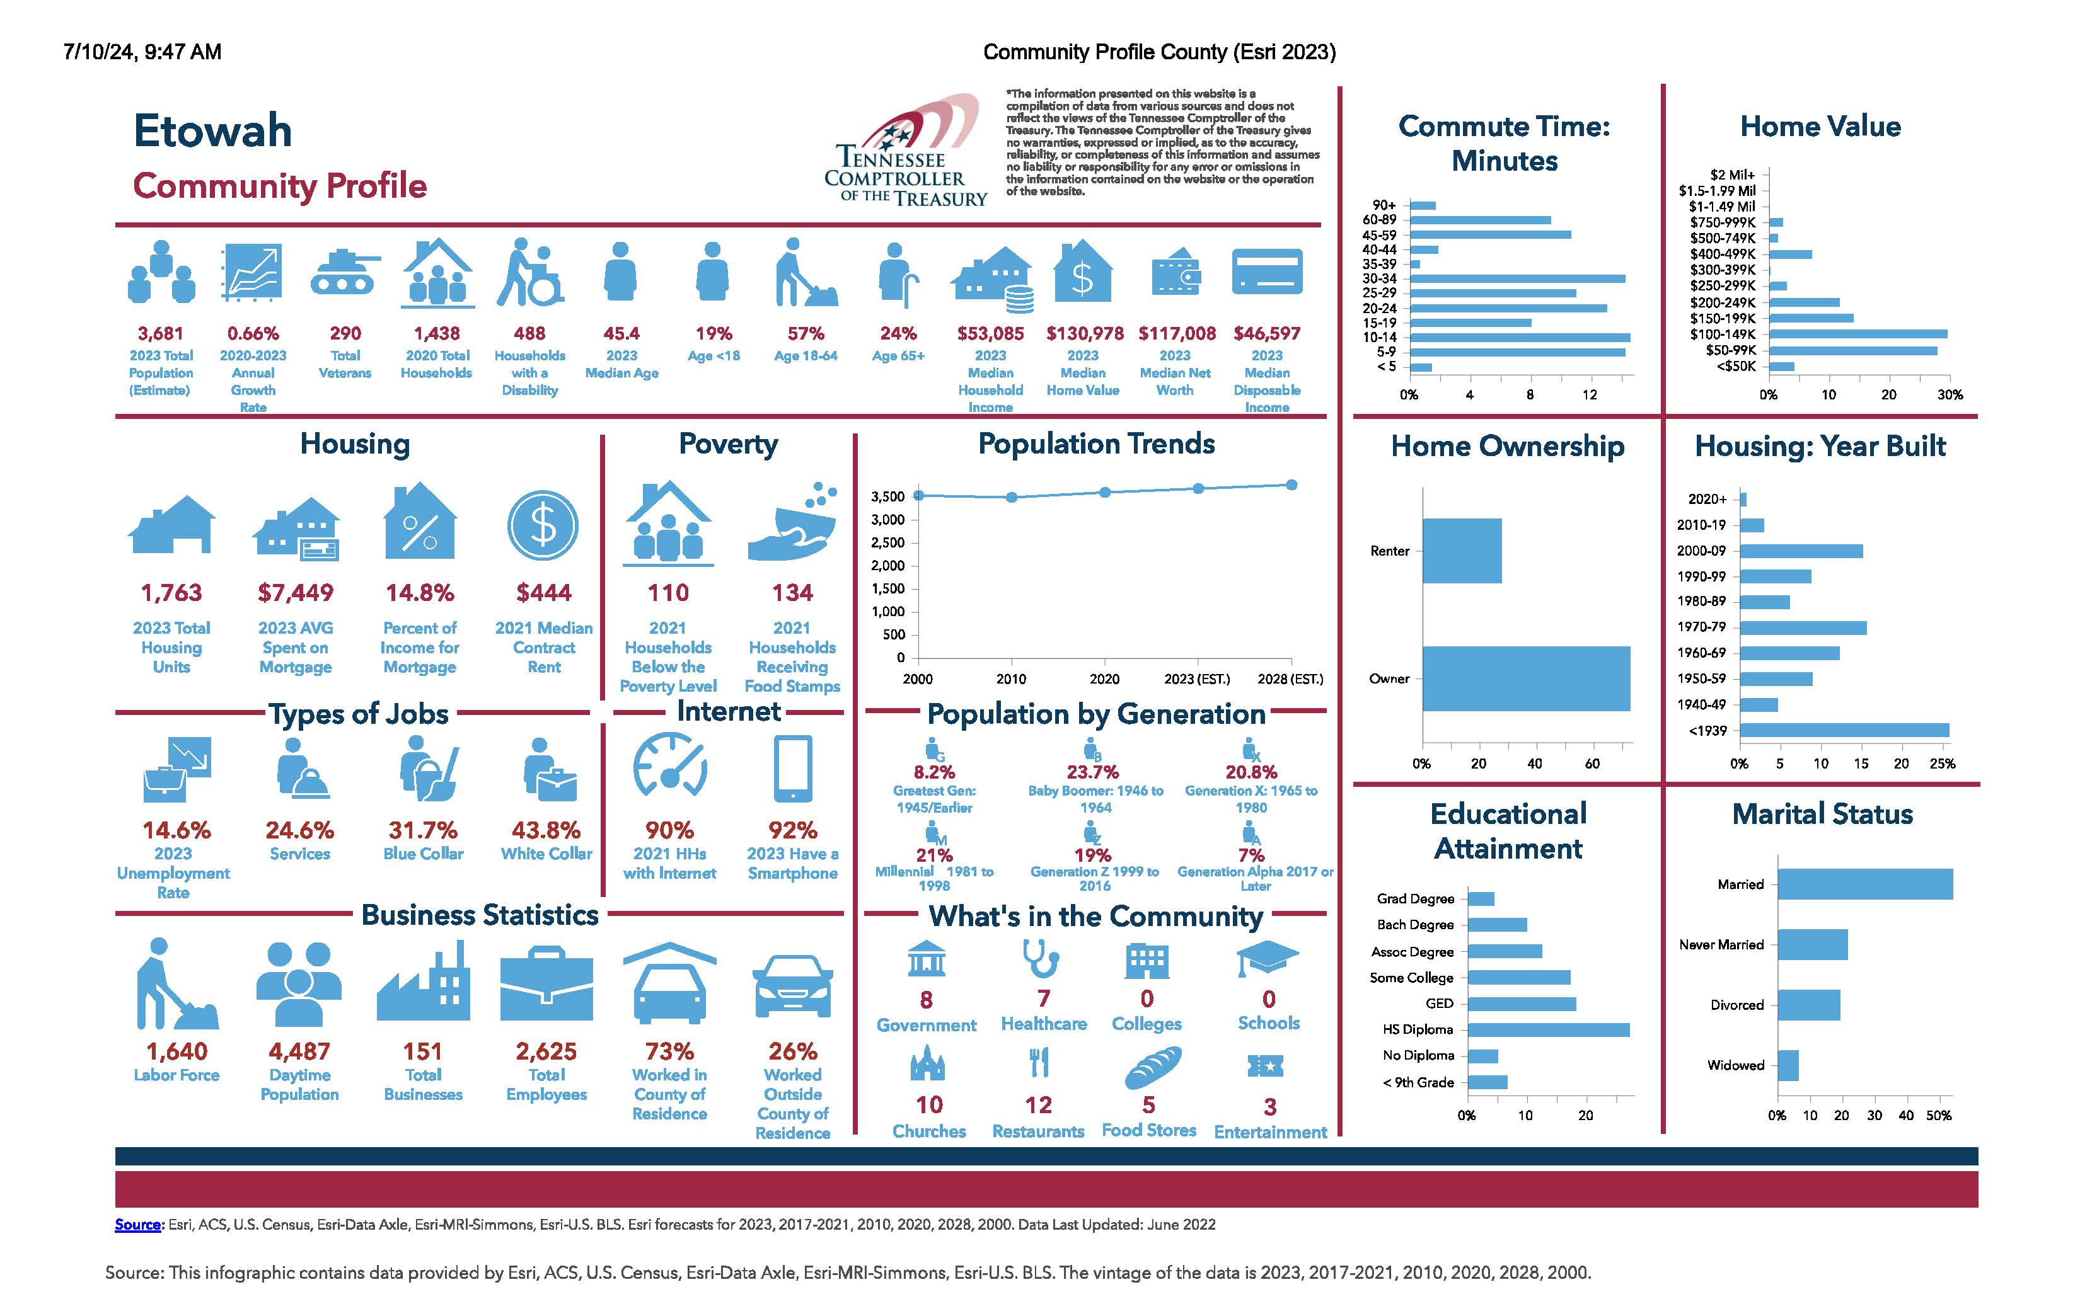

Slide 10
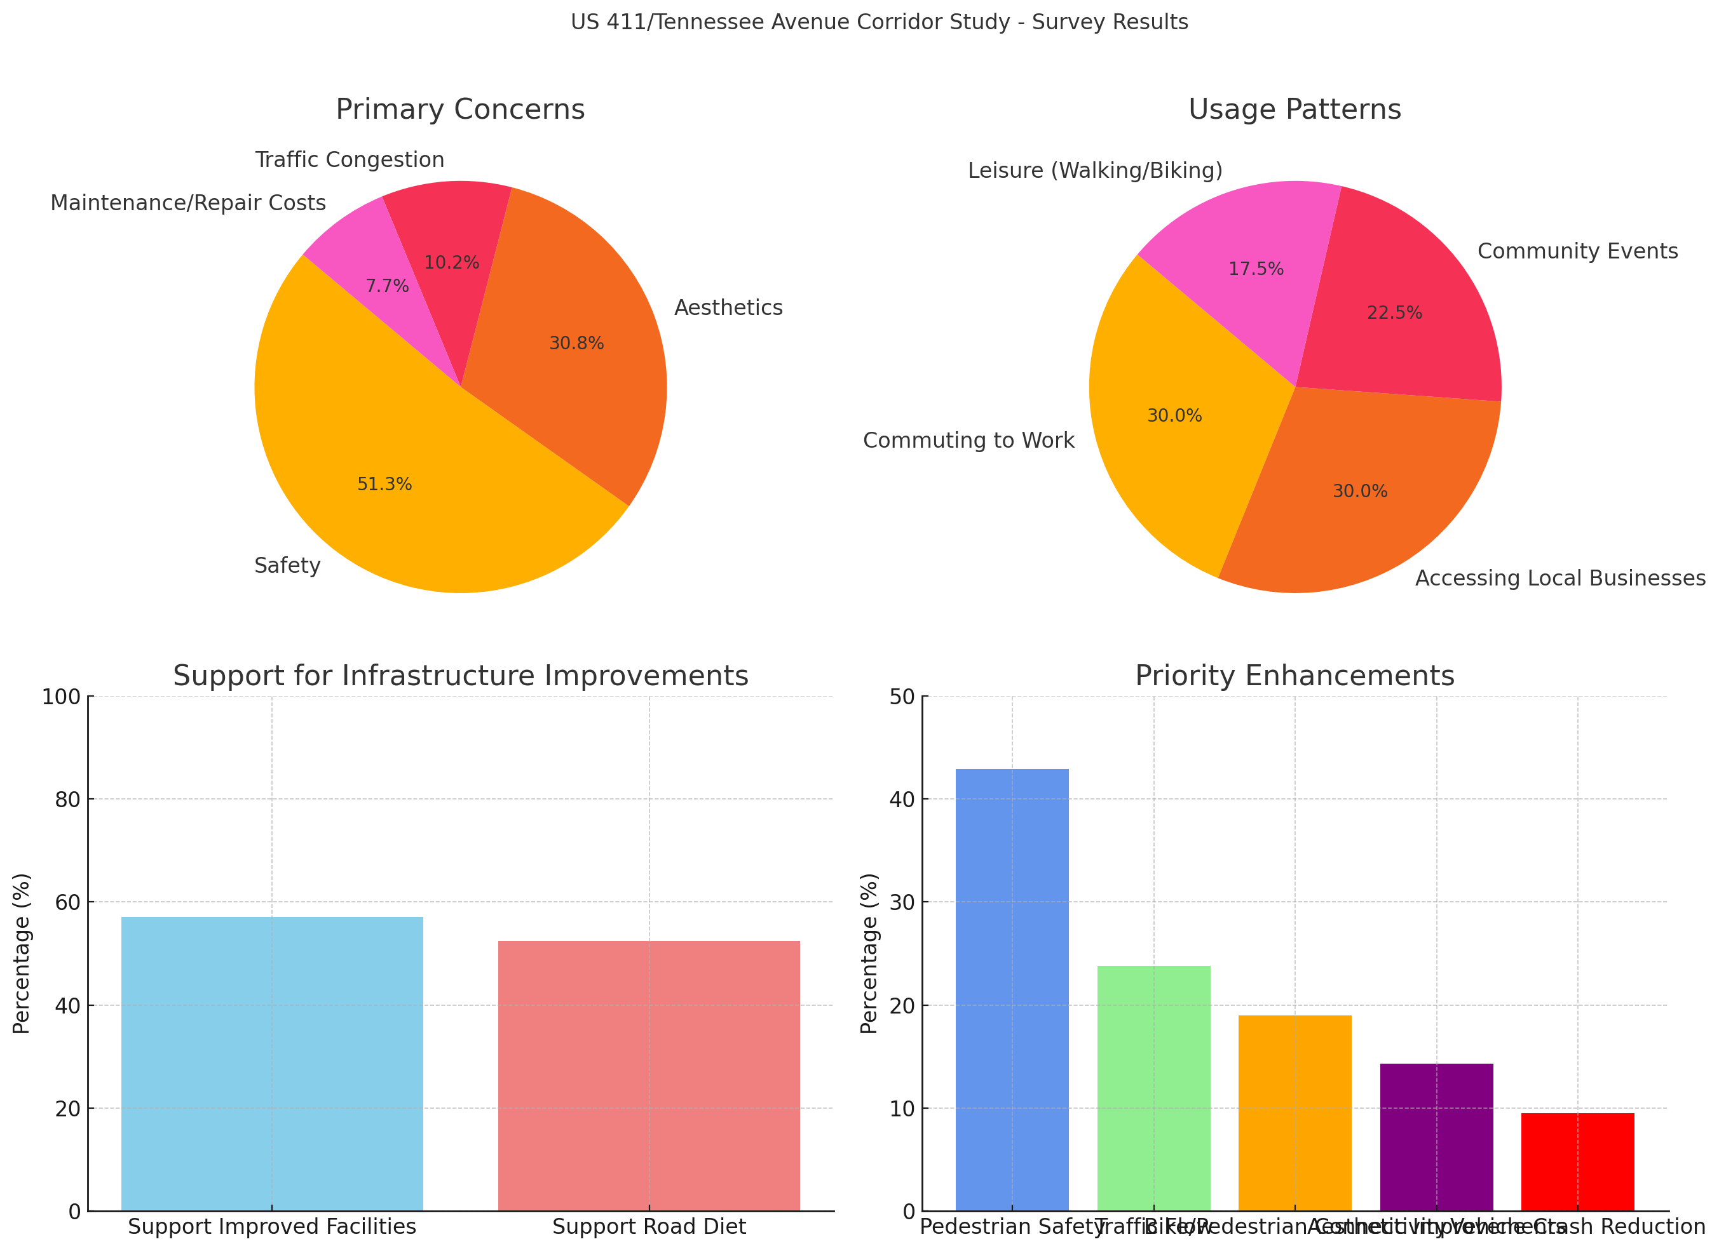
Etowah Corridor Study
Survey Results
1. Pedestrian Safety
2. Traffic Flow
3. Pedestrian Connectivity
4. Aesthetics
5. Crash Reduction
Support Improved Facilities
Support Road Diet
Notes:
11/6 Snapshot: 97 Responses (So far)
Primary Concerns: The majority of respondents (51.3%) are concerned with safety, followed by aesthetics (30.8%), with smaller portions concerned about traffic congestion (10.2%) and maintenance/repair costs (7.7%).
Usage Patterns: Respondents primarily use the corridor for commuting to work (30%) and accessing local businesses (30%). Community events account for 22.5% of use, while 17.5% use it for leisure activities like walking or biking.
Support for Infrastructure Improvements: 57.1% support improved facilities for pedestrians and cyclists, while 52.4% support a “road diet” to reduce lanes in favor of adding bike and pedestrian pathways.
Priority Enhancements: Pedestrian safety is the highest priority (42.9%), followed by traffic flow (23.8%), bike/pedestrian connectivity (19%), aesthetic improvements (14.3%), and vehicle crash reduction (9.5%).

Slide 11
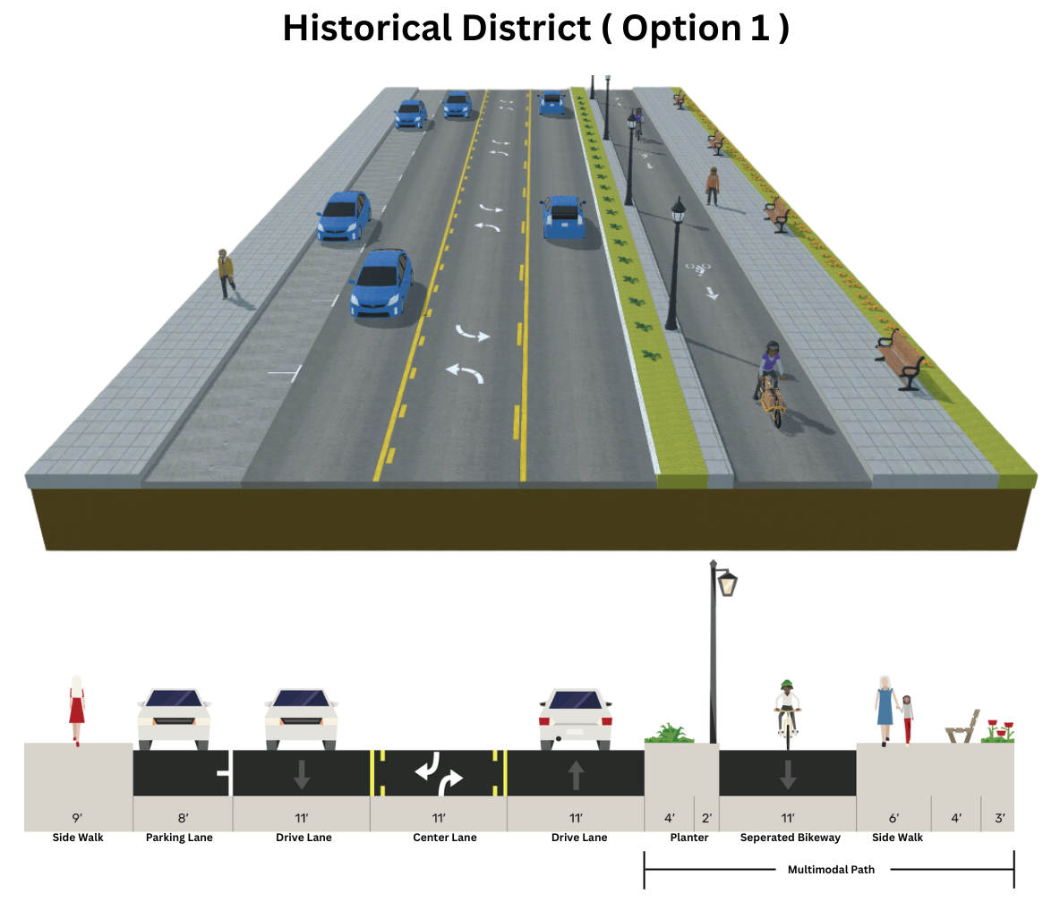
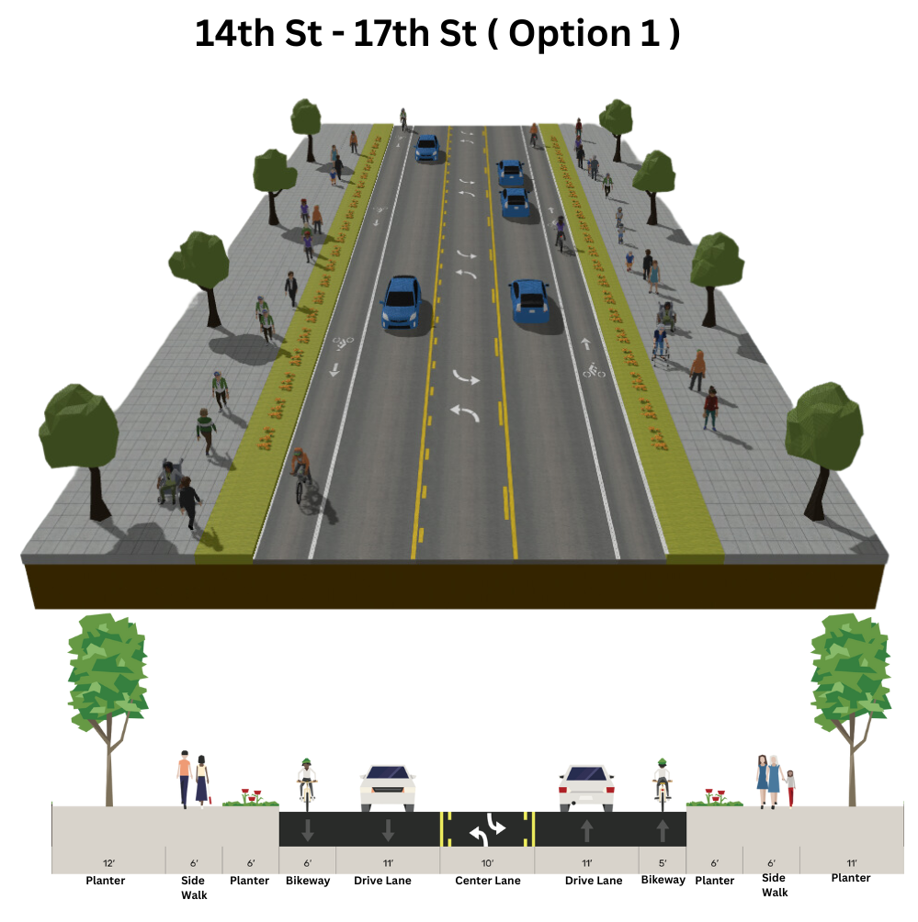
Etowah Corridor Study
Potential
Recommendations
Notes:
11/6 Snapshot: 97 Responses (So far)
Primary Concerns: The majority of respondents (51.3%) are concerned with safety, followed by aesthetics (30.8%), with smaller portions concerned about traffic congestion (10.2%) and maintenance/repair costs (7.7%).
Usage Patterns: Respondents primarily use the corridor for commuting to work (30%) and accessing local businesses (30%). Community events account for 22.5% of use, while 17.5% use it for leisure activities like walking or biking.
Support for Infrastructure Improvements: 57.1% support improved facilities for pedestrians and cyclists, while 52.4% support a “road diet” to reduce lanes in favor of adding bike and pedestrian pathways.
Priority Enhancements: Pedestrian safety is the highest priority (42.9%), followed by traffic flow (23.8%), bike/pedestrian connectivity (19%), aesthetic improvements (14.3%), and vehicle crash reduction (9.5%).

Slide 12





FY 2025/2026 Work Plan
Rural Planning &
Program Management
Community Outreach & Engagement
Transportation Grants Coordination
Rural Planning Program Administration
RPO Focus

Slide 13
Task 5
RPO Focus
Access Management Study
Bicycle and Pedestrian Plan
Corridor Study
Road Diet Analysis
Resurfacing and/or Striping Plan
Transportation Facility Inventory
Transportation Feasibility Study
Transportation Systems Management & Operations
Other creative ideas
Southeast
Transportation
Planning
Grant

Slide 14
Southeast Transportation Planning Grants
Key Facts
$25,000 max award for planning services
Project administered by the RPO and a pre-qualified TDOT consultant of your choosing
12-month timeline from award
Applications available now!
2025/2026 Timeline
April – Applications due
May – Award Grantees
June – Release RFP
July – RFP due
August – January – data collection and analysis, public meeting, etc.
January – February – 1st draft of plan circulated for review
March – Final draft due
April – Adoption by local government
May – Conclusion of grant at the Spring RPO meeting

Slide 15
TDOT Update
SouthEast RPO Meeting
December 19th, 2024
D. Stacy Morrison
TDOT Planning Manager
Community Transportation
Stacy.Morrison@tn.gov

Slide 16
Major Project Types
Legislative Projects
  Design-Bid Build Projects
  P3-Choice Lanes / I55 Bridge
  Alternative Delivery
Program Projects
  Pavement Preservation
  Bridge Replacement
  State Industrial Access
  Safety Projects
Funding
  $15B in 10-Year Plan
  55% for Legislative Projects
  45% for Program Projects
  Each Region receives 25-35% of “standard” $12B Federal and State Funding
  $3B TMA Funding split evenly between Regions, Each Region receives 25% (750K)

Slide 17
Where to Find Information on Projects
10-Year Plan: Build With Us (tn.gov)
  Plan will be updated annually – Expected first Quarter each Year
  Will add Statewide Partnership Program Projects
  Goal is to be consistent across years
  10-Year Plan feeds our 3-Year Multimodal Program
  TDOT Smartway Projects
3-Year Alternative Delivery Plan
3-Year Bridge Plans
3-Year Safety Plan
3-Year Pavement Plan

Slide 18
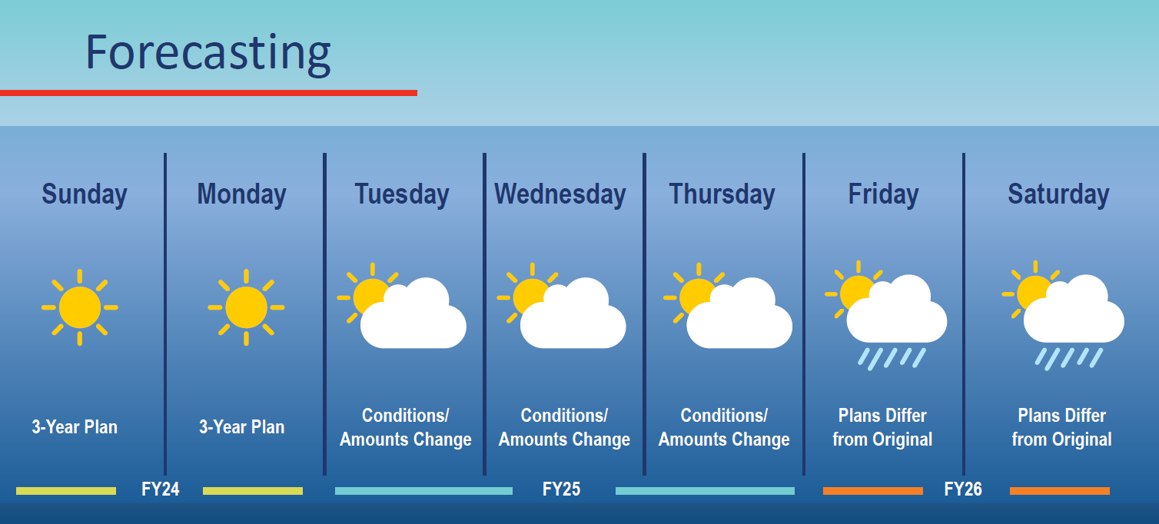
Program Projects
Notes:
Discuss how programmatic projects are also intended to remain consistent across 3-Year Plans, but may shift more than legislative based on funding and maintenance needs. i.e. pavement program with a hard winter or if a bridge is near collapse must be shifted in the plans.

Slide 19
10-Year Plan Update
What gets started gets finished.
  Project Delivery Statewide > 90%
Impact of Hurricane Helene >$500m
  Ability to Respond Quickly due to Strong fiscal position
Federal Emergency Funding
  Timing of reimbursement remains uncertain
The updated 10-Year Plan will be released in the Spring and presented to the General Assembly during the upcoming Annual Legislative Session.
Notes:
Here is an update related to an email you should have received last week (11/15/24) related to the 10YP
Last December, TDOT released its first-ever 10-Year Plan committing to what gets started, gets finished. This has allowed for effective planning for the future to ensure project predictability for communities.
NOTE improvements in Deliverability. Over 90% in the first year.
Over 500 Million to the state’s transportation Infrastructure
Thanks to State’s strong fiscal position and the TMA, we have been able to respond swiftly.
While federal emergency funding is available on a reimbursement basis, the specifics regarding the amount and timing of reimbursement remain uncertain.
This December we'll provide an update on General Fund expenditures provided through the Transportation Modernization Act (TMA) and our progress in advancing projects within the current 10-Year Plan, as required by statute.
The recent impact of Hurricane Helene has caused significant damage to our transportation system, equaling at least $510 million in costs to reestablish our network in Upper East Tennessee.

Slide 20
10-Year Plan Update
Statewide Partnership Program - SPP
  “Annual Enrolment” in 2024 was from July through August.
  Proposals submitted through MPOs and RPOs.
  Project proposals evaluated based on performance, deliverability, and cost.
Identifies Projects that are MPO and RPO priorities
  Represent a significant financial investment by locals with funds that efficiently leverage non-state funding sources.
Development of future 10-Year Plans
  Helps TDOT to better understand, and further communicate, the outstanding critical transportation funding needs in Tennessee.
Notes:
Discuss how these projects once listed typically remain in the 10-Year Plan and goal is for consistency in delivery years, dependent on funding. But it is a plan and plans sometimes have to be adjusted. An example would be another Blue Oval op
opportunity or impacts to natural disasters.
New Legislative Projects added through the Statewide Partnership Program.
“Annual Enrolment” in 2024 was from July through August.
Proposals submitted through MPOs and RPOs.
All project proposals evaluated based on performance, deliverability, and cost.
TDOT intends to prioritize projects that are MPO and RPO priorities and represent a significant financial investment by locals with funds that efficiently leverage non-state funding sources.
All information provided is essential in the development of future 10-Year Plans and for TDOT to better understand, and further communicate, the outstanding critical transportation funding needs in Tennessee.
One that last bullet is so we can show the legislature the Need that is out there – the importance of SPP

Slide 21
THANK YOU

Slide 22
Southeast Rural Planning Organization
Fall Meeting 2024
Region 2

Slide 23
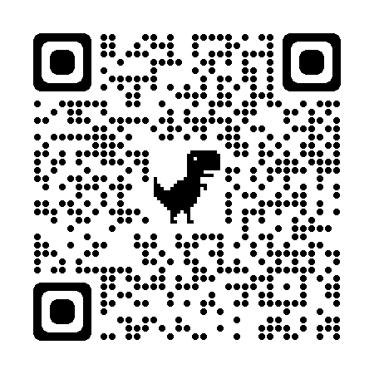
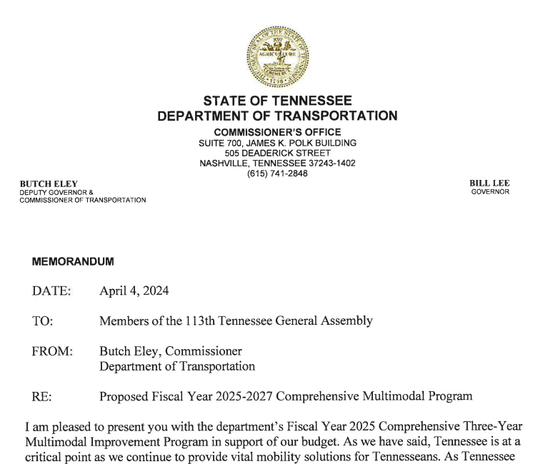
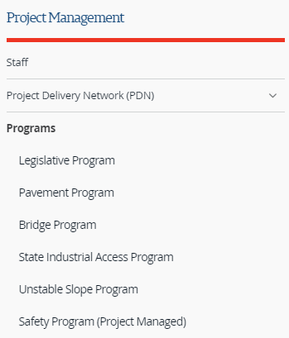

3-Year Plans
The Programs are published on TDOT’s Project Management website: https://www.tn.gov/tdot/pm/programs.html.

Slide 24
Region 2 Highway Program, FY25
County | PIN | Route | Description | Phase
Bledsoe | 124104.05 | SR-28 US-127 | From south of Humble Cemetery Rd. to 5-Lane in Pikeville (IA) | ROW (CN – 28)
Rhea | 109410.03 | SR-30 | (Old Washington Hwy.) From near SR-29 (US-27) to west of New Union Rd. / White Oak Rd. (IA) | ROW (CN – 28/29)

Slide 25
Region 2 Highway Program, FY26
County | PIN | Route | Description | Phase
Bradley | 109276.00 | SR-60 | (25th Street), Intersection at SR-74 (Ocoee Street NE), LM 15.18 in Cleveland | ROW
Grundy | 124782.00 | SR-50 | (Pelham Rd.) From east of Harshman Road to west of SR-108 (IA) | ROW

Slide 26
Region 2 Highway Program, FY27
County | PIN | Route | Description | Phase
Bradley | 109276.00 | SR-60 | (25th Street), Intersection at SR-74 (Ocoee Street NE), LM 15.18 in Cleveland | CN
Grundy | 124782.00 | SR-50 | (Pelham Rd.) From east of Harshman Road to west of SR-108 (IA) | CN
Polk | 102420.13 102420.14 102420.15 102420.16 | SR-40 US-64 | (Corridor K) - Targeted Approach (TA) Locations #3 & #4 Locations #7 & #9 | CN (FY27/28)

Slide 27
Region 2, Pavement Projects
Program | Description
Pavement | FY25 – 68 miles
December | CNY118 Rhea SR-29 From south of Boofer Lane to south of Metzger Lane
February | 12 Projects, totaling 45 log miles (# - include Micro)
 | D28 Grundy – 2.39 Marion – 20.92 (#) | D29 Bradley – 16.45 (#) Hamilton – 8.31 (#) McMinn – 2.01 Polk – 3.66
March - June | Additional 21.8 log miles planned over 6 projects

Slide 28
Region 2, 3-Year Bridge Program Projects
Program | Description
Bridge – On System | Polk SR-68 over SR-40, February 2025 McMinn SR-310 over Conasauga Creek, Fall 2025 Polk SR-68 over Davis Creek, Spring 2027 McMinn SR-163 over Chestuee and Conasauga, Fall 2027
Bridge – Off System | Polk Easley Ford Road over Conasauga River, Spring 2025 Bradley Old Lower River Road over South Mouse Creek, FY26

Slide 29
Region 2, 3-Year Program Projects
Program | Description
Unstable Slopes | SR-108 in Marion County, Spring 2025 I-24 in Grundy County, FY26 SR-2 in Grundy County, FY27
MMAG | Rhea SR-30 at SR-29, FY26 Rhea SR-29 Kemmer Rd to Murray Ave in Spring City, FY27
Safety | Bradley SR-60 at Benton Pike, Cleveland, FY25 Marion SR-28 at Moss Loop, Jasper, FY25 Grundy SR-56 Turn Lane, FY26 Bradley SR-60 Medians, FY26 Bradley SR-2 at 17th Street, Cleveland, FY27 McMinn SR-30 at 8th Street, Etowah, FY27

Slide 30
Region 2 Highway Program, Specials
County | PIN | Route | Description
Grundy | 132953.00 | I-24 | At SR-50, interchange improvements, ramp widening and auxiliary lane extensions. Summer 2026.
Marion | 133134.00 | I-24 | At SR-15, interchange improvements, bridge replacement, intersection reconstruction and trail, lighting. Fall 2026.
Polk | 125101.00 | SR-68 Connector | Copperhill TN, SR-5 Connector in McCaysville with GDOT
Sequatchie | 133753.00 | SR-8 (Rankin Ave) | Dunlap RAISE Grant with corridor modifications for bicycles, pedestrians, stormwater management, bridge replacement.

Slide 31
Alternative Delivery 3-Yr Plan – Region 2
Website: www.tn.gov/tdot/alternative-delivery
Contacts:
  Jeff Blevins – Region 2 Alternative Deliver Manager
  Clayton Markham – Alternative Delivery Director

Slide 32
Notes:
COMMISSIONER:
This 10-year plan is more than just improving infrastructure; it's a commitment to enhancing the everyday lives of our residents.
Smoother commutes mean more time for families, reduced stress for workers, and increased access to essential services.
Our goal is to further aid communities, help create jobs, offer transit options, and foster a more prosperous and sustainable economy all while building a modernized transportation system.
Thank you. Happy to take questions.

