Slide 1
Southeast RPO TDOT Update
Region 2- Polk, Rhea, McMinn, Meigs, Bledsoe, Grundy, Marion, Sequatchie

Slide 2








Region 2: Recap FY25
6 Bridges with value of
$52.4M
3 Small Structures Projects
with value of
$5.2M
No Highway Program Projects this Fiscal Year
2 Bridge Repairs
with value of
$8.0M
37 Pavement Program
Projects
with value of
$76.9M
1 Unstable Slopes Project
with value of
$29.1M
1 Economic Development Projects
with value of
$7.7M
6 Safety Program Projects
with value of
$6.0M
Includes October 2025 letting
Notes:
Region 2 has delivered 100% of our projects the last 3 years.
Safety includes $3.1M for Statewide ITS
57 projects let with a total value of over $185 million.
Projects in all 24 of Region 2’s counties.
Awarded to 18 different contractors.

Slide 3
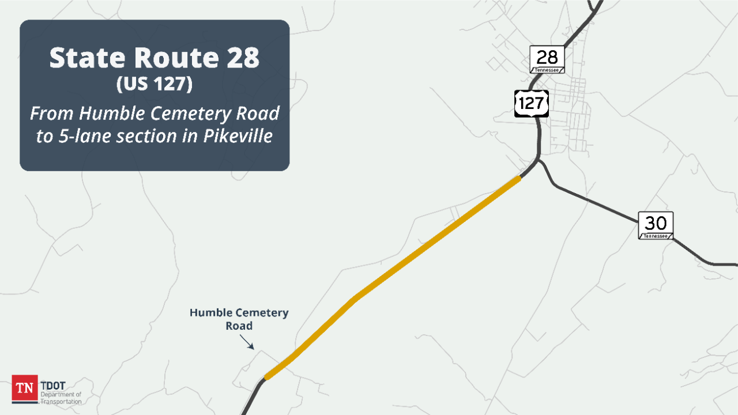
Bledsoe County
PIN: 124104.05
Program: Highway
Route: SR28/US-127
Termini: From South of Humble Cemetery Road to 5-Lane in Pikeville (IA)
RW: Underway (2025)
CN Year: 2028

Slide 4
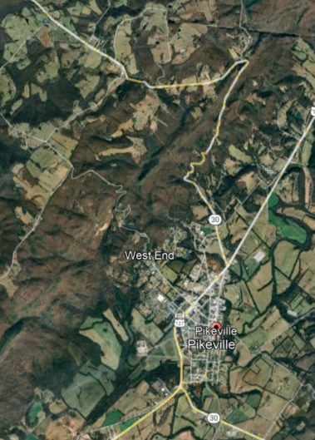

Bledsoe County
PIN: 126772.00
Program: Unstable Slope
Route: SR-30
Termini: Near LM's 7.4 and 7.8, Rockfall Mitigation
RW Year: 2026
CN Year: 2028

Slide 5
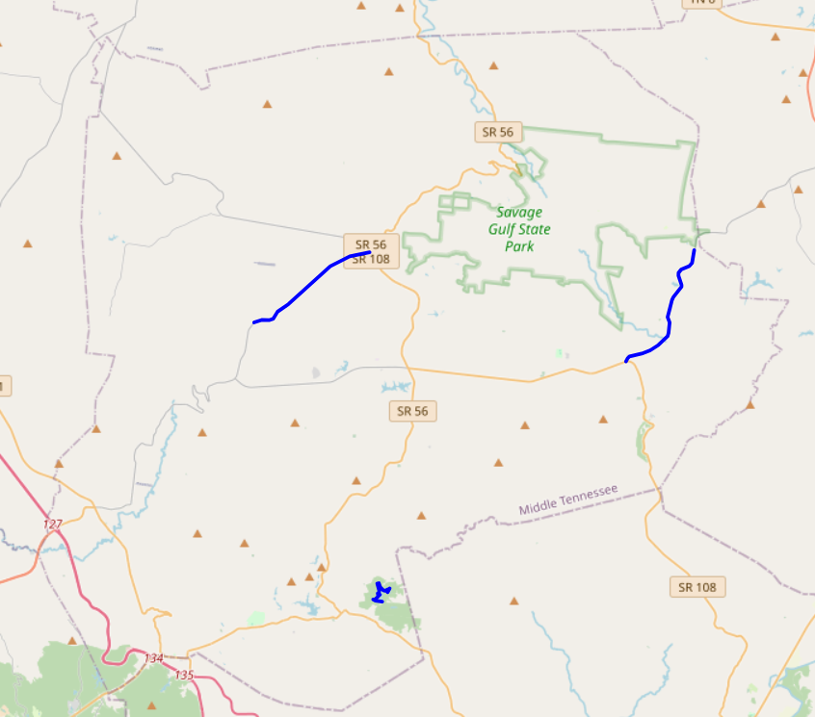
Grundy County Pavement Projects
FY26
Grundy Lakes State Park Resurfacing
SR-399
  From SR 108 to Sequatchie Co. Line – Begin LM 0.00 – End LM 4.78
SR-50
  From near Hideaway Cabin Rd. to near SR 56 – Begin LM – 13.23 – End LM 17.74

Slide 6
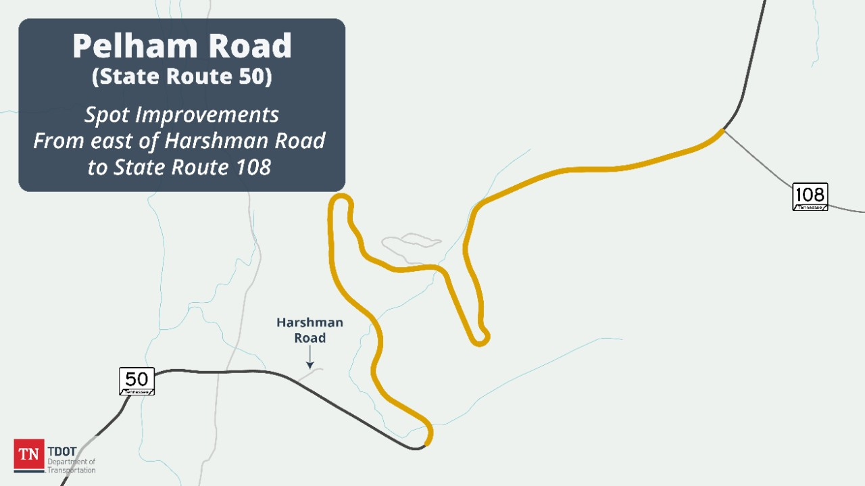
Grundy County
PIN: 124782.00
Program: Highway
Route: SR-50 (Pelham Rd.)
Termini: From east of Harshman Road to west of SR-108 (IA)
RW Year: 2026
CN Year: 2027

Slide 7
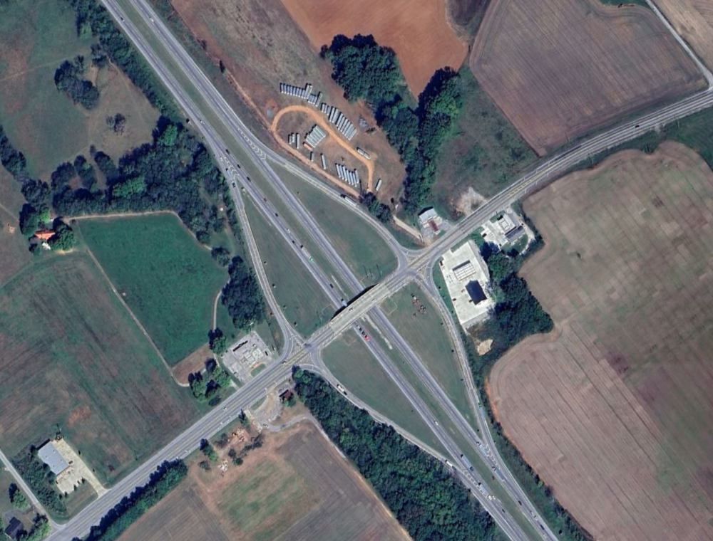



Grundy County
PIN 132953.00
Program: Highway
Route: SR-50 / I-24
Termini: Grundy Rural Interchange, Pelham (Exit 127)
CN Year: 2026

Slide 8

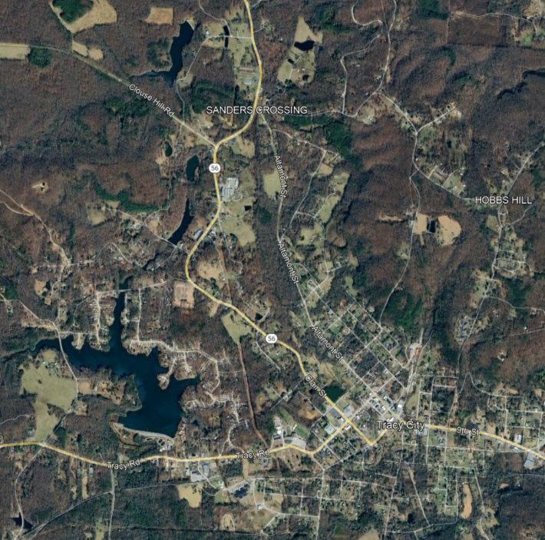
Grundy County
PIN129114.01
Program: Safety
Route: SR-56
Termini: Grundy Turn Lane at Firetower Road
RW: Underway (2025)
CN Year: 2027

Slide 9
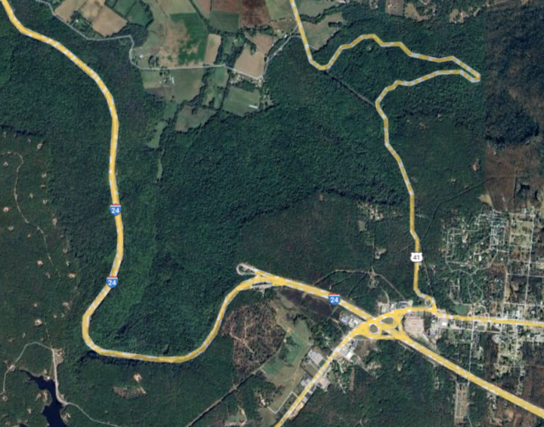
Grundy County
PIN 125383.00
Program: Unstable Slope
Route: I-24
Termini: Grundy (eastbound) at LM 5.6 (Rockfall mitigation)
CN Year: 2026*

Slide 10
Grundy County
PIN: 133433.00
Program: Unstable Slope
Route: SR-2
Termini: Grundy near LM 7.3 (Slide Repair)
RW Year: 2027
CN Year: 2028

Slide 11
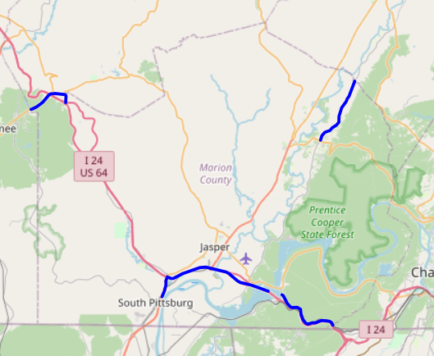
Marion County Pavement Projects
FY26
I-24 From Near SR-27 to East of SR-28
  LM 17.61 – LM 21.76
SR-134 From SR-156 to Hamilton Co. line (GFT)
  LM 0.49 – LM 5.94
SR-15 From Near Clifftops Ave to Near SR-2
  LM 0.98 – LM 2.19 (exclude interchange)
SR-2 From Near SR-15 to Near I-24
  LM 0.0 – LM 1.437
SR-27 From North of SR-156 to I-24
  LM 2.73 – LM 4.22
SR-238 From Near SR-27 to Sequatchie Co. line (GFT)
  LM 2.69 – LM 8.11

Slide 12
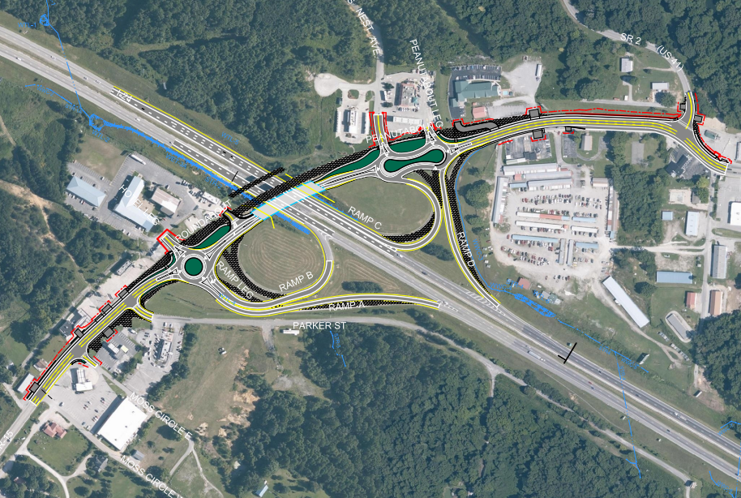

Marion County
PIN: 133134.00
Program: Highway
Route: SR-15/ I-24
Termini: Exit 134
RW: Underway (2025)
CN Year: 2027

Slide 13
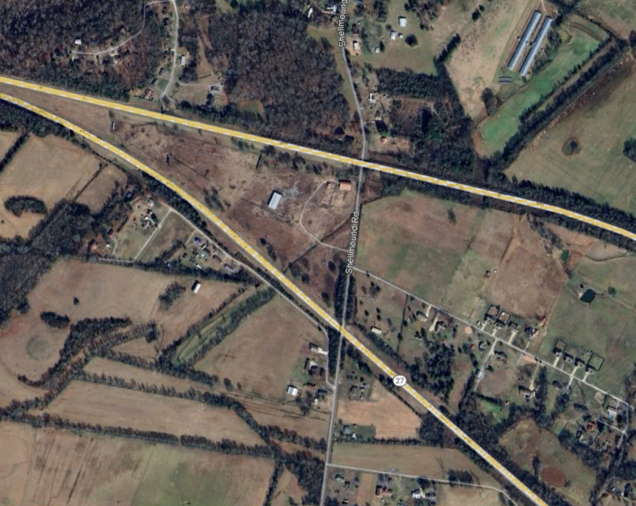
Marion County
PIN: 130902.00 & 130900.00
Program: Bridge
Termini: Shellmound Road, Bridge over I-24 EB and I-24 WB Bridge over Shellmound Road
PE: Underway (PDB)
RW Year: 2026
CN Year: 2027

Slide 14
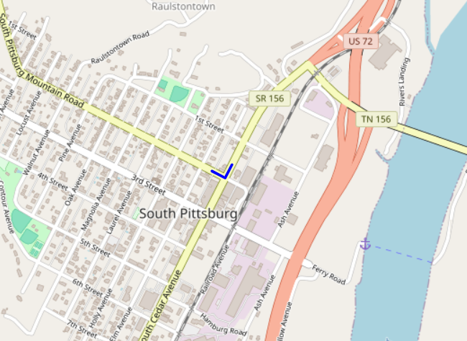
Marion County
PIN: 134182.10
Program: TSMP
Route: SR-156
Termini: (South Cedar Avenue) at East Second Street
RW Year: 2026
CN Year: 2027

Slide 15
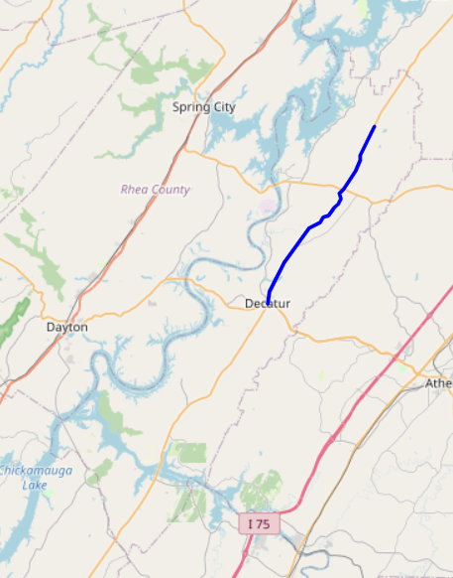
Meigs County Pavement Projects
FY26
SR-58 From north of SR-30 to SR-68
  LM 18.21 – LM 26.82
SR-58 From SR-68 to North of Ten Mile Road
  LM 26.82 – LM 31.26

Slide 16
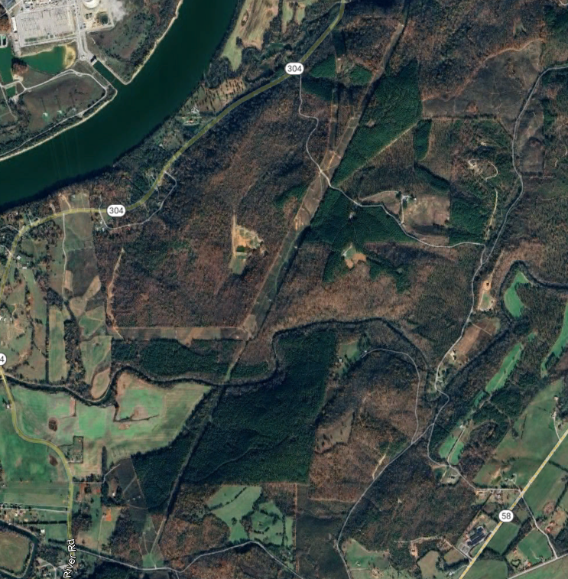
Meigs County
PIN: 124091.00
Program: Bridge
Route: Big Sewee Road
Termini: At Big Sewee Creek
RW Year: 2026
CN Year: 2028

Slide 17
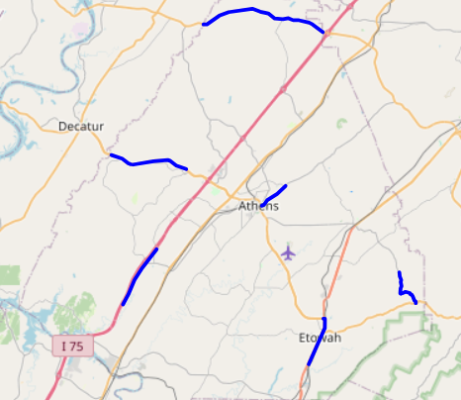
McMinn County Pavement Projects
FY26
SR-30 From south of David W. Lillard Memorial Hwy to N. of East Etowah Rd.
  LM 19.59 – LM 22.76
SR-30 From Meigs Co. Line to East of County Rd 166 (GFT)
  LM 0.0 – LM 5.0
I-75 From South of County Rd. 50 to South of County Rd 130
  LM 4.32 – LM 8.38
SR-307 From north of SR-30 to North of Tellico Ave. (GFT)
  LM 0.0 – LM 1.95
SR-39 From near County Road 469 to SR-310
  LM 19.63 – LM 22.52
SR-68 From Meigs Co. line to East of County Rd 286
  LM 0.0 – LM 2.00

Slide 18
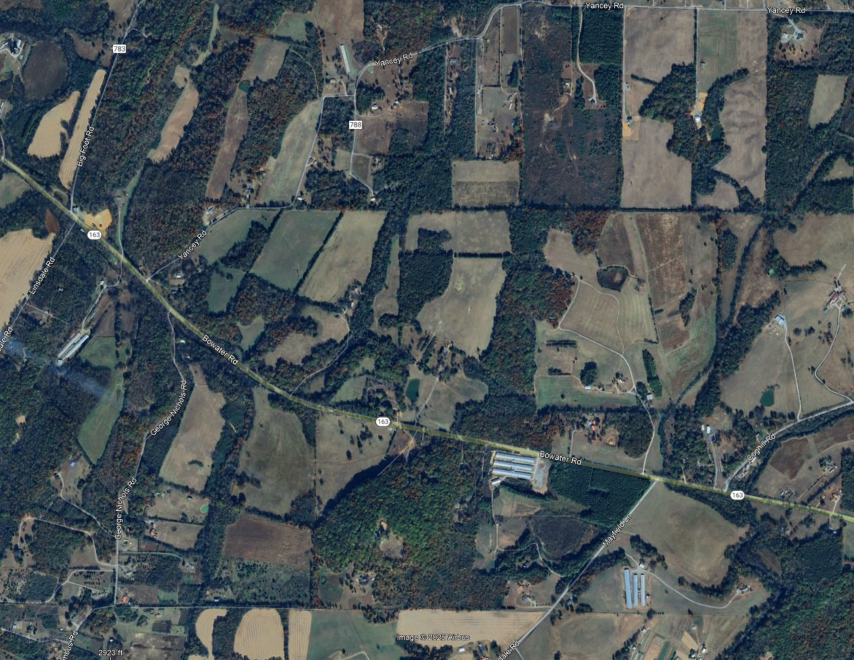

McMinn County
PIN: 124088.00 & 132423.00
Program: Bridge
Route: SR-163
Termini: Bridges over Chestuee Creek (11.7) and Conasauga Creek (13.7)
RW Year: 2026
CN Year: 2027

Slide 19
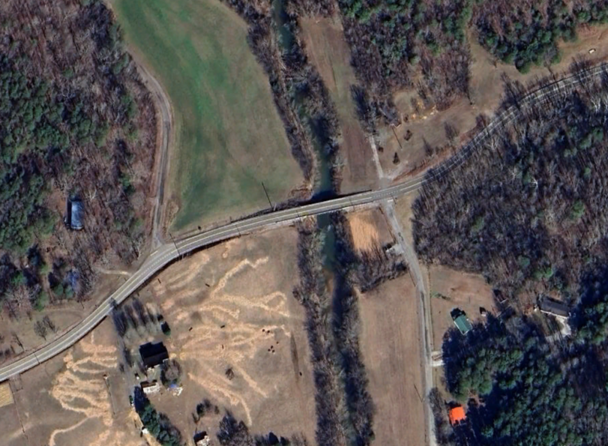
McMinn County
PIN: 130666.00
Program: Bridge
Route: SR-310
Termini: Bridge over Conasauga Creek, LM 4.360
CN Year: 2026
CR 480
CR 876

Slide 20
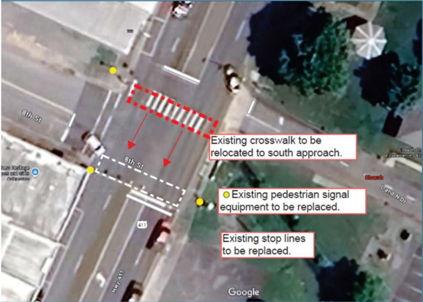
McMinn County
PIN: 125526.20
Program: Safety
Route: SR-30
Termini: Intersection at 8th St, LM 20.96 in Etowah
RW Year: 2026
CN Year: 2027*

Slide 21
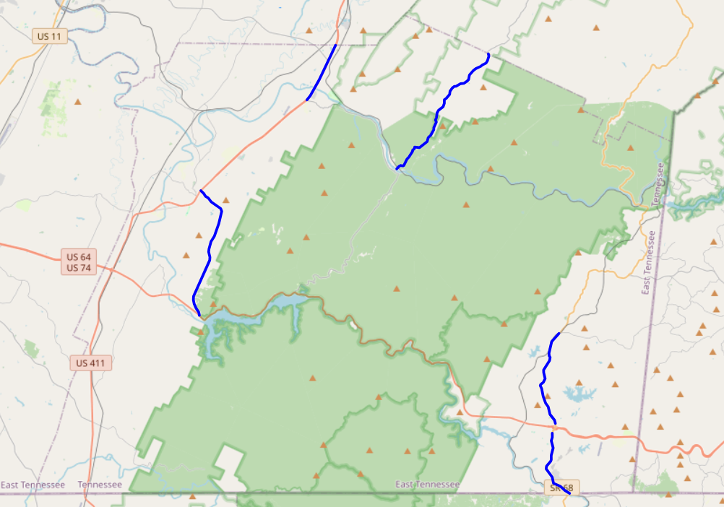
Polk County Pavement Projects
FY26
SR 30 From SR-33 to SR-163
  LM 0.00 – LM 2.65
SR 314 From SR-40 to SR-33
  LM 0.00 – LM 6.08
SR 315 from Near SR-30 to Monroe Co. line (GFT)
  LM 0.15 – LM 7.16
SR68 From near SR-40 to Georgia State line (GFT)
  LM 18.39 – LM 21.88
SR 68 From south of New Stansbury Rd. to near SR-40 (GFT)
  LM 13.91- LM 18.39

Slide 22
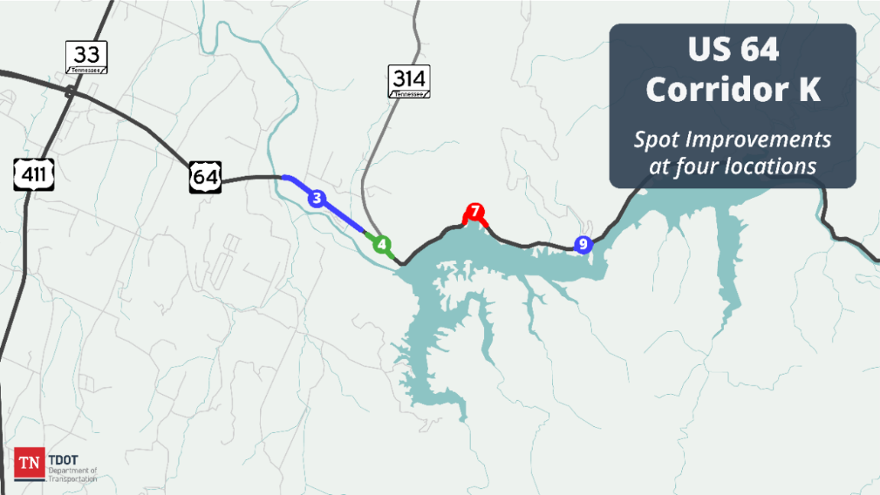
Polk County – US-64 Corridor K
Locations 3 & 4
From Welcome Valley Road to east of SR-314
Location 7
At Lake Ocoee Marina
Location 9
At Oswald Road/Ranger Station
RW FY27
CN FY28
RW Underway
CN FY27

Slide 23
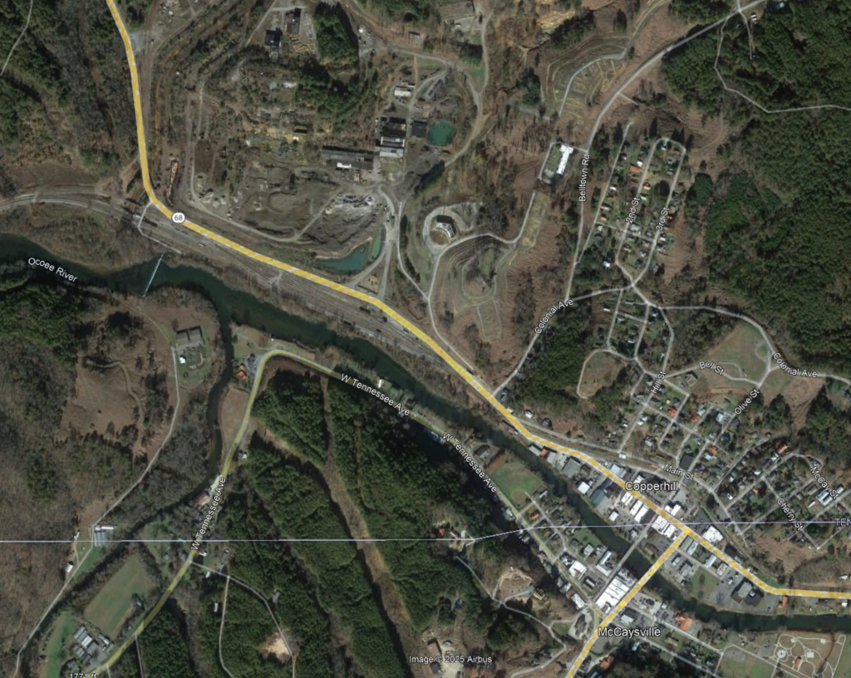
Polk County
PIN: 125101.00
Program: Highway
Route: SR-40
Termini :Georgia State Line to 2.3 Miles North at SR-68 (SR-5 and McCaysville Bypass from Georgia)
RW Year: 2026
CN Year: 2027

Slide 24
Polk County
PIN: 124099.00
Program: Bridge Repair
Route: SR-68
Termini: Polk Bridge over Davis Mill Creek, LM 21.01
RW Year: 2026
CN Year: 2028

Slide 25
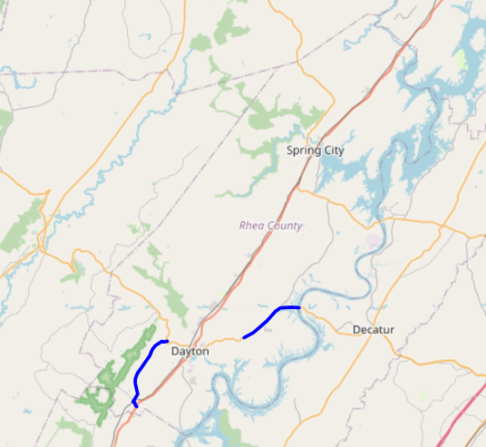
Rhea County Pavement Projects
FY26
SR 30 From Cottonport Rd to Meigs County Line
  LM 13.09 – LM 17.26
SR 303 From SR-29 to SR-30
  LM 0.00 – LM 5.73

Slide 26
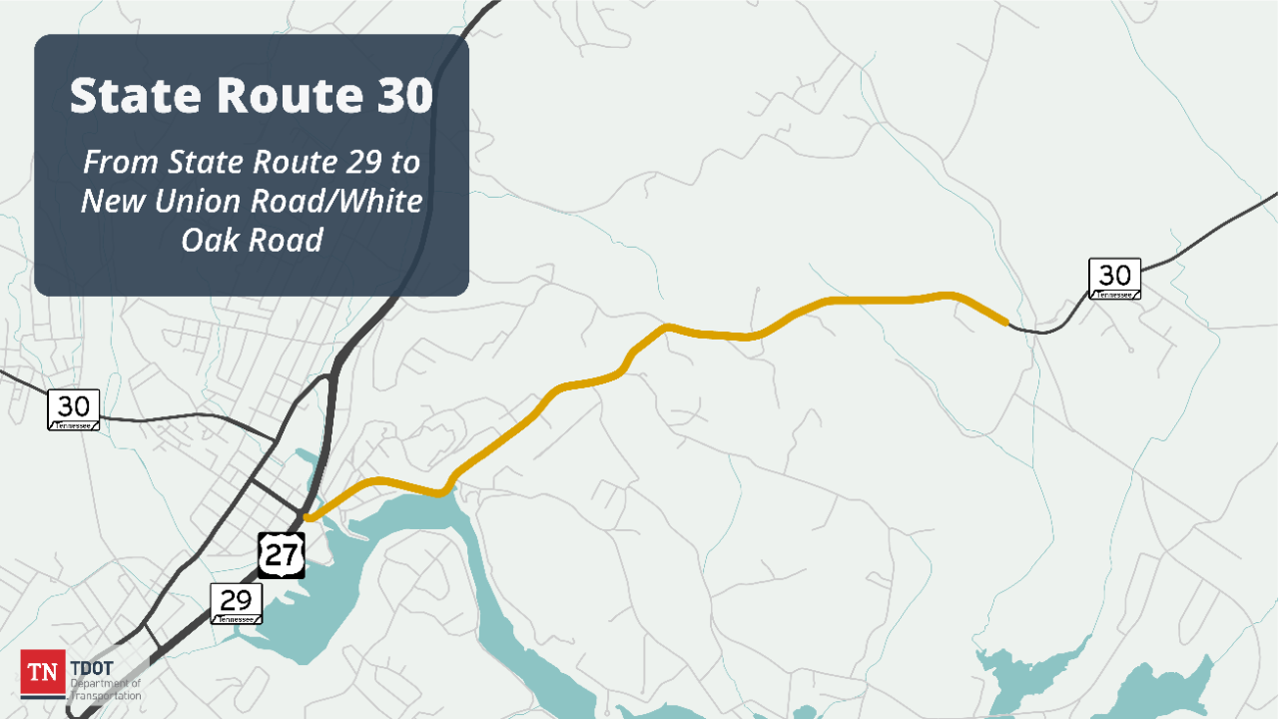
Rhea County
PIN: 109410.03
Program: Highway
Route: SR-30 (Old Washington Hwy.)
Termini: From Near SR-29 (US-27) to West of New Union Rd. / White Oak Rd.(IA)
RW Year: 2026
CN Year: 2030
PIN: 132603.00
Pedestrian Improvements at SR-30 and US-27

Slide 27
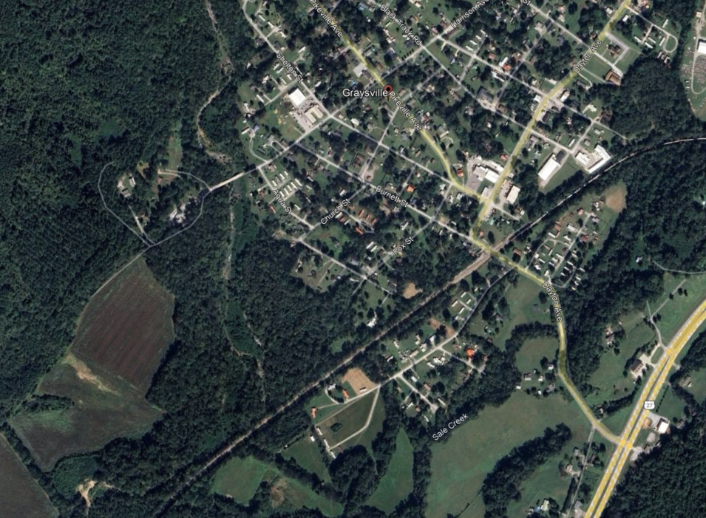

Rhea County
PIN: 124103.00
Program: Bridge
Route: Harrison Ave
Termini: Bridge over Roaring Creek, LM 0.72 in Graysville (IA)
RW Year: 2026
CN Year: 2028

Slide 28
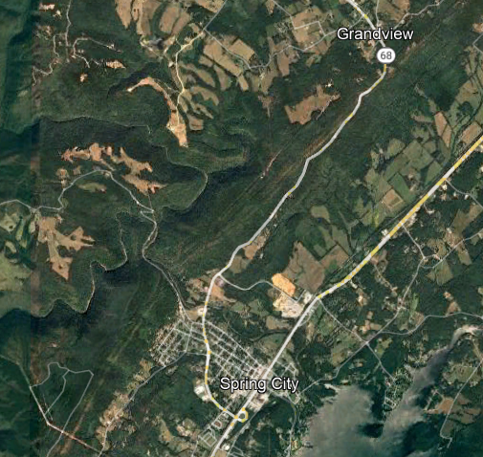
Rhea County
PIN: 126774.00
Program: Unstable Slope
Route: SR-68
Termini: Near LM 4.2 and 4.3, Rockfall Mitigation
RW Year: 2026
CN Year: 2028

Slide 29
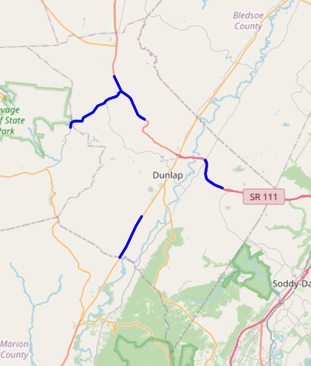
Sequatchie County Pavement Projects
FY26
SR-111 From near Lewis Chapel Rd to near East Valley Rd.
  LM 4.32 – LM 7.57
SR-28 From Marion Co. line to east of Wilson Rd.
  LM 0.00 – LM 4.00
SR-399 From Grundy Co. line to near SR-111
  LM 0.00 – LM 5.9
SR-8 From south of Withlow Rd. to north of Sherman Rd.
  LM 22.73 – LM 27.42

Slide 30
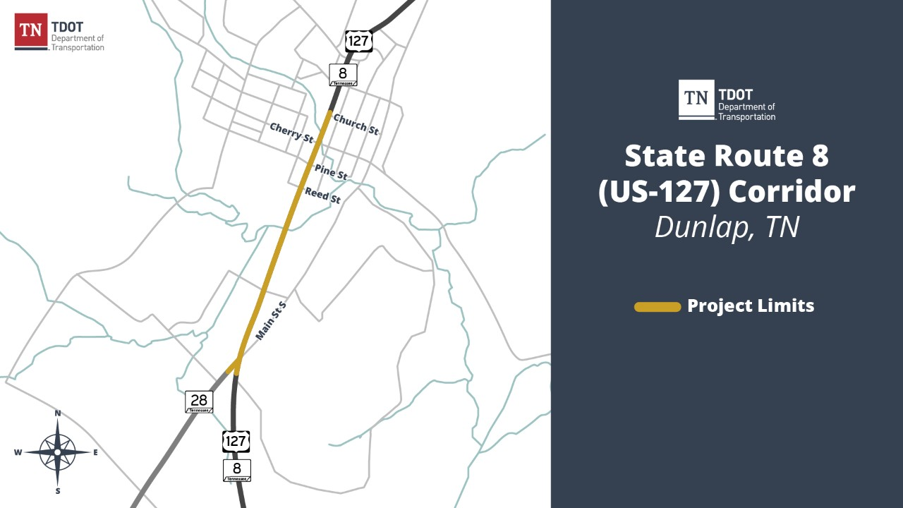
Sequatchie County
PIN: 133753.00
Program: Highway
Route: SR-8
Termini: Main to Church Complete Streets (RAISE Grant)
RW Year: 2026
CN Year: 2027

Slide 31

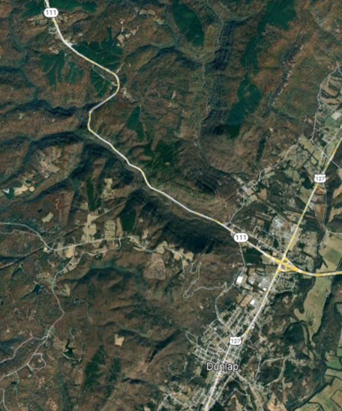

Sequatchie County – SR-8
PIN: 136374.00 (Safety)
Termini: Install 51" Barrier near LM 21.599
RW Year: 2027
CN Year: 2028
PIN: 126750.00 (Unstable Slope)
Termini : LM's 20.5 and 20.7, Rockfall Mitigation
RW Year: 2027
CN Year: TBD

Slide 32
THANK YOU

