Slide 1
The TNCleanFuels Team, a Snapshot of Alt Fuels Use in TN, and Growing Relationships in Southeast TN
Jonathan G. Overly
East TN Clean Fuels, Drive Electric TN, &
Middle-West TN Clean Fuels
Southeast Tennessee Development Board
December 10, 2025

Slide 2

















































Our Members
This includes both Tennessee Clean Fuels and Drive Electric TN members.

Slide 3



COALITIONS
Who is ETCleanFuels?
23-year old Nonprofit in East TN, 501(c)3
  4 full-time staff, 2 part-time staff and 1 part-time intern
  Became designated member of U.S. DOE Clean Cities Program in 2004
  1 of 2 Clean Cities coalitions in Tennessee; as a team are “Tennessee Clean Fuels”
  We administer the Middle-West TN Clean Fuels Coalition
  30+ dues-paying members statewide and beyond; hundreds of stakeholders
Helps Fleets Save $$ while reducing emissions
DriveElectricTN (DET) is a statewide program
that exists as a business unit in ETCleanFuels;
many diverse partners

Slide 4
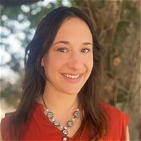
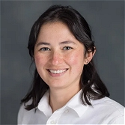
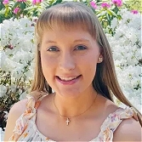
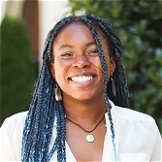
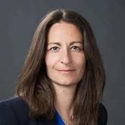
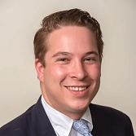
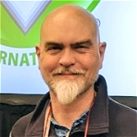
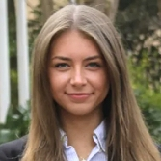
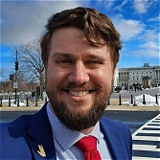
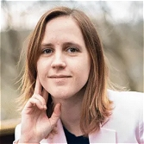
COALITIONS
Who is TNCleanFuels?
Darcy Ayers, Snr Project Manager
Alex Strong, Drive Electric TN Manager
Ashley Draper, Communications Coordinator
Wesleigh Wright, Community Engagement Liaison
Jennifer Kidd, Chief of Staff
Mark Finlay, Program Partner
Jonathan Overly, Director/CEO
Kaitlyn Jauch, Program Manager
Daniel Siksay, Senior Consultant
Alexa Voytek, Director

Slide 5
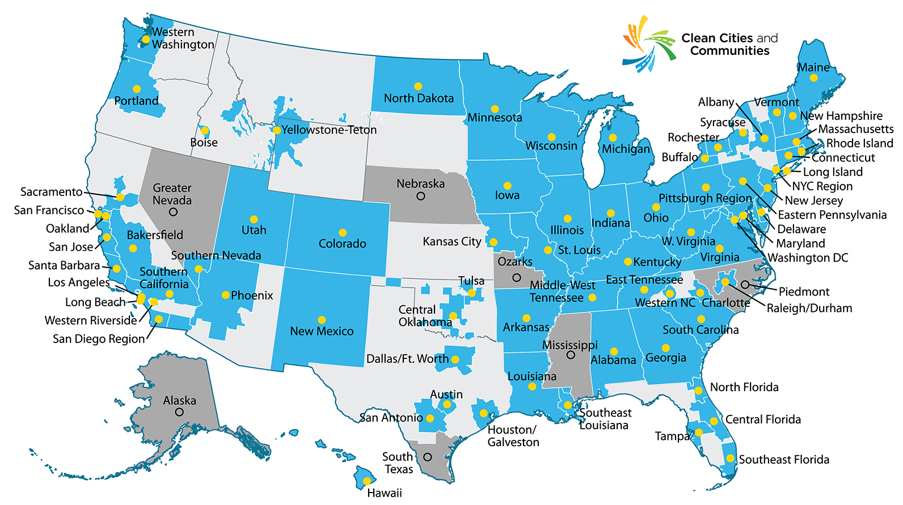
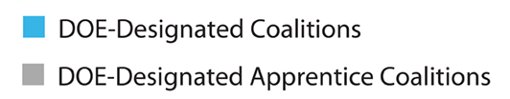
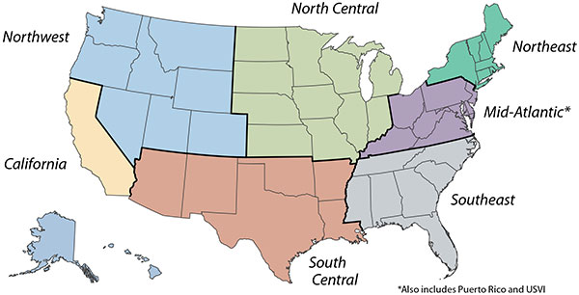
COALITIONS
Clean Cities & Communities Coalitions – All Across the USA

Slide 6
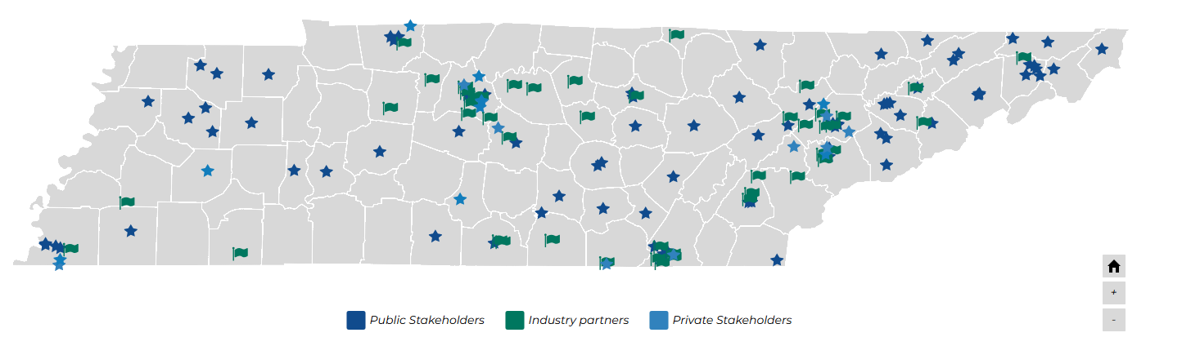
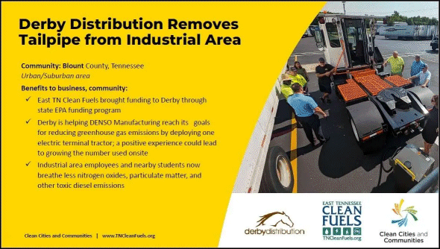
COALITIONS
Highlighting Members & Partners – Stakeholders Map
This map resides on the homepage of the two coalitions – http://www.TNCleanFuels.org

Slide 7











FLEETS
What alt fuels and tech do fleets in TN use?
Largest Fleet Users:
BIODIESEL
RENEWABLE
FUEL ECONOMY
WM
UPS
Amazon &
Knoxville Area Transit
City of Knoxville
Averitt Express
Class 8 haulers
ETHANOL
Tennessee
IDLE RED.
Clarksville-Montgomery County Schools
WM & UPS
Memphis Fire Dept.
Plug Power
EPB

Slide 8
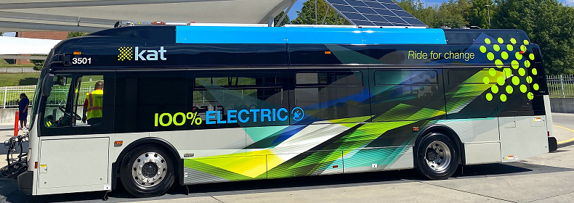
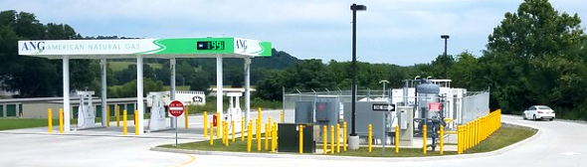
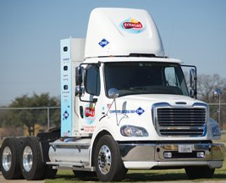
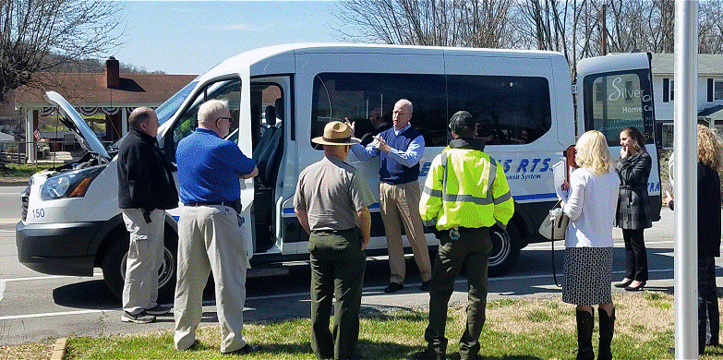
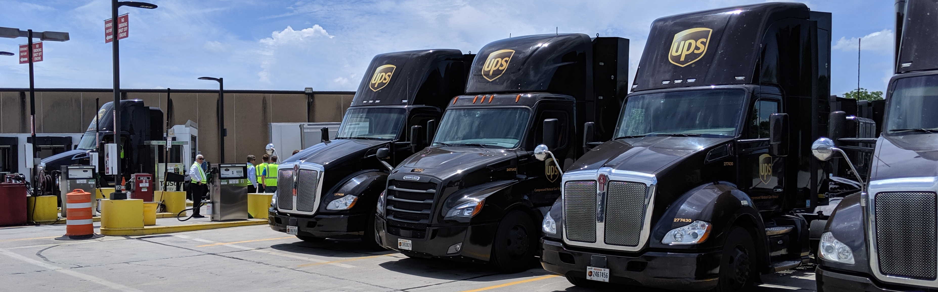
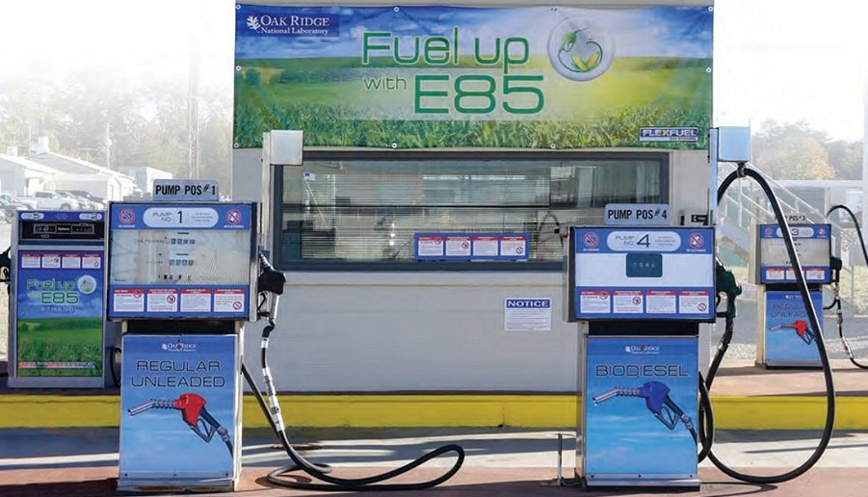
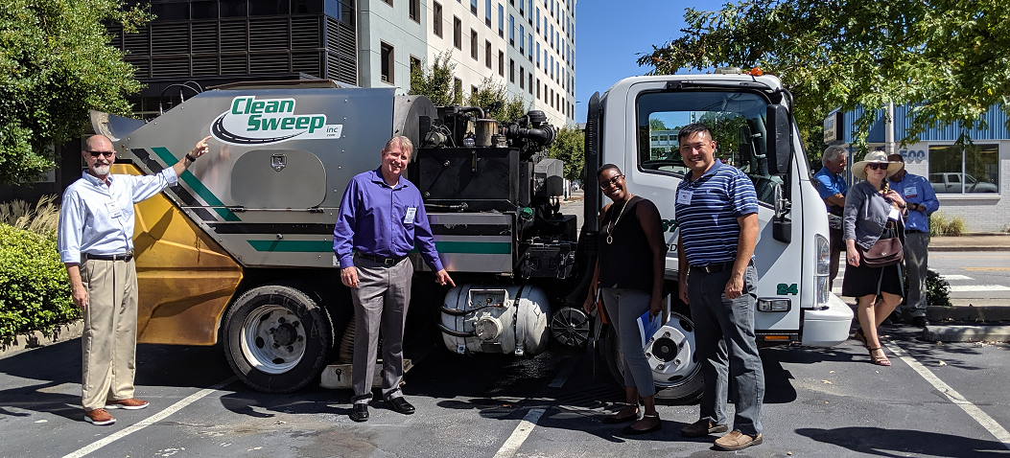
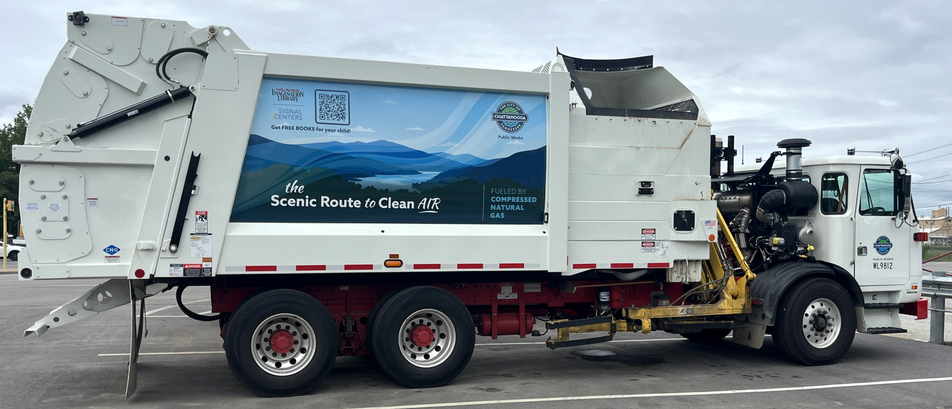
FLEETS
Tennessee Alt-fuel Fleet Examples

Slide 9
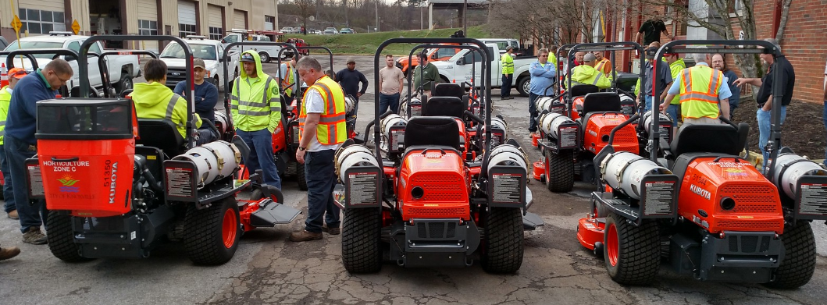
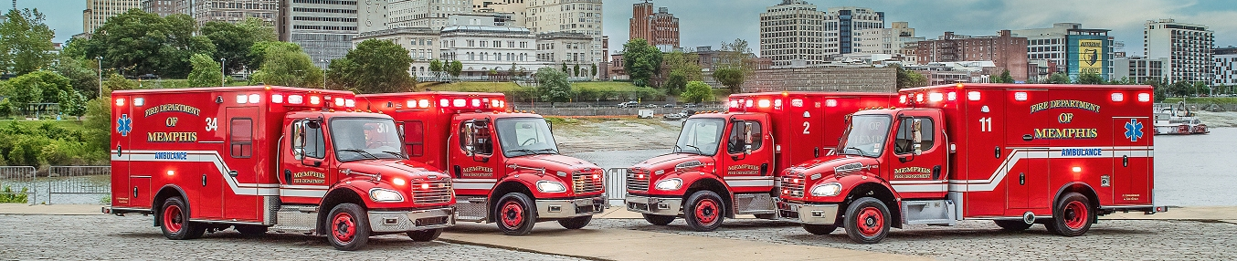
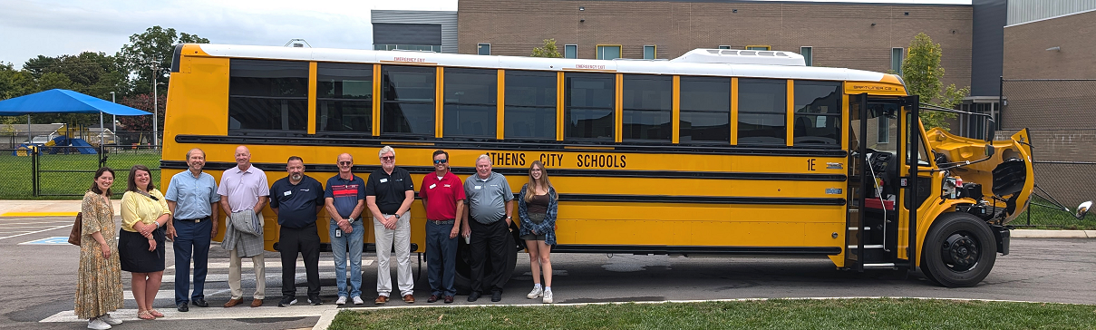
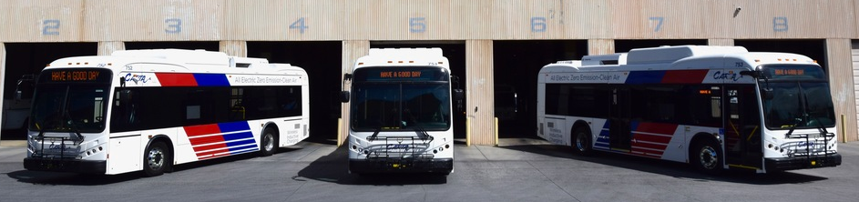
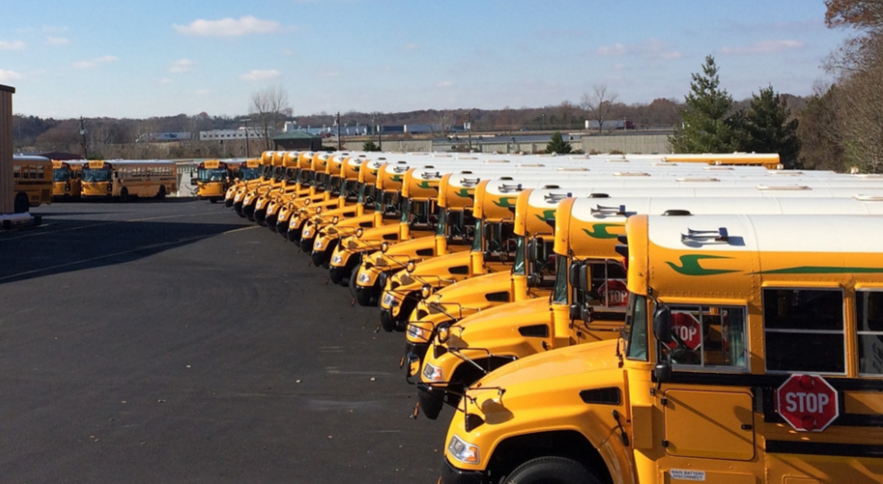
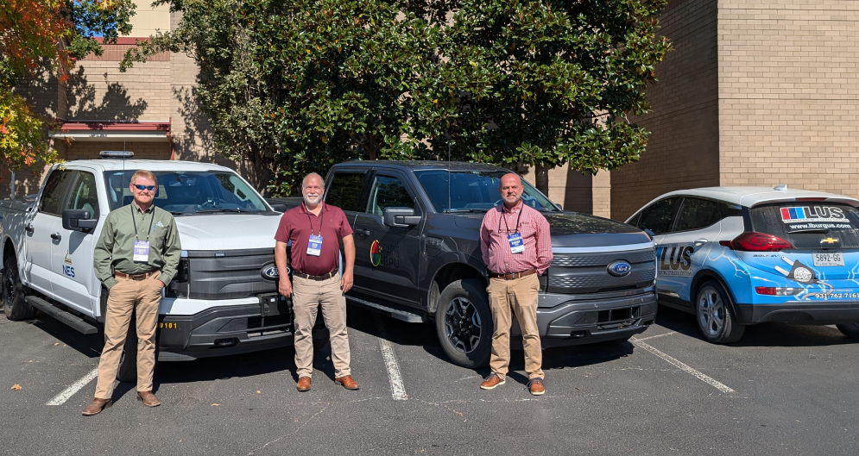
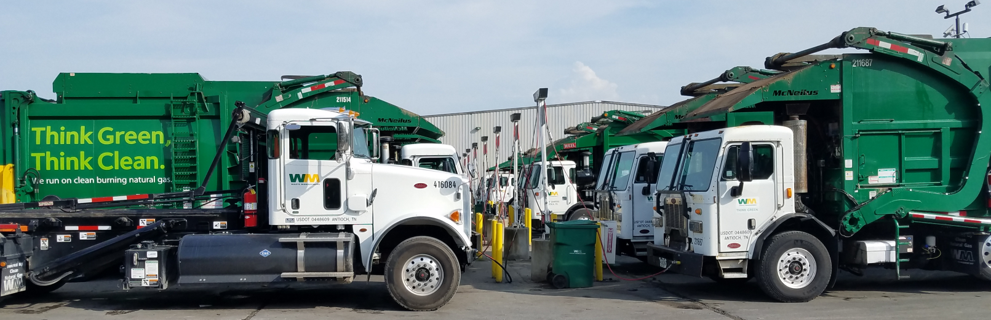
FLEETS
Tennessee Alt-fuel Fleet Examples

Slide 10
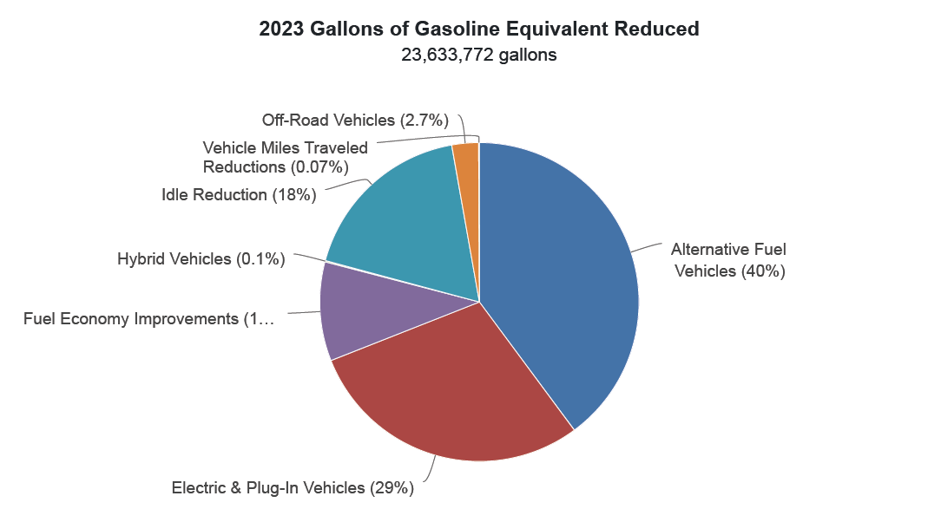
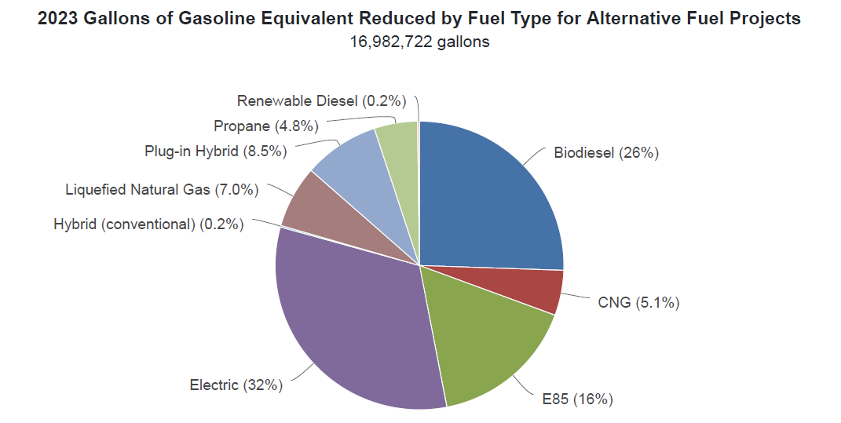
TENNESSEE NUMBERS
Updates on Numbers in East TN – GGEs: All + Alt Fuel
^^^^^ Total GGEs on left – Alt Fuel GGEs on right ^^^^^

Slide 11
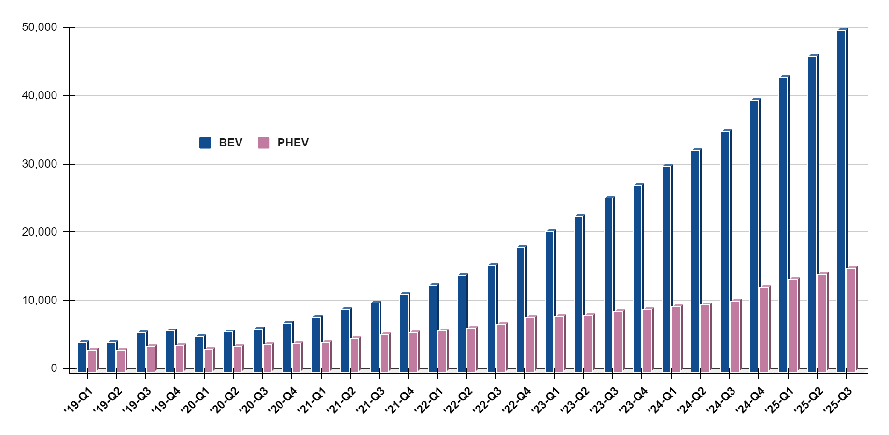
TENNESSEE TRENDS
Tennessee PEV Registrations By Quarter: 2019 - Now
Cross 40k & 50k thresholds for BEVs (~9 mo.s later)
Cross 30k threshold for BEVs (1 year later)
Cross 20k threshold for BEVs (1.5 years later)
Cross 10k threshold for BEVs (3 years after TN starts tracking)
Tennessee
Source: Tennessee Department of Revenue.

Slide 12
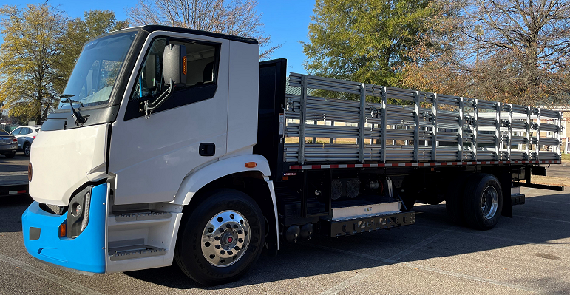
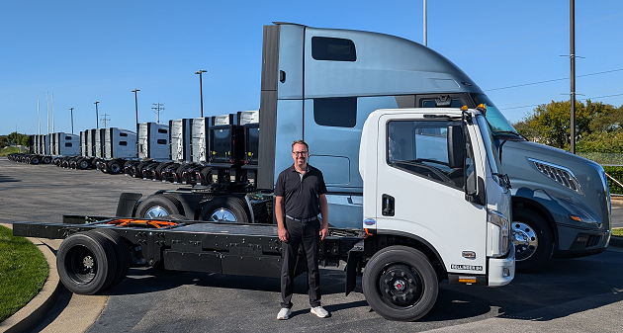
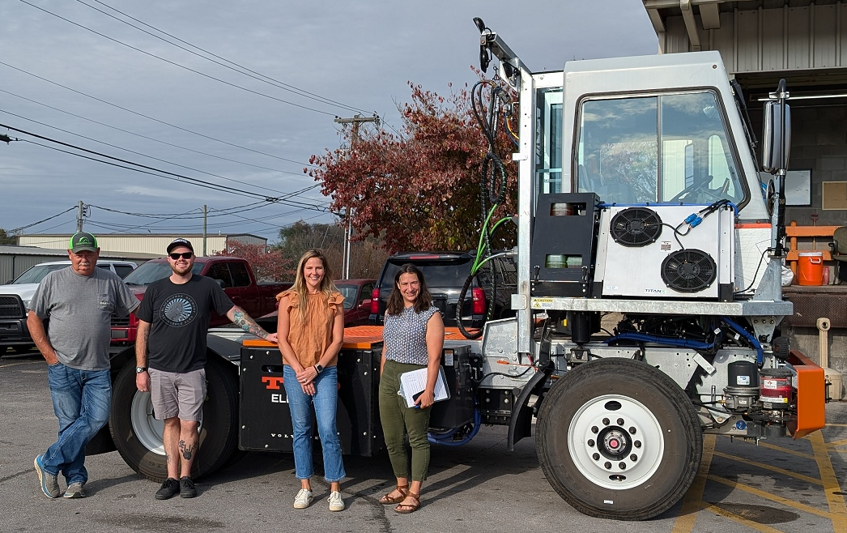
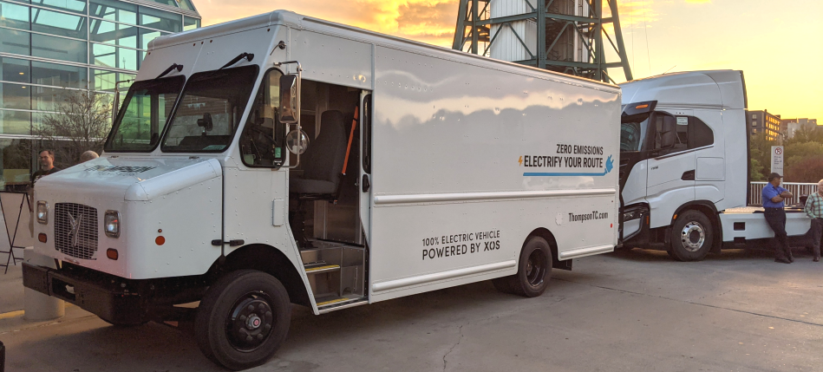
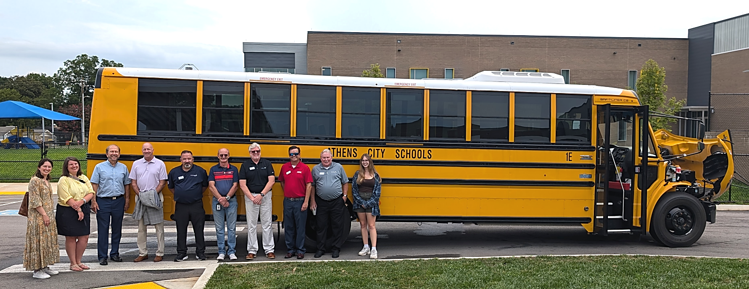
FLEETS
MD & HD EVs in Tennessee
Tennessee

Slide 13
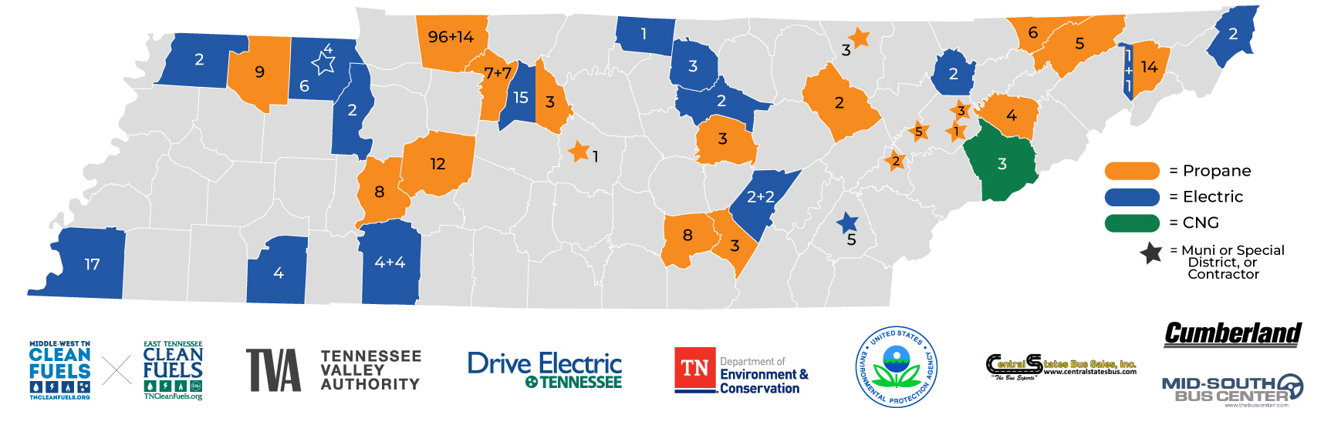
PROJECTS & PROGRAMS
TN School Districts & Alt-Fuel School Buses
Tennessee
As of August 2025.

Slide 14
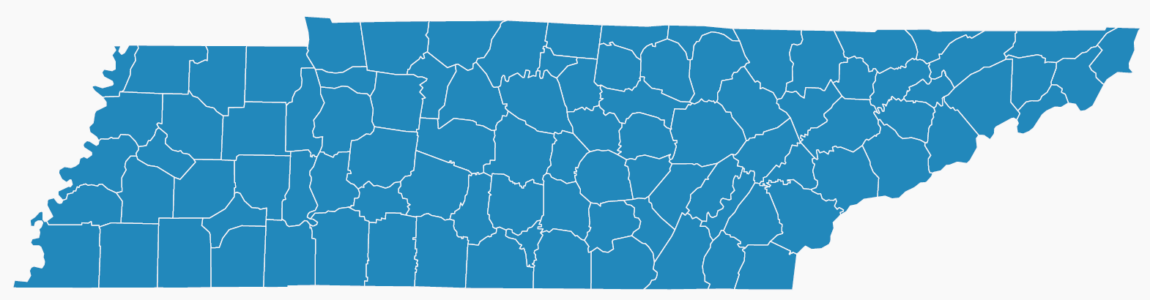









NGVs in Tennessee, & CNG Public Stations
  There are roughly over 900 total NGVs on Tennessee roads today.
  Some gas utility fleets are leading the way and are building CNG stations across TN

Slide 15
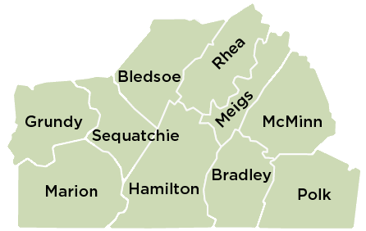
LET’S GET TO WORK
Our work in the SEDEV Footprint

Slide 16
LET’S GET TO WORK
Work in the SEDEV - Examples
Grundy, Sequatchie, Bledsoe, McMinn, Hamilton – alt-fuel school buses; helped Grundy and Sequatchie start their propane autogas school bus initiatives.
McMinn, Marion, Hamilton – Natural gas utility partnerships
Hamilton – partnership with others to bring a) more fleets to using CNG, and b) developing Chattanooga’s and southeast Tennessee’s first public CNG station
Hamilton, Bradley, McMinn – Private fleet work
Marion, Hamilton, Bradley, McMinn – public alt-fuel station development

Slide 17
CONNECTING
How can we help fleets in your communities?
Some recent communication with Mr. McIntyre of SETHRA on including them in ARC ARISE proposal, but we ultimately couldn’t get them included in the grant.
Also, Grundy and Sequatchie School Systems are getting *excellent* pricing for propane for their school buses.
How can we help fleets in your area?
> Let’s collaborate to bring cost savings to your fleets and businesses
Working with Chase Milner in FTDD has brought a number of benefits to the First TN region – let’s keep communicating Rohan!

Slide 18



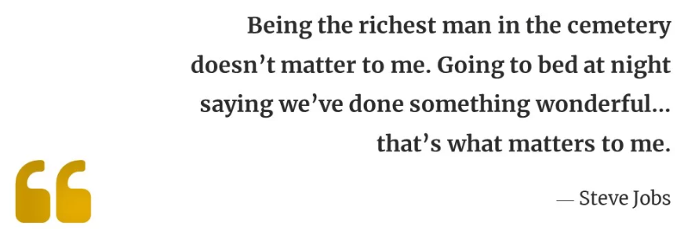
Thank You
Jonathan Overly
ETCleanFuels & DriveElectricTN
jonathan@etcleanfuels.org
865-974-3625

