Slide 1
Understanding the Requirement for Land Use and Height Ordinances Around Aeronautical Facilities

Slide 2

Understanding the Requirement for Land Use and Height Ordinances Around Aeronautical Facilities
01
Land Use Compatibility and Zoning Requirements
02
Applicability of Requirements to Local Governments
03
Status of Statutory Compliance and Next Steps
2

Slide 3

01
Land Use Compatibility and Zoning Requirements

Slide 4

Requirement to Adopt
Airport Zoning Regulations
Title 42, Chapter 6, Airport Zoning, TCA
Requires local governments with an airport hazard area adopt airport zoning regulations
  Consider the nature of airport operations and the local natural terrain
Airport zoning regulations specify
  Land uses that are permitted and prohibited
  The height to which structures and trees may be erected or allowed to grow
If an airport hazard area extends across more than one municipality, those municipalities must adopt airport zoning regulations jointly

Slide 5
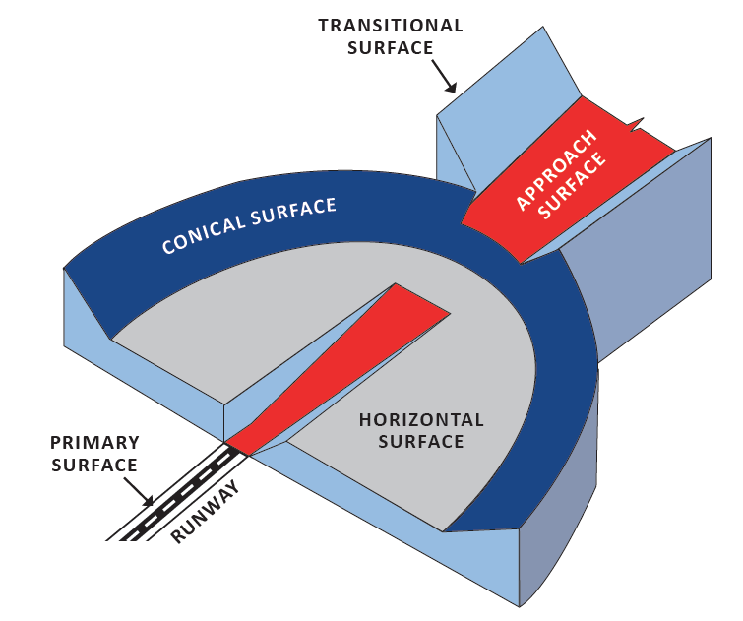
Imaginary (Protected) Surfaces
Imaginary surfaces protect airspace for safe air navigation. The height of objects and trees must not exceed that of the imaginary (protected) surfaces around an airport.
Imaginary surfaces include:
Horizontal Surface
Conical Surface
Primary Surface
Approach Surface
Transitional Surfaces

Slide 6
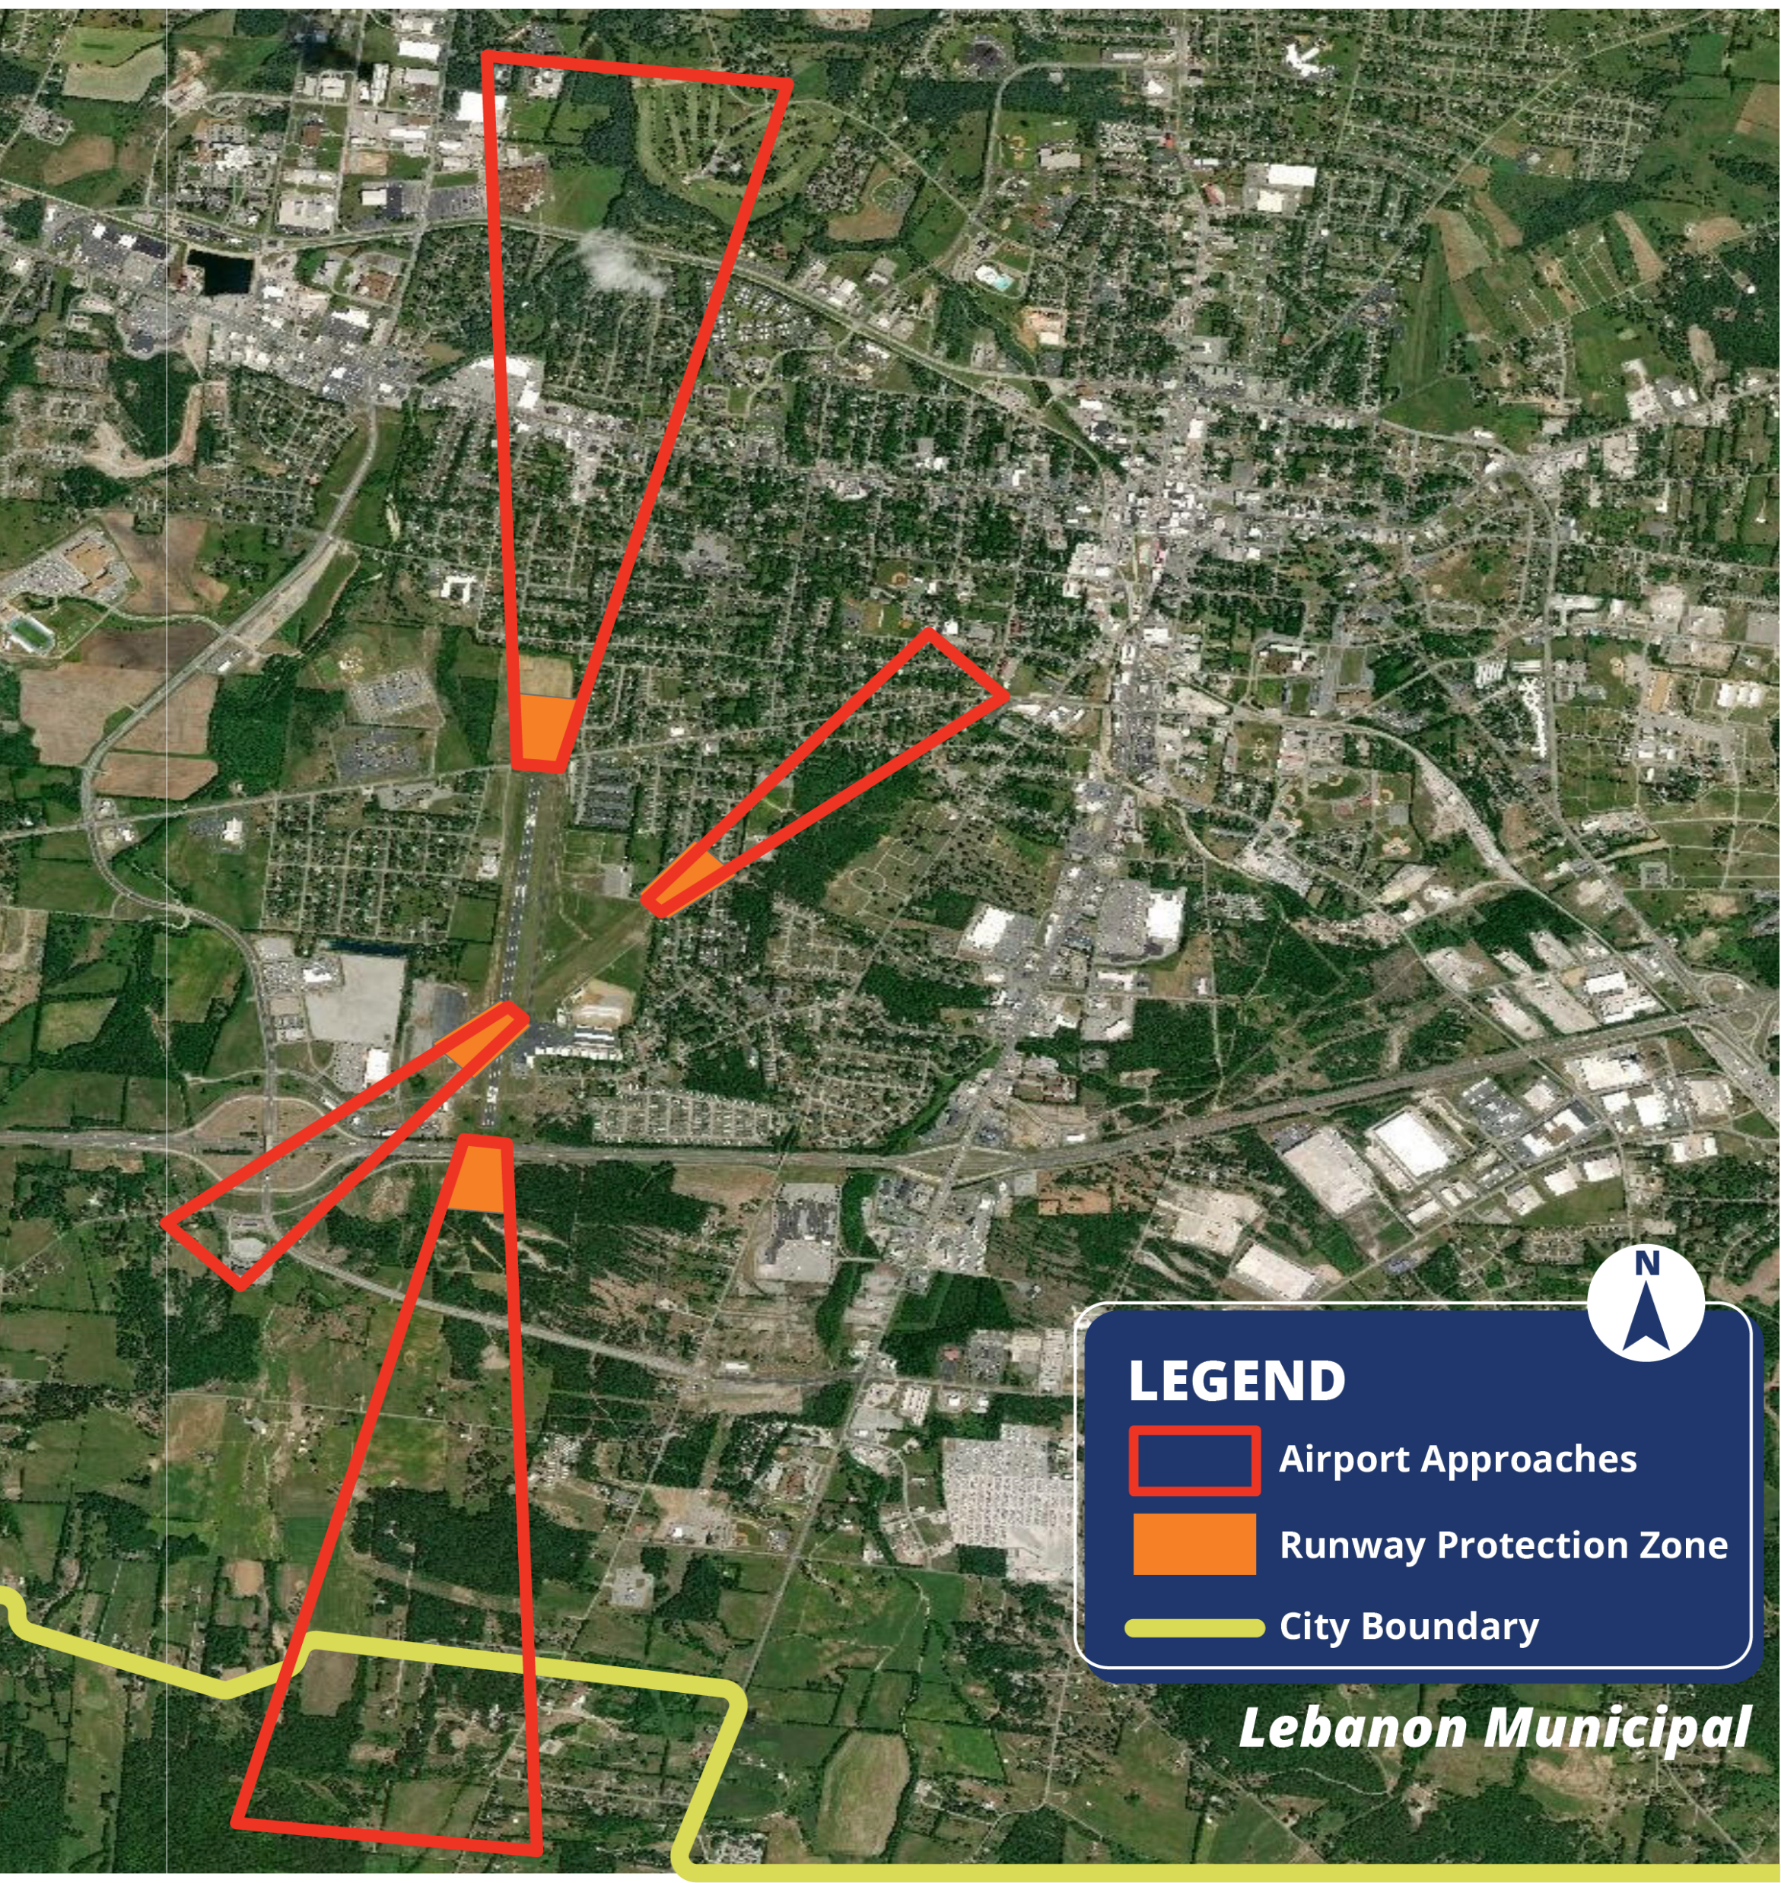
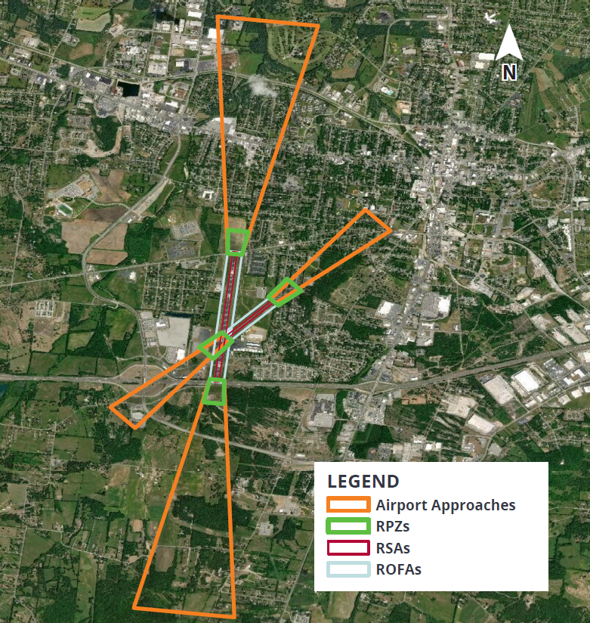

Protected Surfaces Can Extend Well Beyond the Airport Boundary
As indicated on the previous slides, an airport or a related airport hazard area can be located either partially or wholly outside the corporate limits of the municipality
The airport shown here is Lebanon Municipal Airport, in Lebanon, TN (Wilson County). The airport’s southern approach surface (off runway end 01) extends beyond the municipal boundaries of the City
Your municipality may not have an airport—but you may still be required to adopt airport zoning regulations!

Slide 7

Putting it All Together
Title 42, Chapter 6, TCA details the requirement to adopt airport zoning regulations
Municipalities without an airport may still be required to adopt airport zoning regulations
Airport zoning regulations specify permitted land uses and restrict height of objects

Slide 8
02
Applicability of Requirements to Local Governments

Slide 9
Requirement to Adopt
Airport Zoning Regulations
Local governments (political subdivisions) must adopt airport zoning regulations if they have an airport or airport hazard area
“Airport hazard area” = any area of land or water upon which an airport hazard might be established if not prevented
“Airport hazard” = any structure or tree or use of land that obstructs the airspace required for the flight of aircraft in landing or taking off at an airport or is otherwise hazardous to such landing or taking off of aircraft

Slide 10
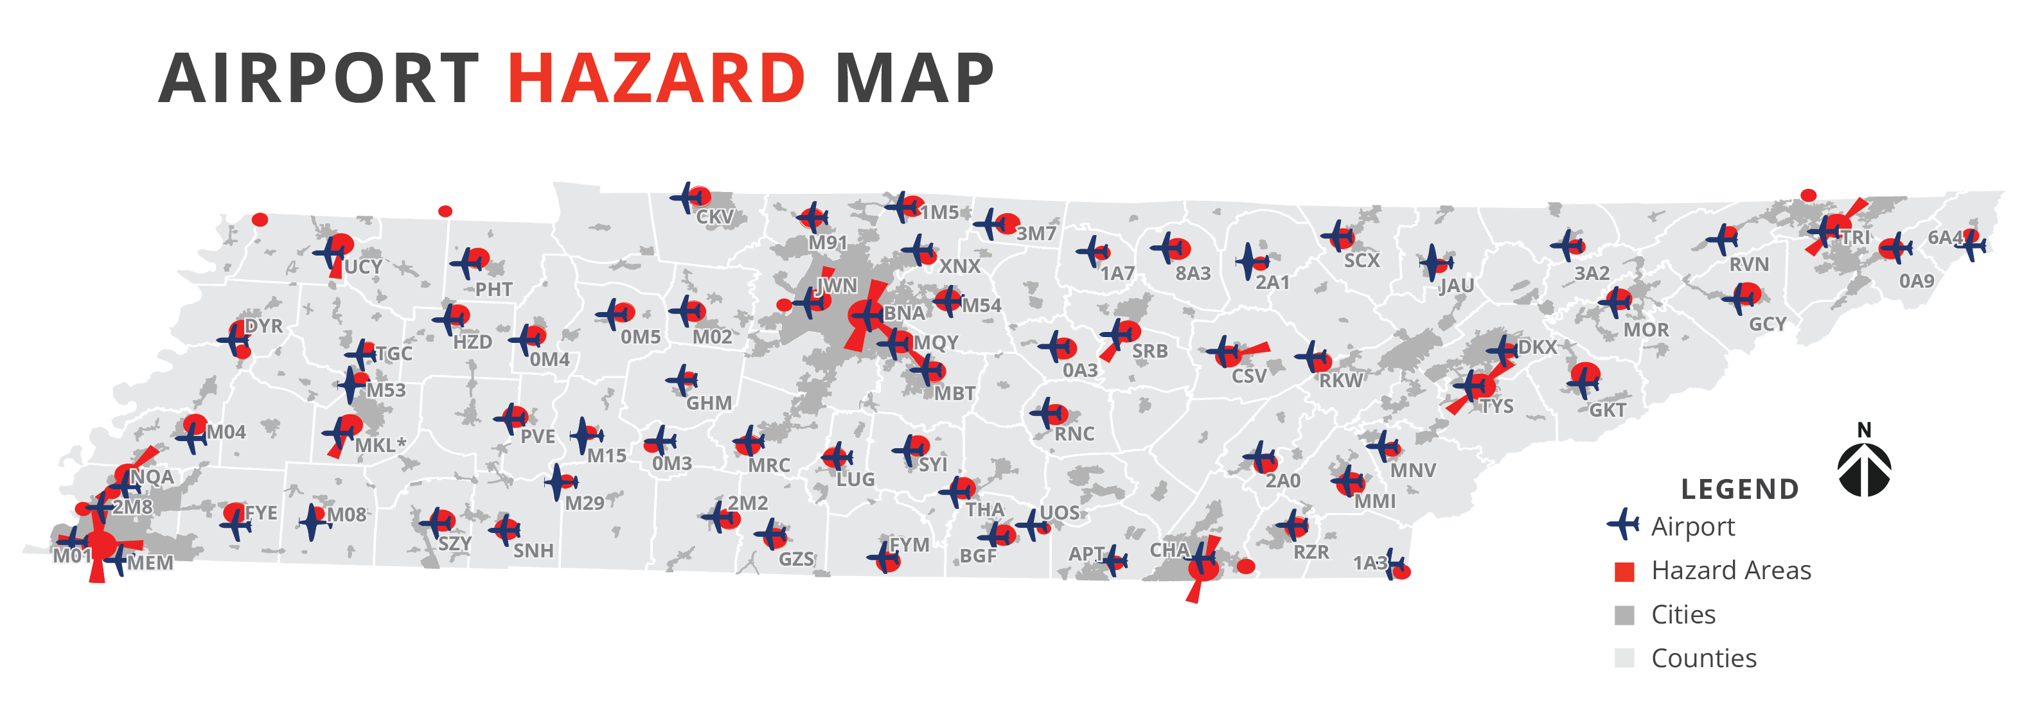
Determination of Required Municipalities and Counties
A recent TDOT Aeronautics Division analysis found that 166 municipalities and counties are required to adopt airport zoning regulations!

Slide 11
Requirement to Adopt
Airport Zoning Regulations
Adopt and enforce airport zoning regulations for the airport hazard area, in coordination with the neighboring jurisdiction if necessary
Airport zoning regulations are adopted alongside existing land use regulations
Consider your local airport/airport hazard area when determining what regulations to adopt
Existing uses and structures will be grandfathered in if you do not currently have airport zoning regulations

Slide 12
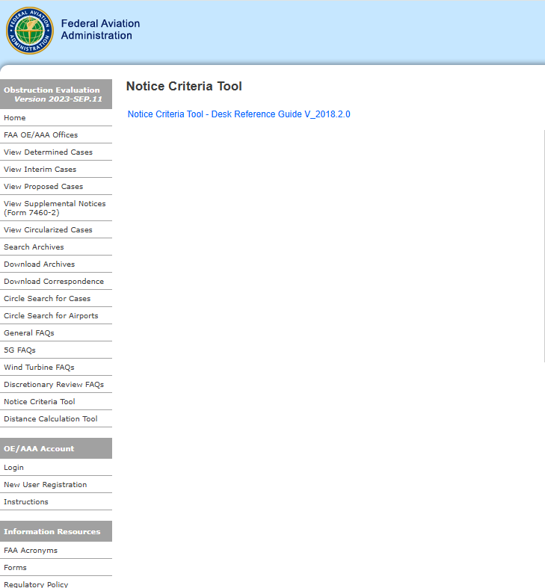
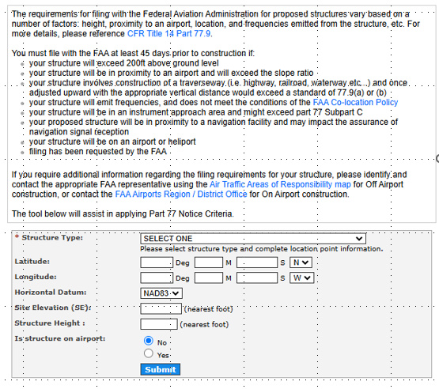
Determining If a Structure or Tree Exceeds Height
Restriction
Airport zoning regulations should restrict the height of objects and trees.
To determine if height is exceeded, developers are encouraged to use the Notice Criteria Tool (NCT).
Accessed through the Obstruction Evaluation/Airport Airspace Analysis (OE/AAA) website
Users (developers) will input information to determine if their development requires notice to the FAA (exceeds height)
If the development does require notice, developers must submit FAA Form 7460-1

Slide 13
03
Status of Statutory Compliance and Next Steps

Slide 14
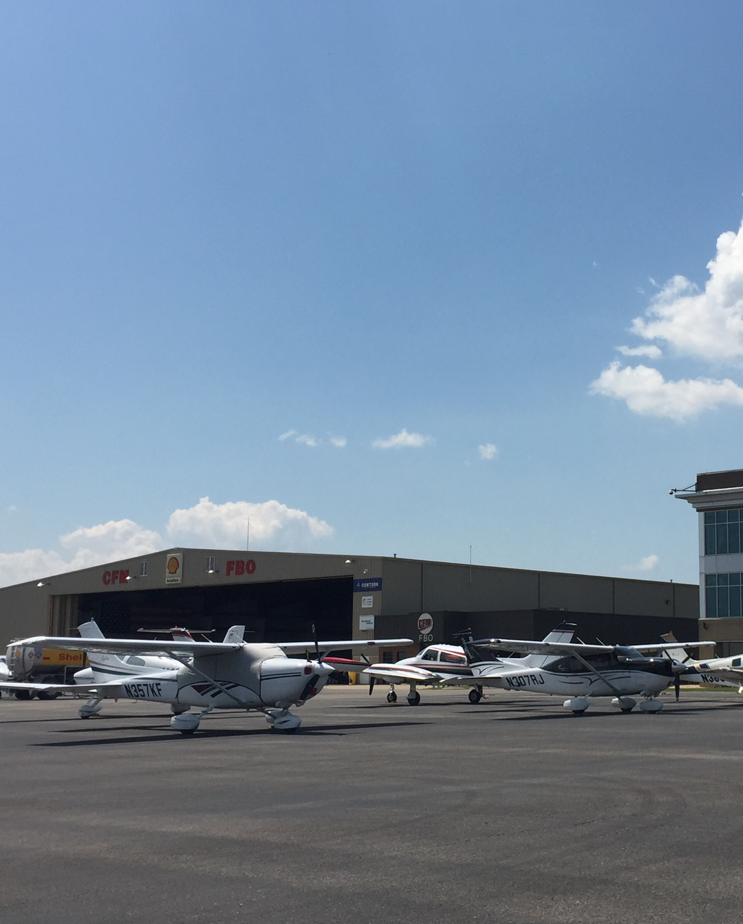
Sufficiency Review Requirements
Airport hazard areas can extend across jurisdictional boundaries, including into a jurisdiction without an airport on its own
Airport zoning regulations are required for every municipality or county with an airport hazard area, including those without airports
To determine which municipalities and counties are required to adopt airport zoning regulations, TDOT Aeronautics Division analyzed which were within airport hazard areas.
This resulted in 166 municipalities and counties

Slide 15

Sufficiency Review Requirements
Only 44 of the 166 municipalities and counties had airport zoning regulations, as required. These 44 municipalities and counties encompassed 39 of the State’s 76 public-use airports
State statute requires four specific items be included in airport zoning regulations:
  Addressing airport hazard areas
  Dividing the area(s) into zones
  Specifying land uses within zones
  Specifying height restrictions within zones
Airport zoning regulations must meet all four criteria to be deemed sufficient; anything less than it is insufficient

Slide 16

Sufficiency Review Findings
municipalities and counties that are required to maintain airport zoning regulations
166
municipalities and counties that have adopted airport zoning regulations accessible online
44

Slide 17

Sufficiency Review Findings
Of these 44…
40
specify permitted heights
37
identify an airport hazard area in their regulation

Slide 18

Sufficiency Review Findings
Of these 37…
36
further divide the airport hazard area into zones

Slide 19
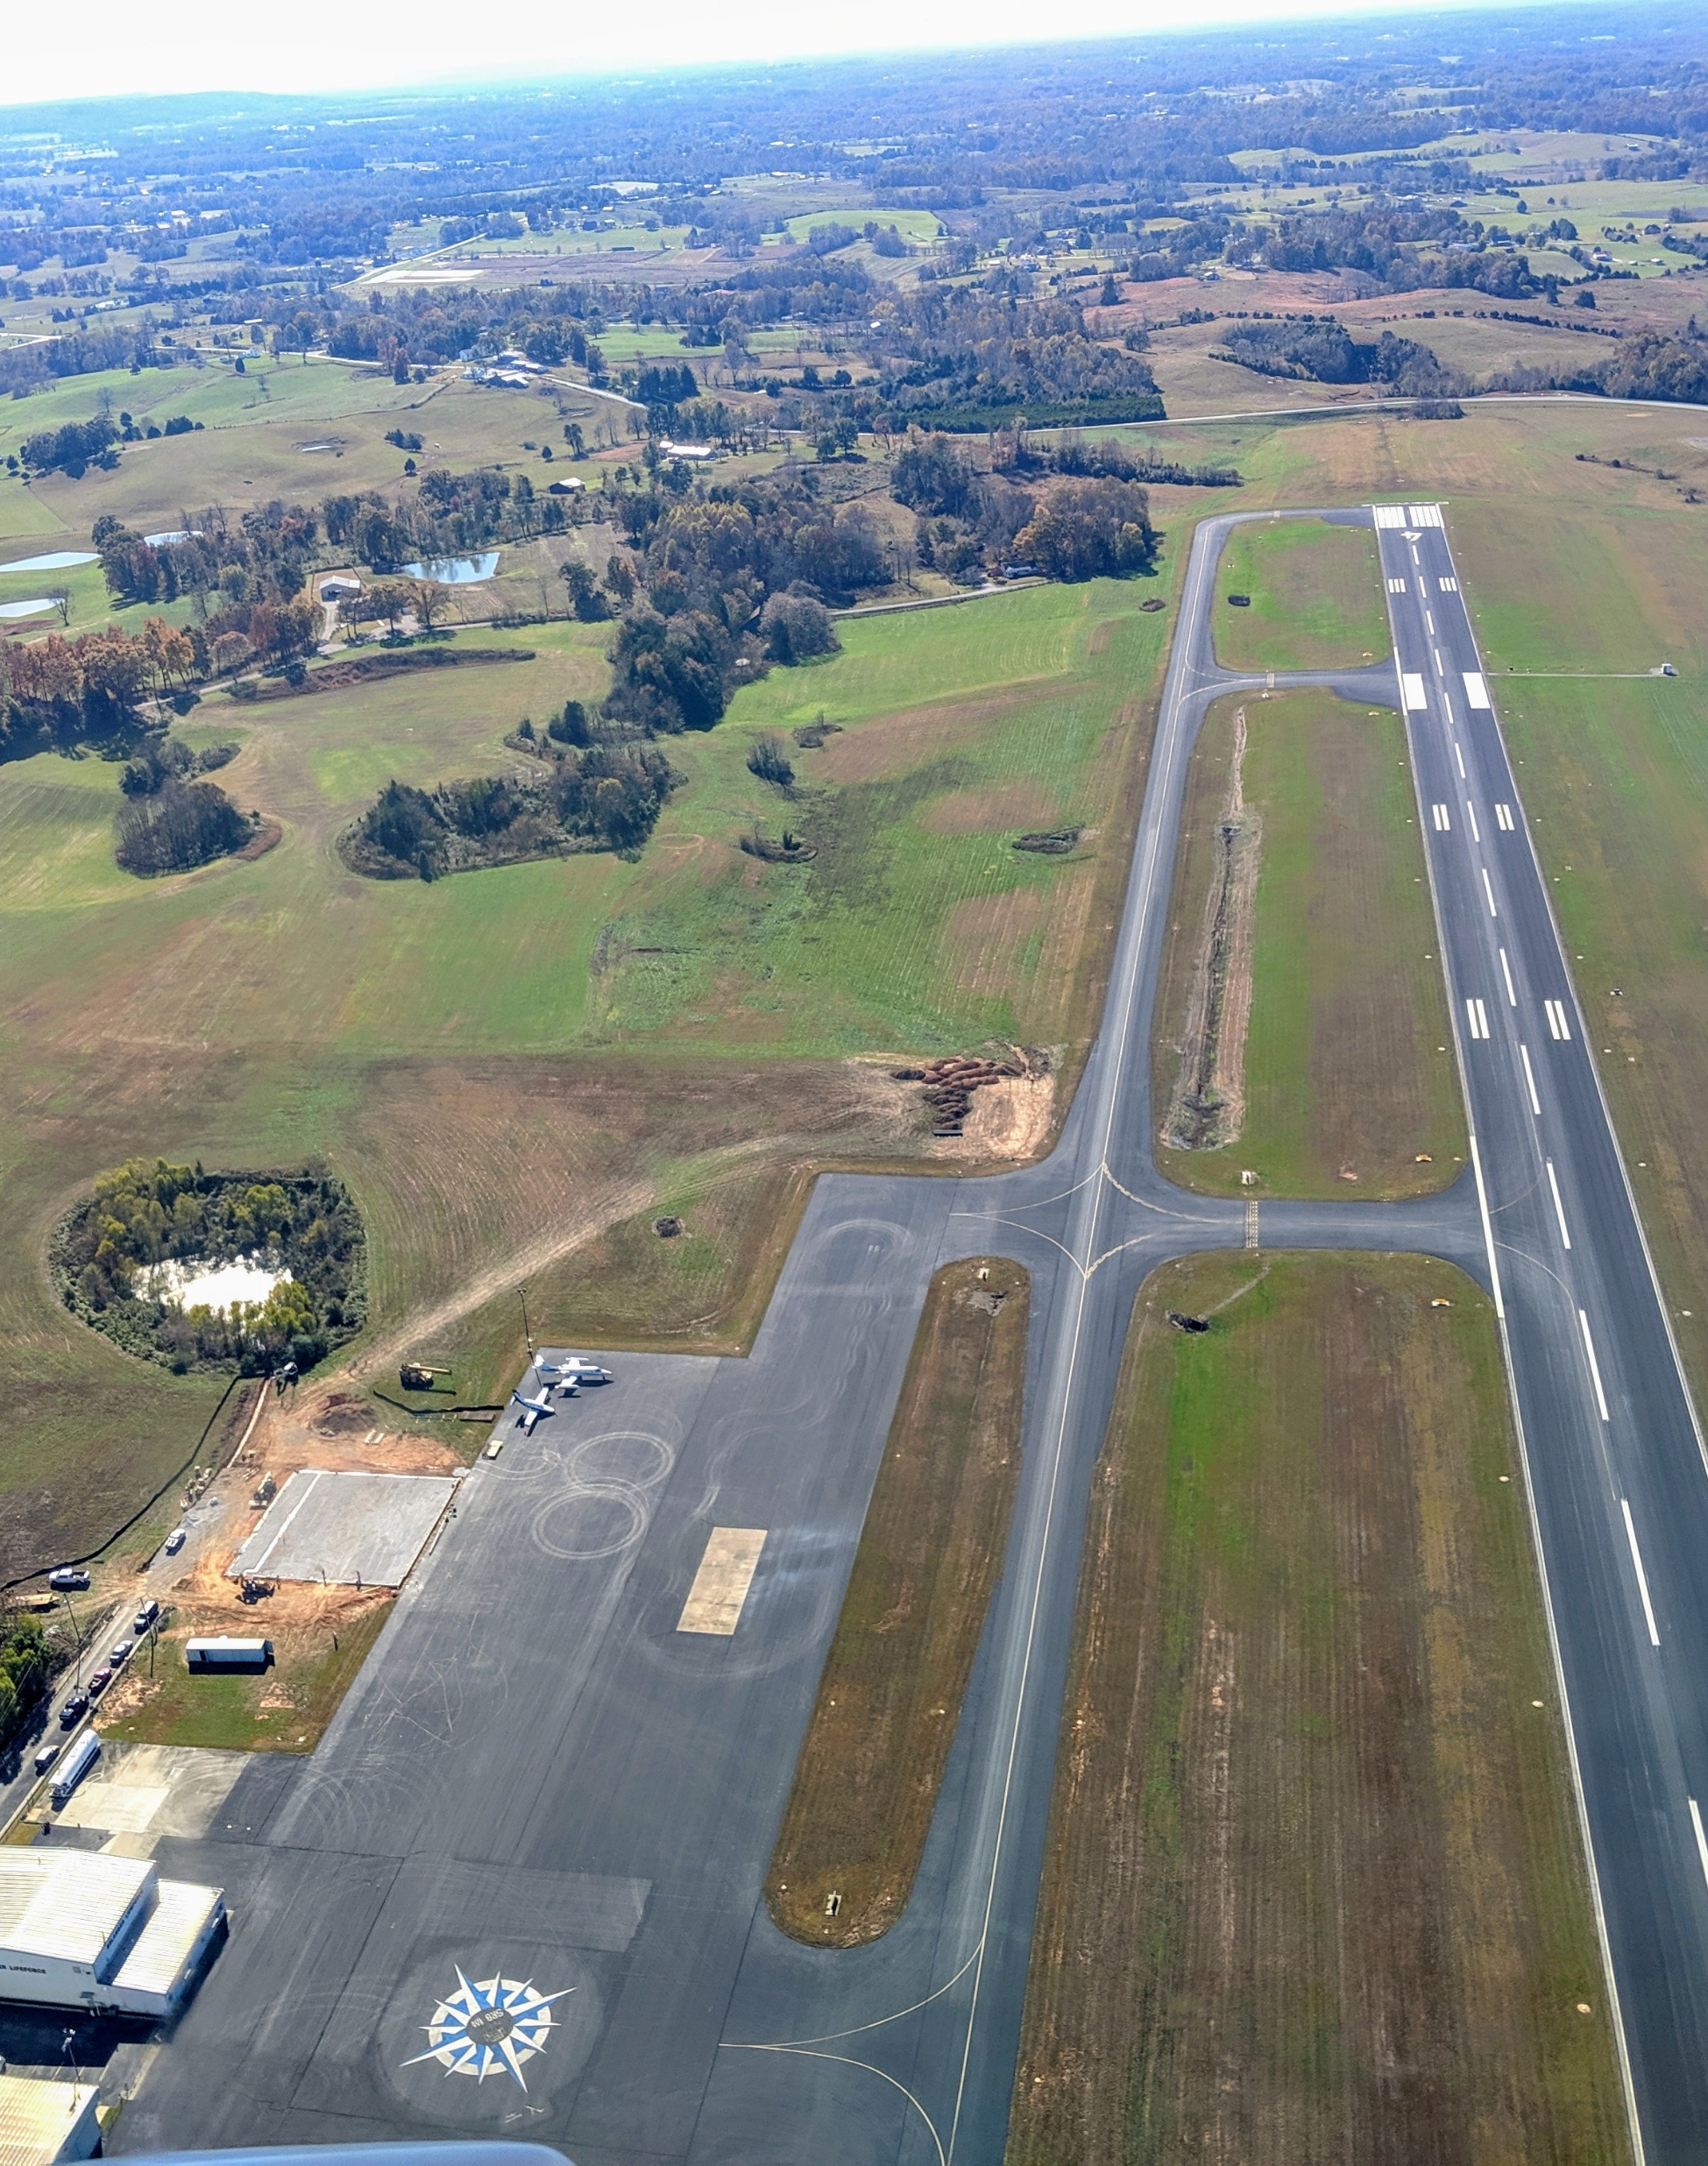
Sufficiency Review Findings
Of these 36…
specify the types of land uses that are permitted or prohibited within each zone
34
Only 30 airport zoning regulations do all four: identify an airport hazard area, divide the airport hazard area into zones, specify permitted heights, and specify the land uses permitted or prohibited within each zone.

Slide 20

Next Steps
TDOT Aeronautics Division is currently working on an Airport Land Use Compatibility Guidebook, which will include:
  Checklist for adopting airport zoning regulations
  Model ordinances
  Information about interlocal agreements and joint zoning boards
TDOT Aeronautics Division is available as a resource. Please contact me [Cavan McGee at cavan.mcgee@tn.gov]
  Review airport zoning regulations
  Answer questions
  Provide additional resources

Slide 21

Current Resources
Tennessee Code Annotated Title 42, Chapter 6
  Statutory requirement to adopt airport zoning regulations. Provides the necessary components to be included
Airport Land Use Compatibility Guidebook
  Provides guidance on adopting airport zoning regulations
  Anticipated in early 2026
AC 150/5190-4B Airport Land Use Compatibility Planning
  Provide guidance on the impact of land use on airport safety and operations, and provides tools, resources, and techniques for compatible land use development to protect nearby communities from related adverse effects.

Slide 22
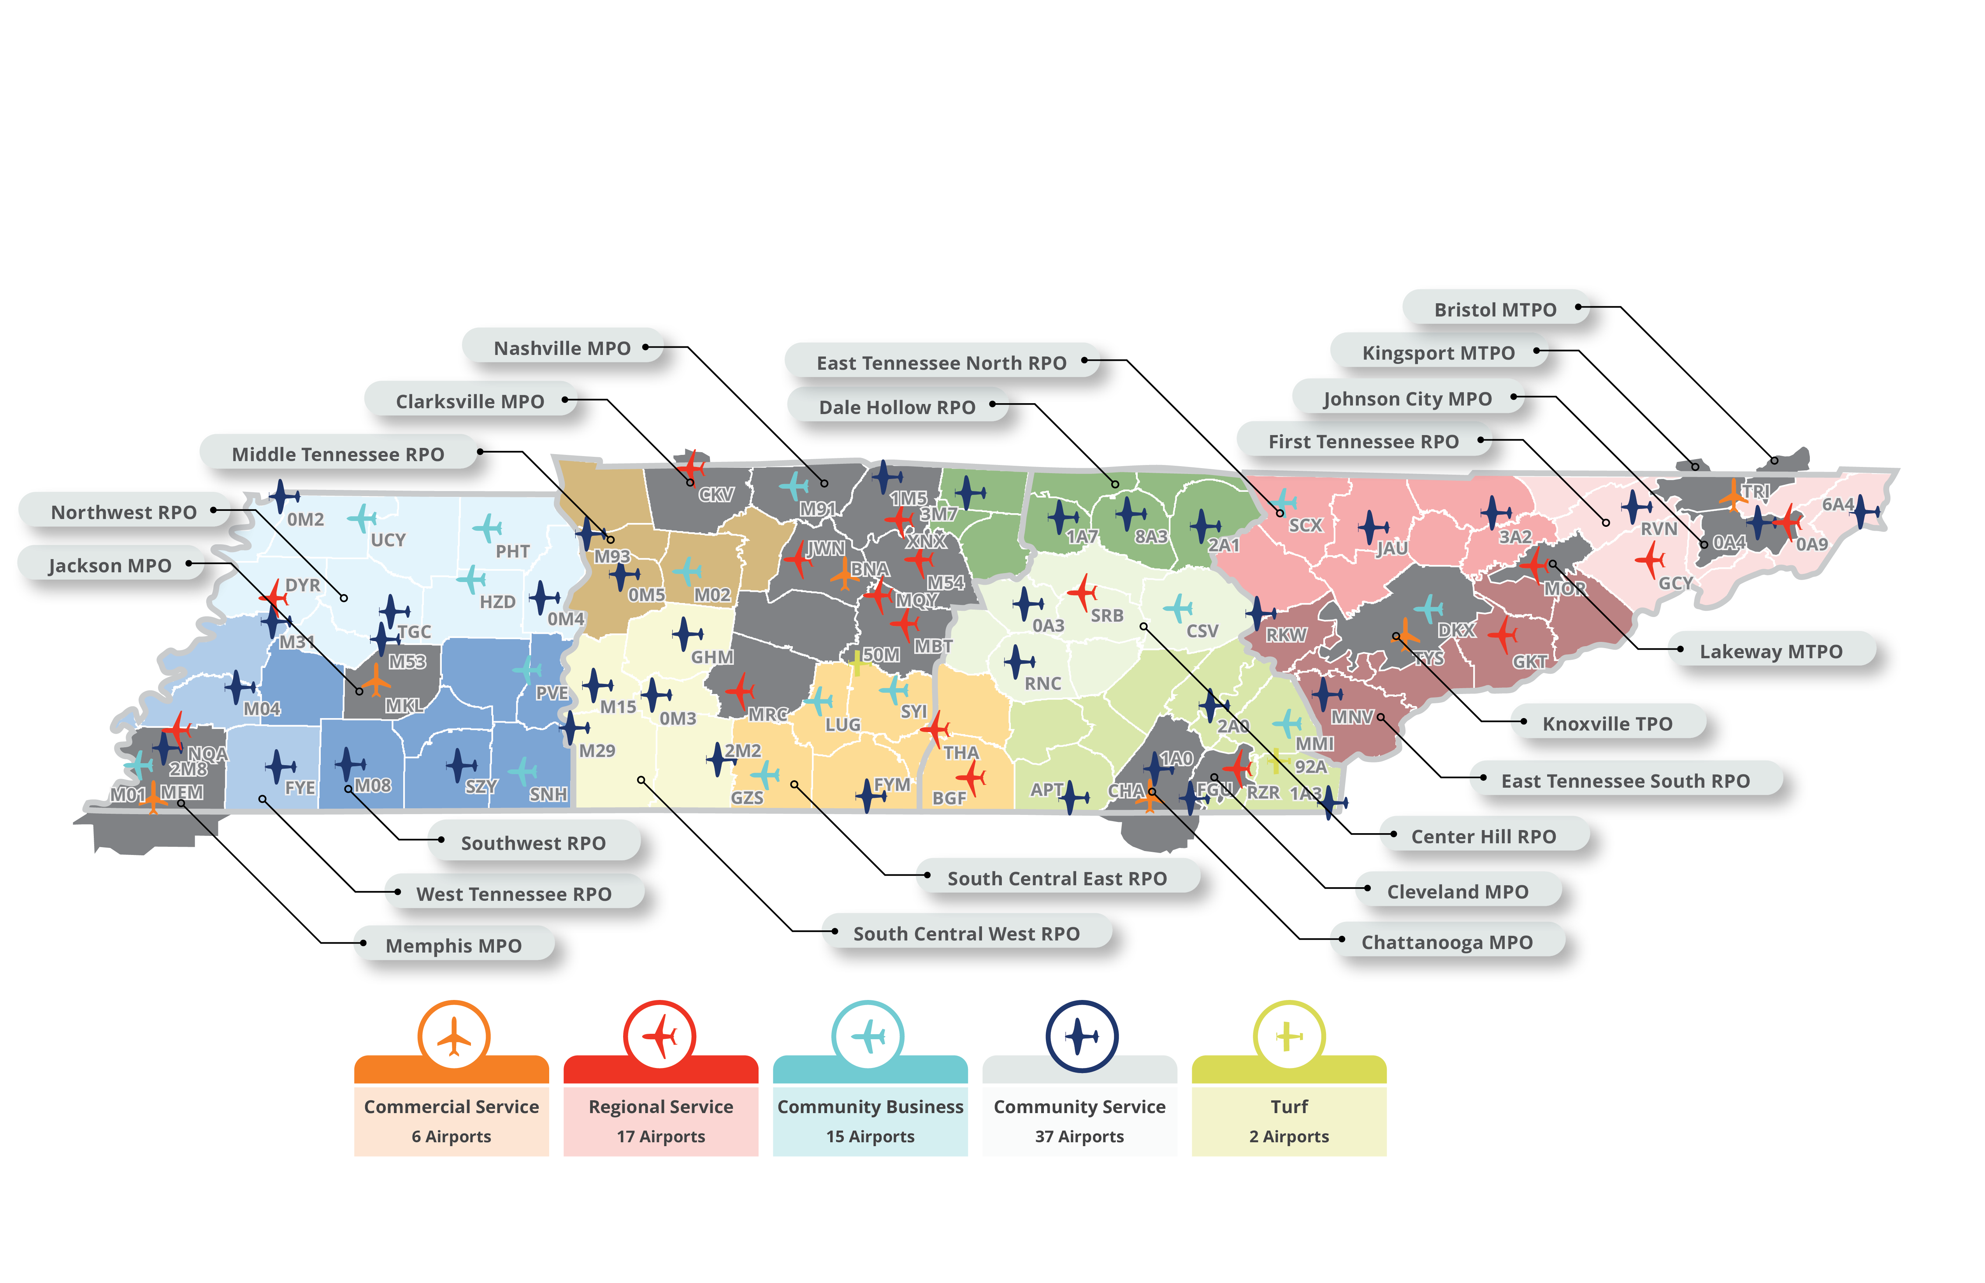
Questions & Discussion
Cavan McGee, Senior Technical Specialist
Cavan.McGee@tn.gov
C: 629-900-5808

Slide 23
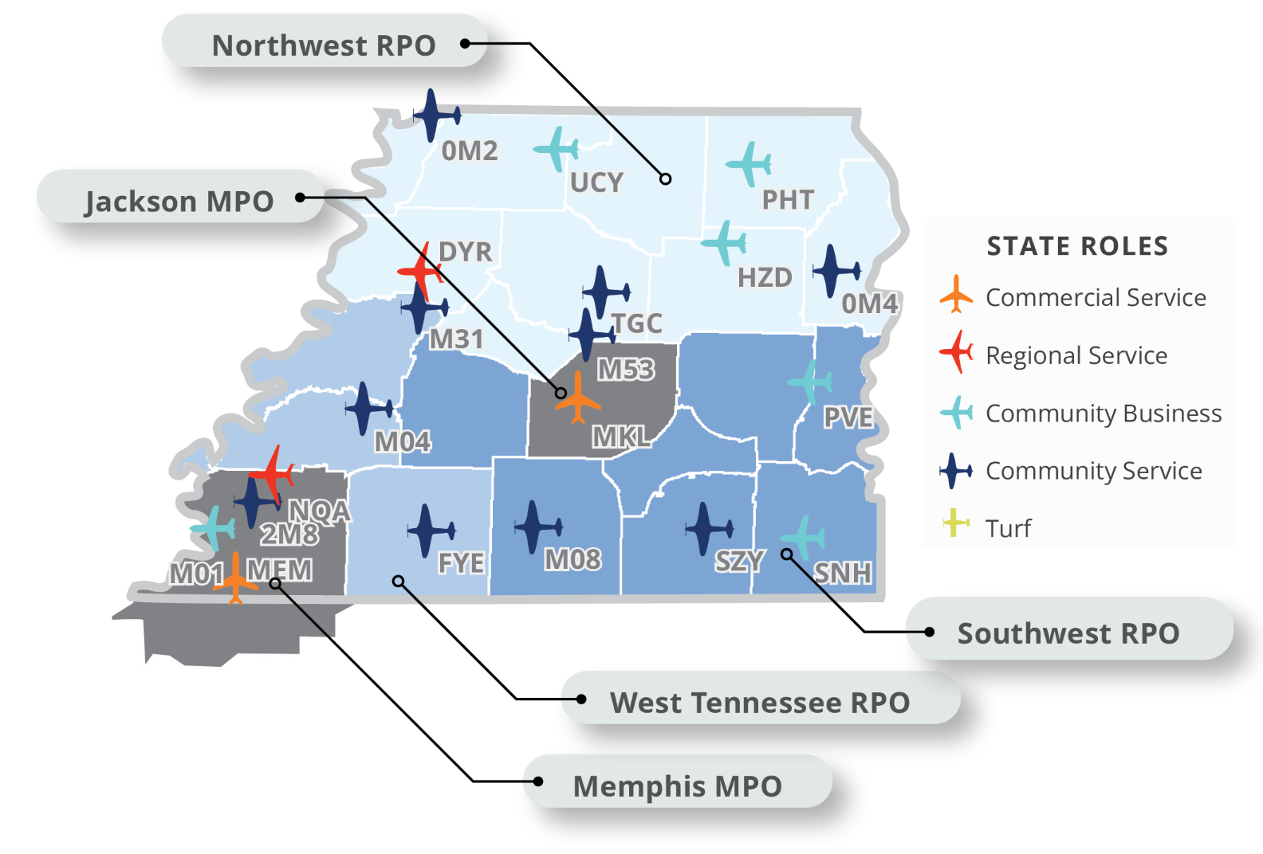
Your Local Airports

Slide 24
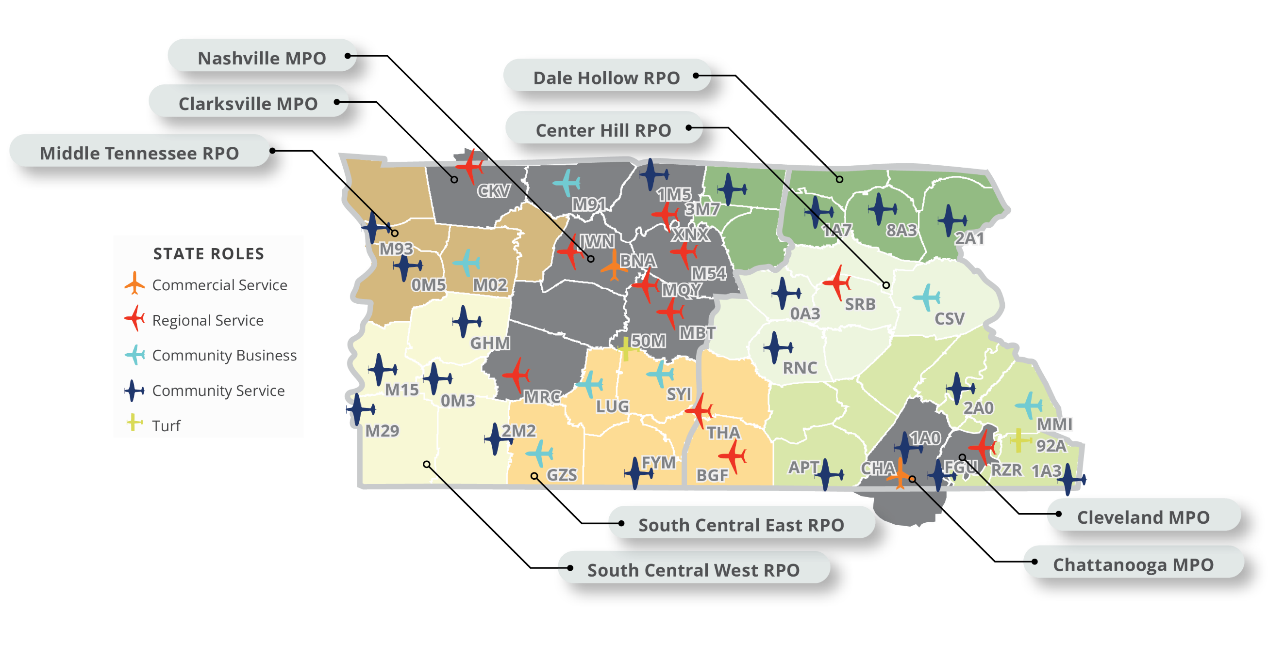
Your Local Airports

Slide 25
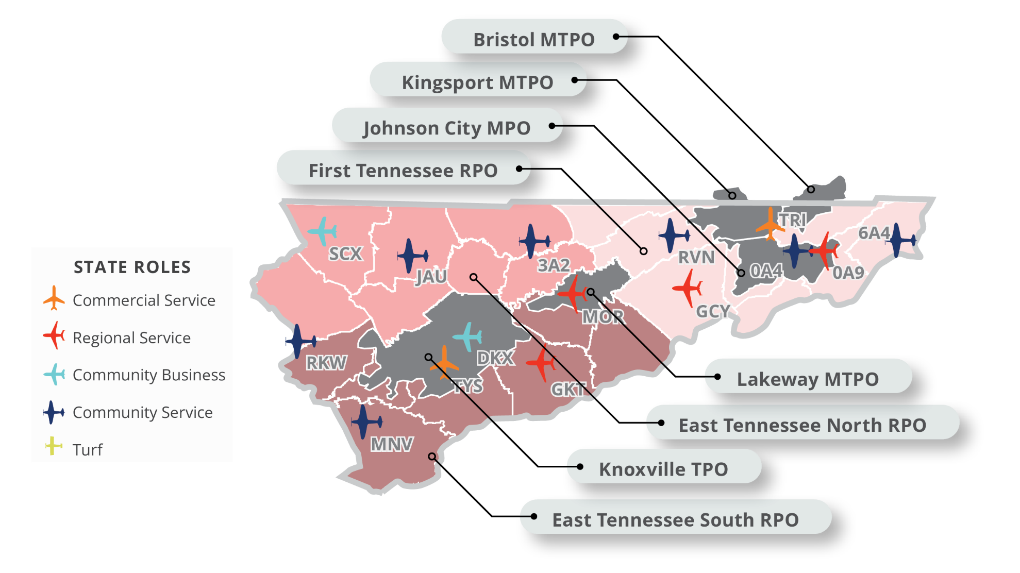
Your Local Airports

