Slide 1

TDOT Updates
Office of Community Transportation

Slide 2
Rural Consultation Process Transportation Planning Grant Updates Long Range Transportation Plan Updates
TDOT LRTP
TDOT 10-Year Plan TDOT STIP

Slide 3
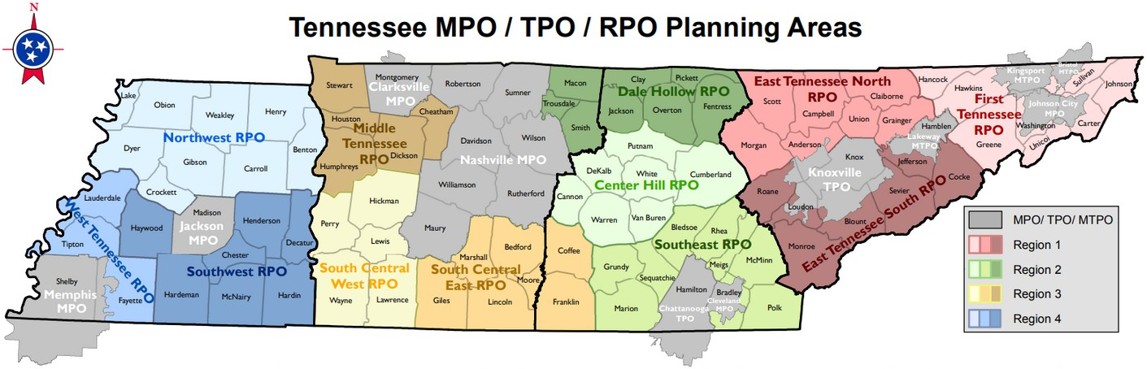
TDOT Rural Consultation Process
TDOT is federally required to provide for non-metropolitan local official participation in the development of the statewide Long Range Transportation Plan and State Transportation Improvement Program
This process is designed to ensure consultation with non-metropolitan local officials in the state’s transportation planning and programming decisions

Slide 4
TDOT Rural Consultation Process
Every 5 years, TDOT must review the Rural Consultation Process and solicit comments from non-metropolitan local officials and other interested parties regarding the effectiveness of the cooperative process and any proposed changes for a period of at least 60 days
TDOT’s Rural Consultation Process was reviewed in 2021 and will be due to FHWA in June of 2026
We will be issuing a survey to collect your feedback in early 2026 and will present results at Spring RPO meetings

Slide 5
TDOT Transportation Planning Grant Updates
We received 63 applications statewide
Rural vs. Metropolitan
Plan Type
Both 7.9%
TSMO Community Mobilty Plans
Bicycle & Pedestrian Master Plans Complete Streets Plans Other Corridor Studies Resurfacing Plans
We are scoring applications right now, and will make award decisions in early December
MPO 30.2%
2
5
RPO 61.9%
6
We intend to issue Notices to Proceed in January of 2026
7
9
5 of 63 applications were for counties that are bisected by MPO/RPO boundaries
16
19
TNECD County Status
Applications per TDOT Region
Distressed 11.1%
25
20
15
10
5
0
22
19
11
11
Neither 47.6%
At-Risk 41.3%
Region 1
Region 2
Region 3
Region 4

Slide 6

TDOT Long Range Transportation Plan
A statewide Long Range Transportation Plan must:
Establishes the policy framework for TDOT’s strategic decision making
Have a minimum 20-year horizon period at the time of adoption
Include both short term and long term actions
Be submitted to the Federal Highway Administration and Federal Transit Administration for approval
The LRTP is required under 29 CFR 450.216
Current TDOT 25-Year Policy Plan

Slide 7

State Transportation Improvement Program (STIP)
The STIP must:
Be developed every 3 years to provide a statewide listing of transportation projects covering a period of 4 years
Be consistent with the Statewide LRTP and MPO plans Be fiscally constrained
Include state and local roadway, bridge, bicycle, pedestrian, safety, and transit projects
Be submitted to the Federal Highway Administration and Federal Transit Administration for approval
TN STIP Project Viewer
The STIP is required under 49 USC 5304(g)

Slide 8

TDOT 10-Year Project Plan
An annual plan tied to the state budget
Fiscally constrained list of funded transportation projects for the next 10 years, evaluated annually
What gets started gets finished - we completed 100% of projects committed in FY25
The TDOT 10-Year Plan is required under state law

Slide 9
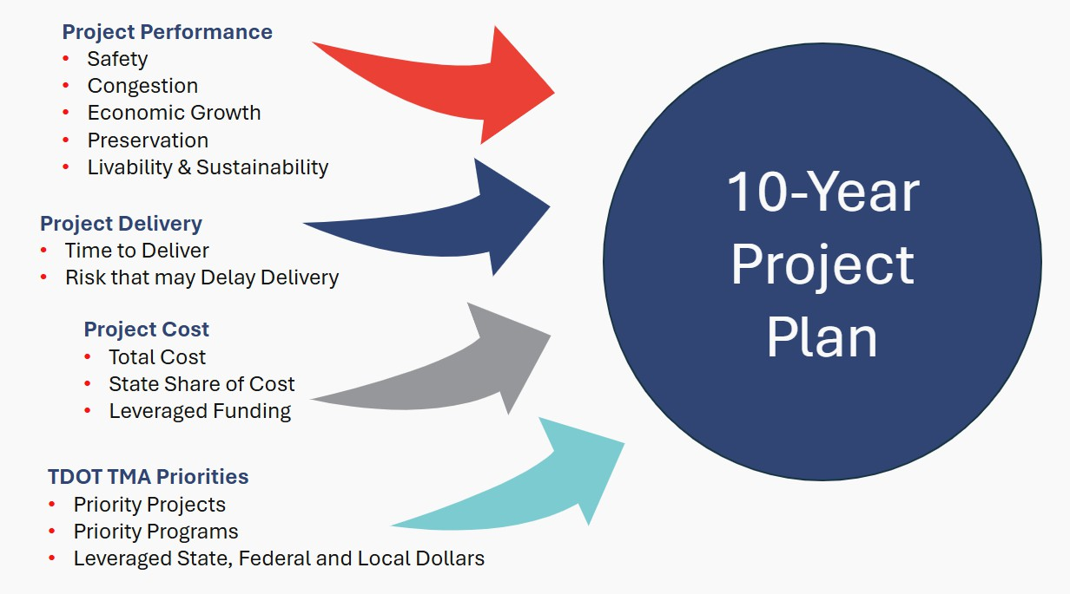
How are projects selected?

Slide 10

TDOT Statewide Partnership Program
Part of the 10-Year Project Planning Process
An avenue for stakeholders to provide input on their priorities to better inform the annual reassessment of TDOT’s 10-Year Plan.
Supports local authorities in maximizing funding dollars for critical mobility and economic development needs
Submissions gathered will be evaluated for inclusion in the updated 10-Year Plan

Slide 11

TDOT Transportation Planning Process
Planning
Statewide Long Range Transportation Plan Updated every 5 years Strategic Framework
Programming
TDOT 10-Year Plan Updated annually Statewide project list
Reflects TDOT and local priorities
P
T
T
D
R
O
L
T
T
S
O
T
Where do we want to go?
Goals | Objectives | Measures
D
Statewide Transportation Improvement Program Updated every 3 years Federally funded or regionally significant projects
Includes MPO TIPs
I
T
P
How are we going to get there?
Implementation Strategies Policies | Priorities Functional Plans
MPO LRTPs
T
n
D
a
O
l
T
P
r
1
a
0
e
-
Y

Slide 12
TDOT 3-Year Programs
TDOT 10-Year Plan
TDOT STIP
TDOT Statewide 3-Year Programs
Bridge
Resurfacing
Safety
Unstable Slope
Economic Development

Slide 13
Document Statuses
TDOT LRTP
TDOT 10-Year Plan
TDOT STIP
We are currently operating under 25-Year Long Range Transportation Policy plan, updated in 2021
We are currently operating under the 2025 10-Year Plan
We are currently operating under the 2023-2026 STIP
The 2026 will be released in
Spring 2026
The 2026-2029 STIP is under development and will go for approval in early 2026
The 2055 Policy Plan is under development now, with a larger update planned for 2026.

Slide 14


RPO Updates
November 2025

Slide 15

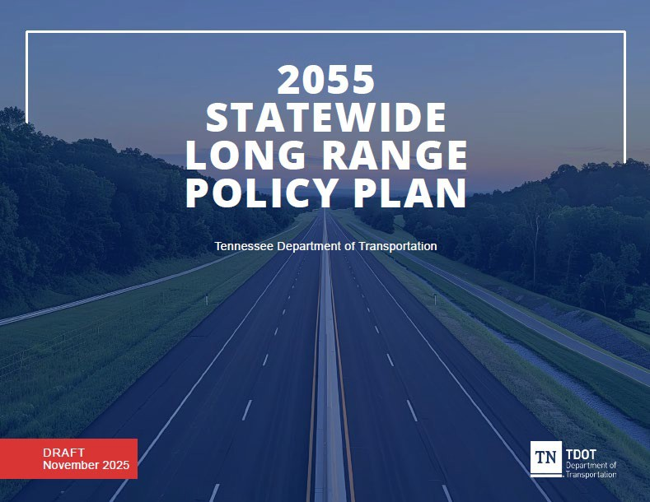


2055 Policy Plan Updates
Development District and RPO 1-on-1s completed
Conducted meetings with MPOs and various internal TDOT Divisions
Policy Plan to go out for public comment this month
Notes:
Presenter
2025-11-10 22:42:44
--------------------------------------------
Thank you for the time you took out to talk to us as part of the policy plan update. Updates
All Development District, RPO, and MPO 1-on-1 meetings have been completed The updated policy plan will go out for public comment this month

Slide 16
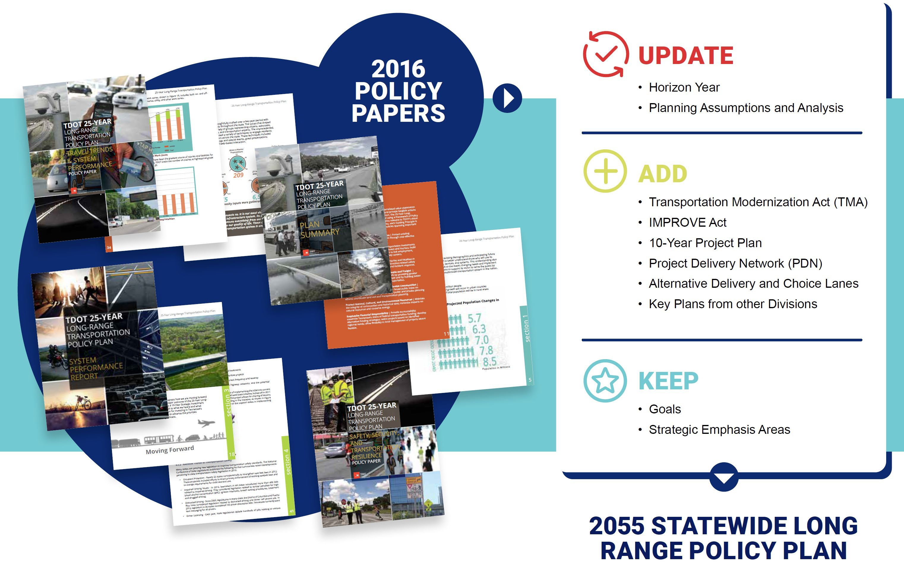
Update Process
Horizon Year
Planning Assumptions and Analysis
Transportation Modernization Act (TMA)
IMPROVE Act
10-Year Project Plan
Project Delivery Network (PDN)
Alternative Delivery
Key Plans from Other Divisions
Goals
Strategic Emphasis Areas
Notes:
Presenter
2025-11-10 22:42:45
--------------------------------------------
Reminder from the discussions we had with each RPO
This policy plan reflects a modest update, with a more robust update to be kicked off in 2026.
Goals (previously called Guiding Principles), and Emphasis Areas remain the same from the 2016 plan
Includes greater focus on program and project delivery, and reflects the 10-Year Project Plan and Build with Us.

Slide 17
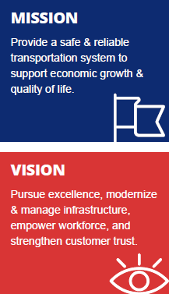
2055 Policy Plan Goals
GOAL 1
GOAL 2
GOAL 3
PRESERVE AND MANAGE THE EXISTING SYSTEM
Protect existing assets and maintain efficiency of the system through cost-effective management and new technologies.
SUPPORT THE STATE’S ECONOMY
Make transportation investments that support economic growth, competitiveness and tourism; build partnerships with communities and regions to link employment, commercial/retail areas, and other key activity centers.
MAXIMIZE SAFETY AND SECURITY
Reduce injuries and fatalities in all modes of transportation; minimize construction-related safety incidents; improve disaster preparedness and incident response.
GOAL 4
GOAL 5
GOAL 6
PROVIDE FOR THE EFFICIENT MOVEMENT OF PEOPLE AND FREIGHT
Optimize the movement of people and goods by providing greater access to transportation services for all people and by building better connections among different modes of transportation.
BUILD PARTNERSHIPS FOR SUSTAINABLE AND LIVABLE COMMUNITIES
Provide early and ongoing opportunities for broad public input on plans and programs; work closely with local public and private planning efforts; coordinate land use and transportation planning.
PROTECT NATURAL, CULTURAL, AND ENVIRONMENTAL RESOURCES
Maintain the integrity of communities and historical sites; minimize impacts on natural resources and conserve energy.
GOAL 7
EMPHASIZE FINANCIAL RESPONSIBILITY
Provide accountability; maximize Tennessee’s share of federal transportation funding; develop alternative funding strategies; select projects based on identified regional needs; allow flexibility in local management of projects where feasible.
Notes:
Presenter
2025-11-10 22:42:46
--------------------------------------------
2055 Plan Goals align with TDOT’s Strategic Directions

Slide 18
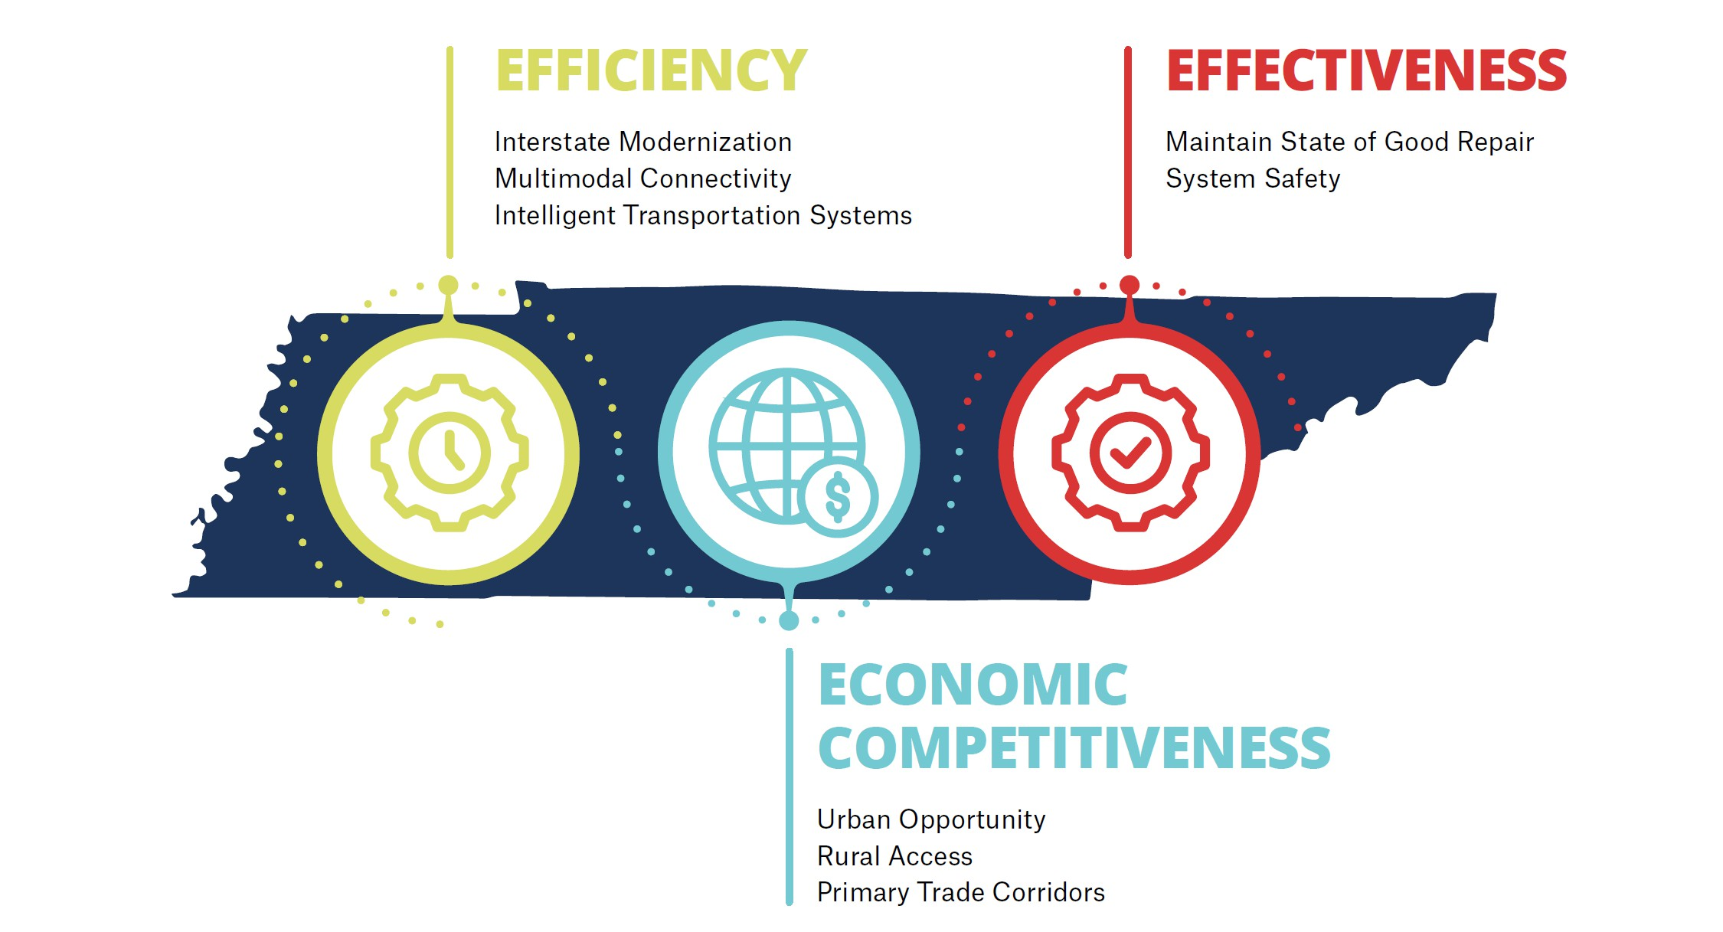
2055 Policy Plan Strategic Emphasis Areas
Interstate Modernization Multimodal Connectivity
Intelligent Transportation Systems
Maintain State of Good Repair System Safety
Urban Opportunity Rural Access
Primary Trade Corridors
Notes:
Presenter
2025-11-10 22:42:46
--------------------------------------------
Emphasis Areas focus on modernization, efficiency in project delivery, SOGR, safety, and economic competitiveness

Slide 19
Next Steps
Larger update planned for 2026
  Technical analyses
  Robust public engagement – We’ll need your help!

Slide 20
THANK YOU!
Jaret Shaffer
jaret.shaffer@tn.gov
Mary Connelly
mary.connelly@greshamsmith.com

Slide 21
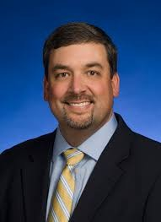
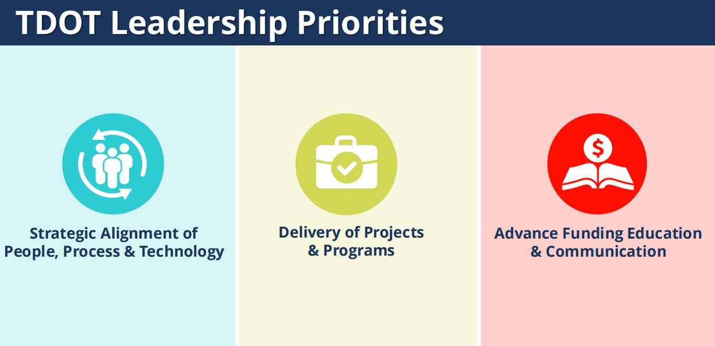
New TDOT Commissioner: Will Reid
Appointed to Commissioner role in July
Previously served as TDOT’s Chief Engineer and Deputy Commissioner since 2022

Slide 22
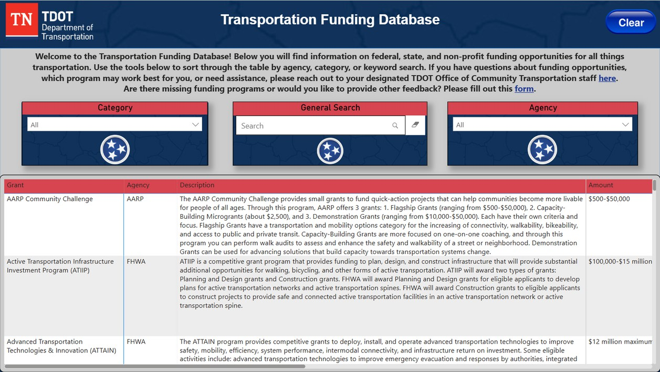
Transportation Funding Database
Currently details 55 transportation-related funding programs from the Federal and State level, as well as non-governmental organizations
A living resource that is updated as new funding information is available
Contains a brief description, funding amount, local match amount, eligible applicants, and website for each program, as well as category tags for easy searching

Slide 23
Transportation Funding Database
TDOT 3 Year Programs
TDOT 10-Year Plan
Questions?

